Slide 1
Introduction to the Kingdom animalia
pp. 554-560

Slide 2
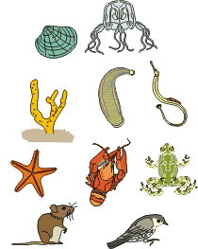
General Characteristics
Multicellular
Heterotrophic
Eukaryotic
Lack cell walls

Slide 3
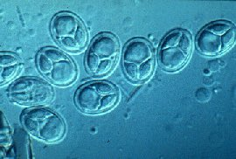
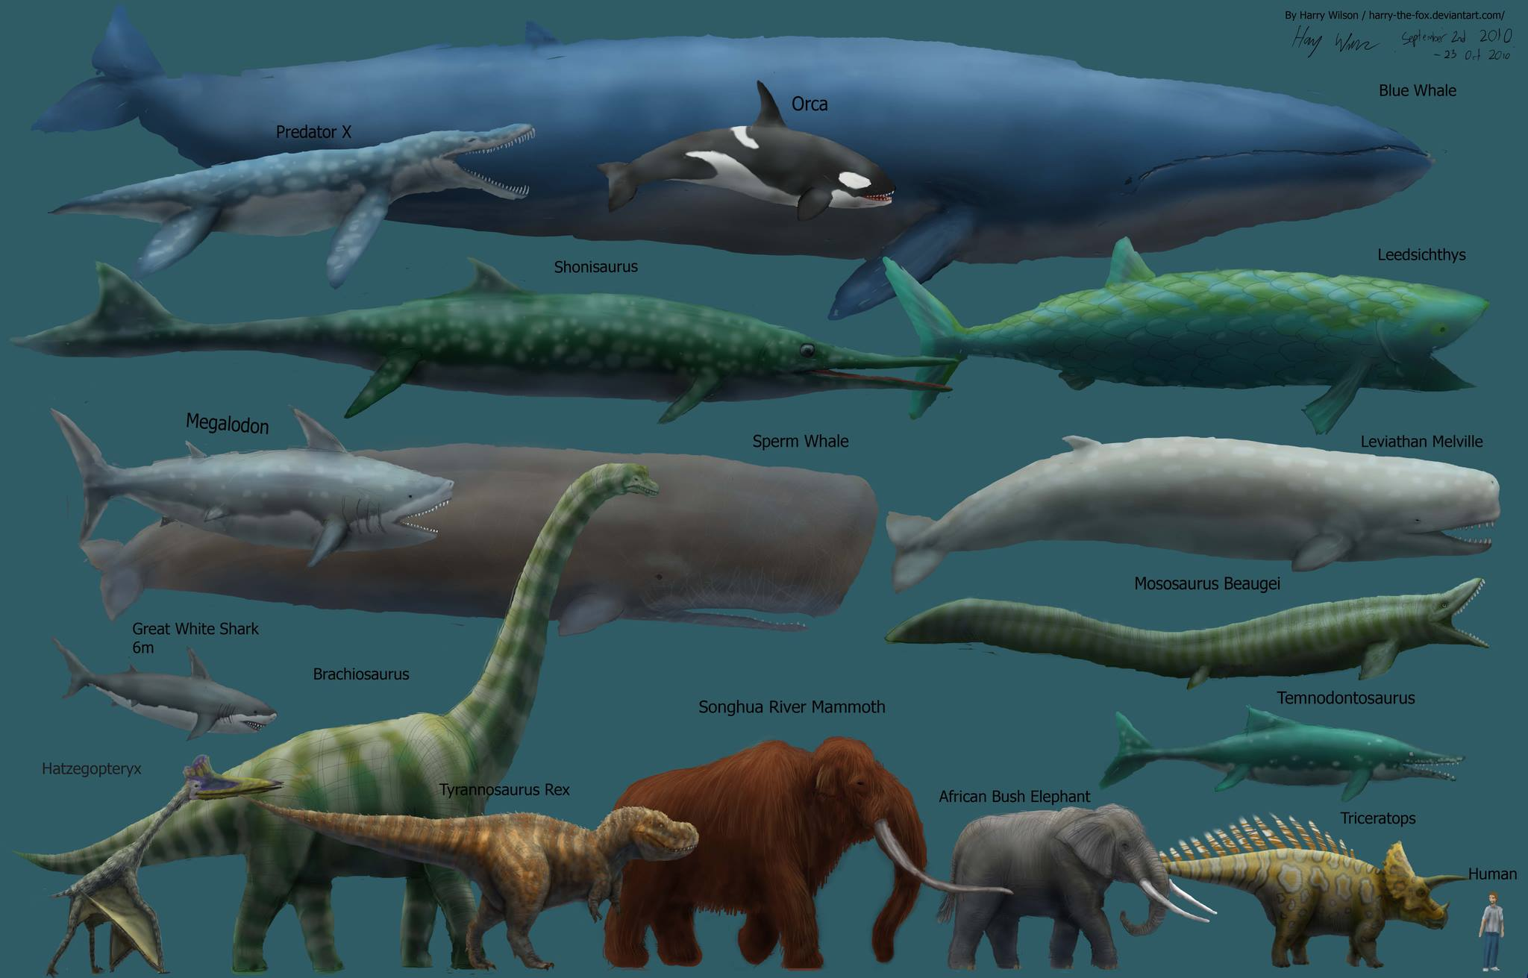
Evolutionary trends
Animal size: small → large
Myxobolus shekel is no more than 8.5 µm
Blue Whale – up to 33.6 m (110 ft)

Slide 4
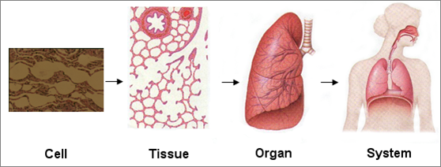
Level of Organization:
cells → tissues → organs → organ systems
Specialization = does a better job (protection, support, etc.)

Slide 5
Body plan:
all organisms are generally a hollow tube
One opening → two openings (mouth & anus)
2 layered tube (2 germ layers) → 3 layered tube (3 germ layers)
Diploblast
Triploblast
Ectoderm
Digestive cavity
Endoderm
“Jelly” – NO cells
Mesoderm

Slide 6
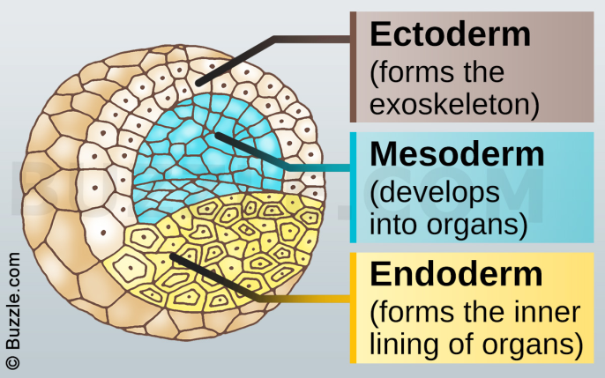
Ectoderm – protection & sensing
Endoderm – digestion
Mesoderm – muscles, circulation, glands, other tissues

Slide 8
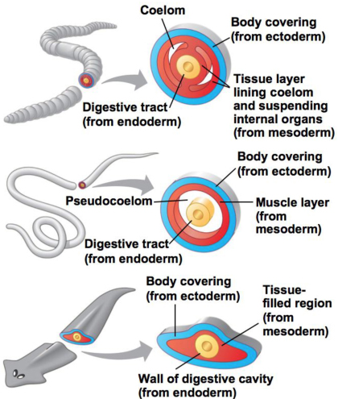
Body cavities:
Acoelomate → pseudocoelom → coelom
Acoelomate = NO coelom
Pseudocoelom = have a body cavity but it does not develop from mesoderm
Coelom = body cavity lined with mesoderm

Slide 9
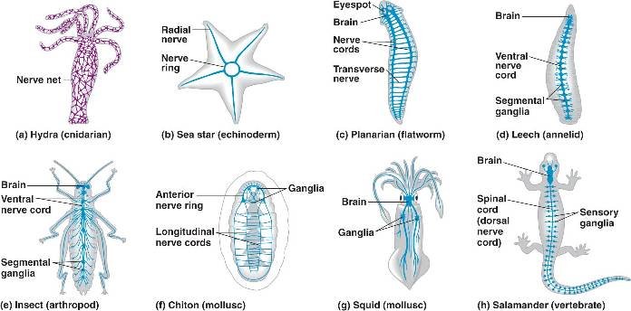
Cephalization:
No nervous system → well-developed nervous system with a brain

Slide 10
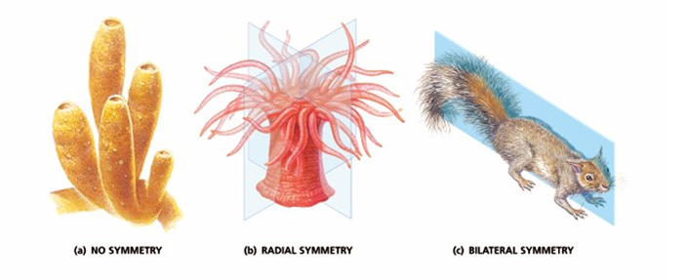
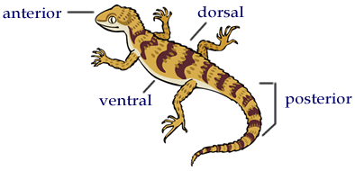
Body shape: asymmetrical → radial → bilateral

Slide 11
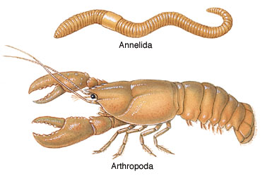
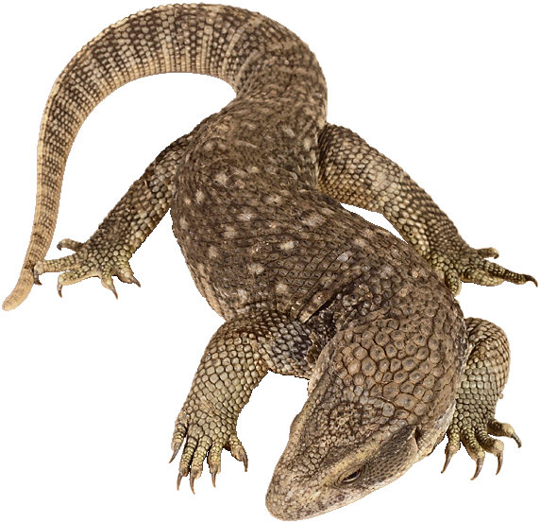
Segmentation:
no segmentation → segmentation
Allows specialization of certain segments
Ex) specialized limbs (claws, antennae, etc.)

