Slide 1
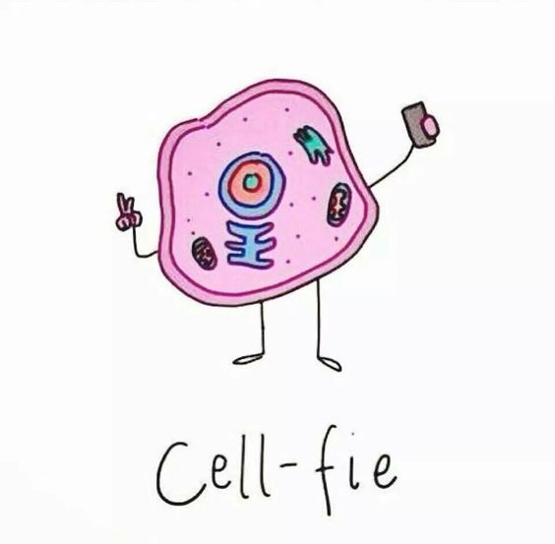
Cells – The Basic Unit of Life

Slide 2
Some Random Cell Facts
The average human being is composed of around 100 Trillion individual cells!!!
It would take as many as 50 cells to cover the area of a dot on the letter “i”
WOW!!!

Slide 3
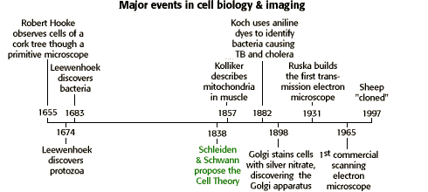
Timeline

Slide 5
What they discovered…
Robert Hooke (1665): Cells
Anton van Leeuwenhoek (1673): Single celled organisms
Matthias Schleiden (1838): All plants are made of cells.
Theodor Schwann (1839): All animals are made of cells.
Rudolph Virchow (1858): All cells come from pre-existing cells.

Slide 6
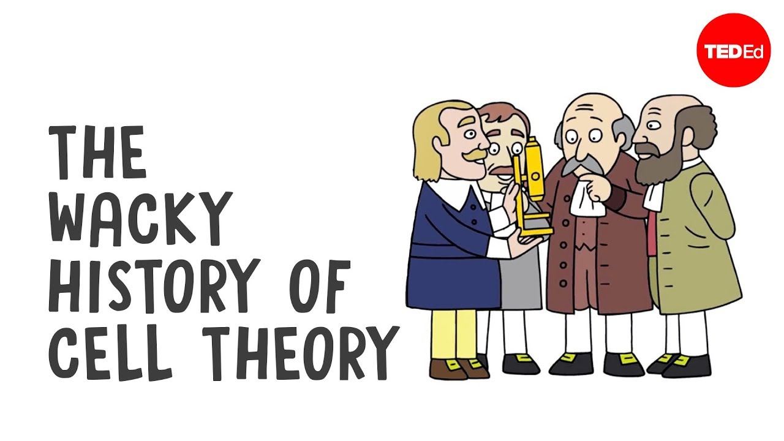
The (original) Cell Theory
The 3 Basic Parts:
1. All organisms are composed of one or more cells. (Schleiden & Schwann)
2. The cell is the basic unit of life in all living things. (Schleiden & Schwann)
3. All cells are produced by the division of preexisting cells. (Virchow)

Slide 7
Modern Cell Theory
Modern Cell Theory contains 4 statements, in addition to the original Cell Theory:
The cell contains hereditary information (DNA) which is passed on from cell to cell during cell division.
All cells are basically the same in chemical composition.
Energy flow occurs within cells
Cell activity depends on the activities of sub-cellular structures (= organelles) within the cell.

Slide 8
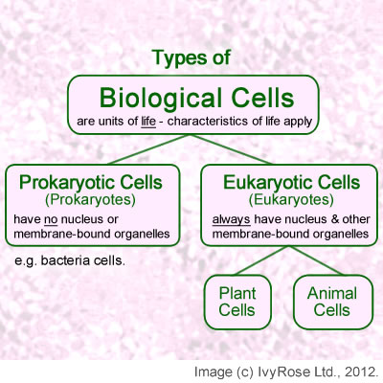

Slide 9
Prokaryotic versus Eukaryotic Cells
Prokaryotic | Eukaryotic
Small cells (< 5 μm) | Larger cells (> 10 μm)
Always unicellular | Often multicellular
No nucleus or any membrane-bound organelles | Has nucleus and other membrane-bound organelles
DNA is circular without proteins | DNA is linear & associated with proteins to form chromatin
Ribosomes are small. | Ribosomes are large.
No cytoskeleton | Has cytoskeleton
Motility by rigid rotating flagellum | Motility by flexible waving cilia or flagella
Cell division by binary fission | Cell division by mitosis or meiosis
Asexual reproduction | Asexual or sexual reproduction
Huge variety of metabolic pathways | Common metabolic pathways (i.e. cellular respiration)

Slide 10
Endosymbiosis
A theory that eukaryotic cell organelles came from prokaryotic cells that become incorporated inside larger prokaryotic cells.
Supported by these observations:
Organelles contain circular DNA like bacteria.
Contain the same ribosomes as bacteria.
Organelles have a double membrane as though a single-membrane cell had been engulfed and surrounded by a larger cell.
Organelles reproduce by binary fission like bacteria.
Organelles are very like some bacteria that are alive today

