Slide 1
Chapter 15 - Classification
pp. 318-333

Slide 2
Species of Organisms
There are 13 billion known species of organisms
This is only 5% of all organisms that ever lived!!!!!
New organisms are still being found and identified

Slide 3
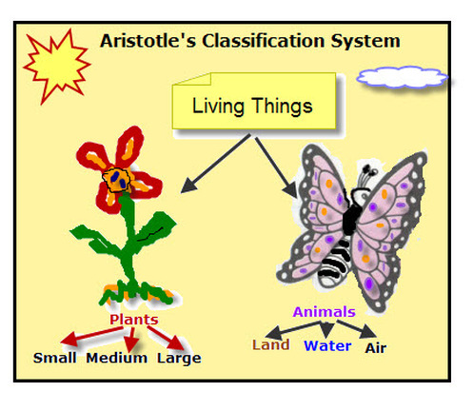
Why Classify Organisms?
Accurately & uniformly names organisms
Prevents misnomers such as starfish & jellyfish that aren’t really fish
Note: We have not always had the same classification system & it is still being modified today.

Slide 4
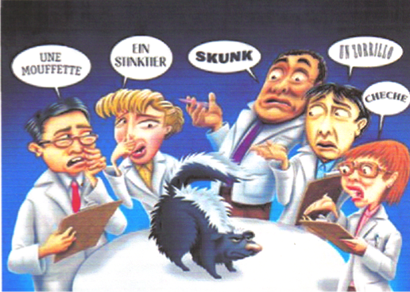
Confusion of using different languages for names

Slide 5
Latin names are understood by all taxonomists

Slide 6
Biological Classification Systems
Assign universally accepted names
Organisms are grouped with other similar organisms

Slide 7
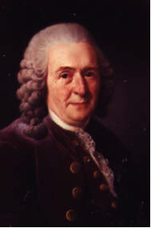
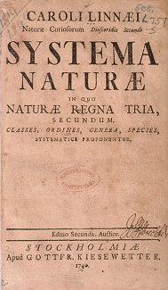
Binomial Nomenclature
Developed by Linnaeus, the “father” of taxonomy, in the 18th century
Classified organisms by their structure
Developed the naming system, binomial nomenclature, still used today

Slide 8
Each organism has a two-part scientific name
First name = genus name (capitalized)
Second name = species name (lowercase)
If the person who named the species is known, use it at the end
Entire two-part name must be written in italics or underlined when handwritten; the person who first gave the name to the species is in non-italic text
Example: Homo sapiens Linnaeus

Slide 9
Taxonomy
Linnaeus grouped organisms with similar structures together in “taxa”
Taxonomy = science of naming organisms & assigning them to groups
In order from largest to smallest taxon:
Domain, Kingdom, Phylum, Class, Order, Family, Genus, Species
“Don’t kind parents carry orders from grocery stores?”
This is also the order of most general to most specific

Slide 10
