Slide 1
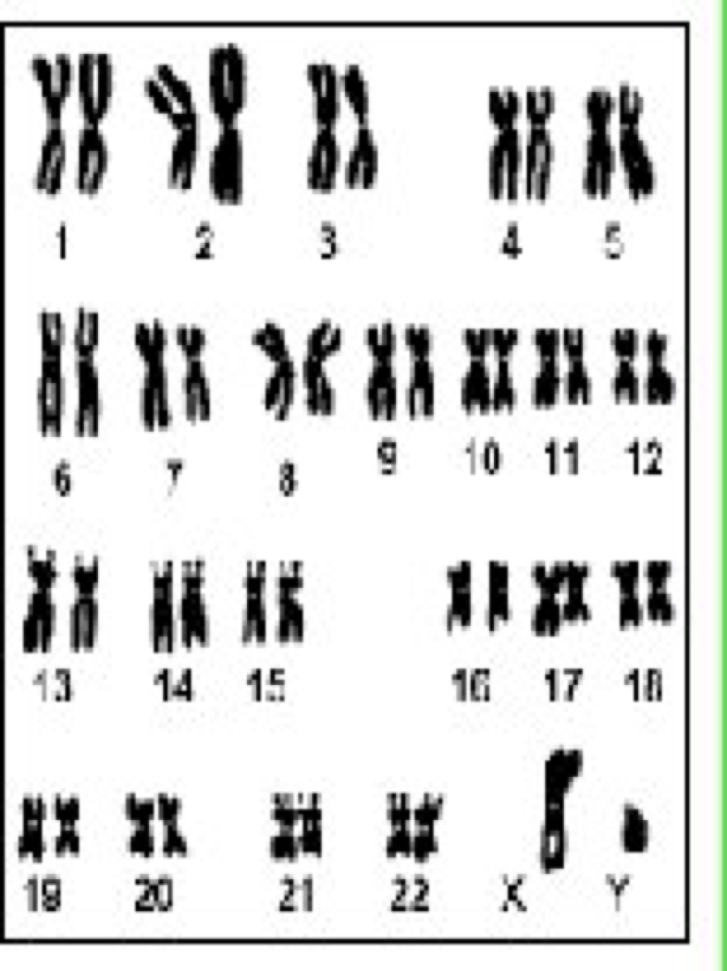
DNA

Slide 2
Contains all of our genetic info & as a result, controls activities of our cell
Is located in chromosomes within the nucleus of each cell
Almost all body cells contain the full amount of DNA (46 chromosomes) except:
Red blood cells (no nucleus at maturity)
Sex cells (gametes only have ½ the amt.)
The DNA molecule is the only molecule capable of replicating itself
Each organism has its own molecule of DNA

Slide 4
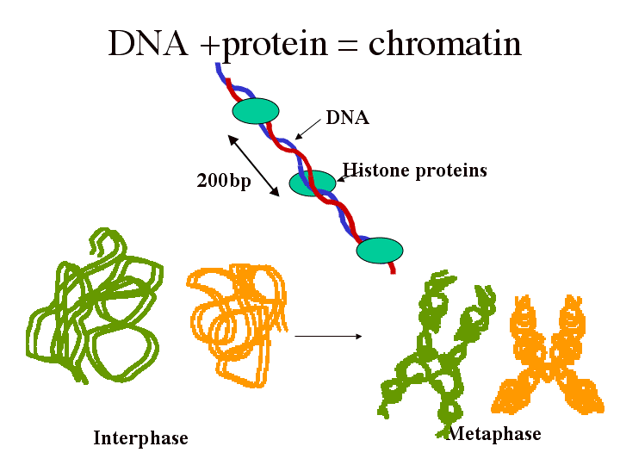
Most of the time, DNA is in the form of a long string called chromatin.
During cell division, chromatin bunches up to form chromosomes.

Slide 5
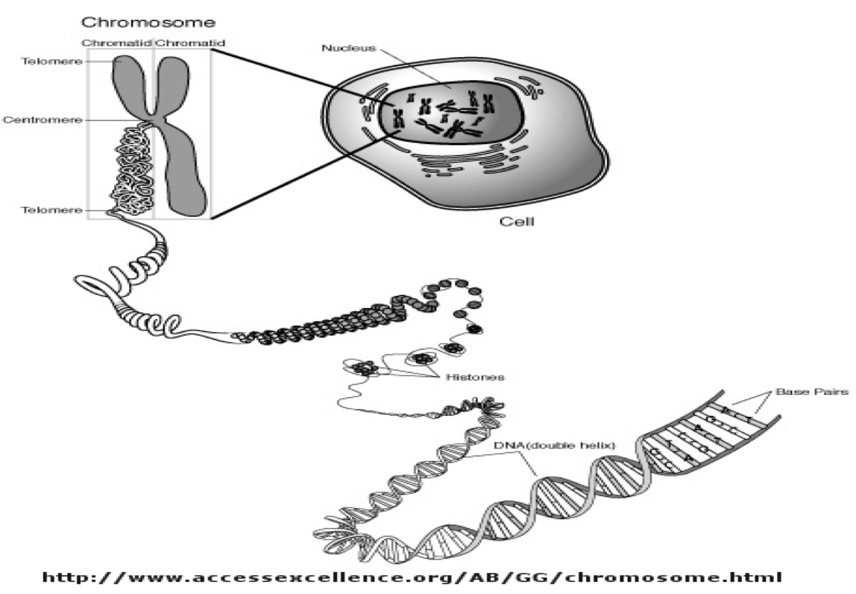

Slide 6
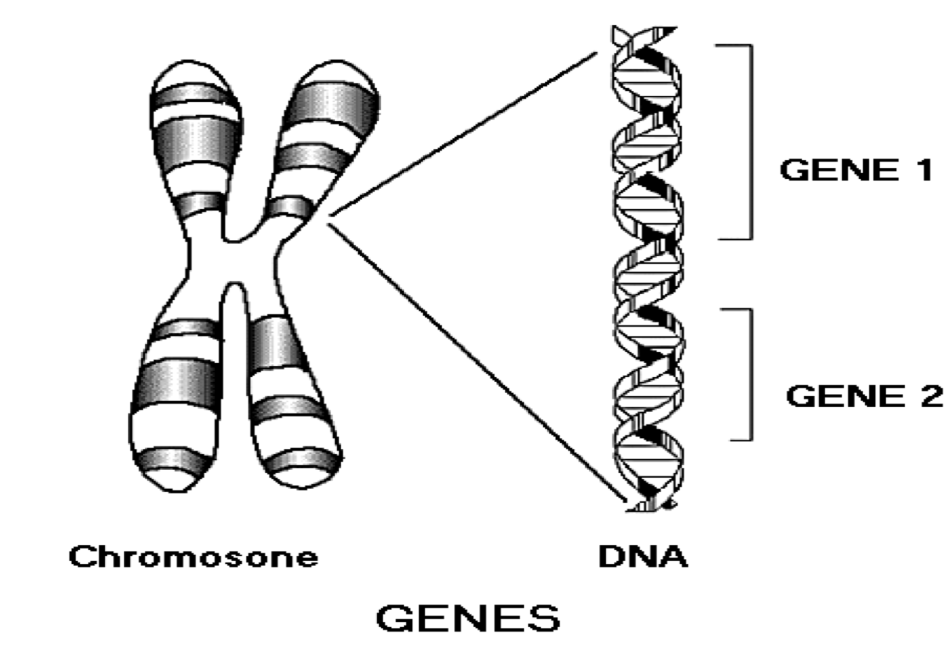
A section of a chromosome, which codes for a certain protein, is a gene.

Slide 7
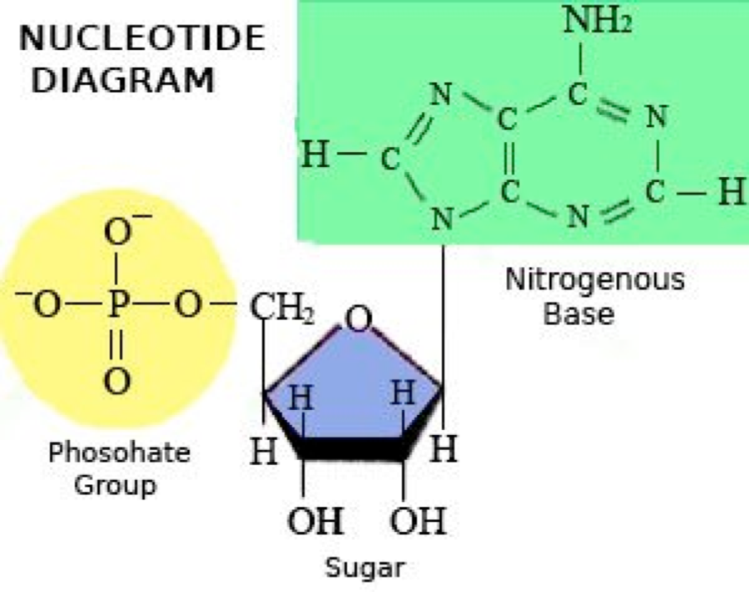
DNA Structure
Composed of nucleotides
Nucleotides have 3 parts:
5 carbon sugar = deoxyribose
Phosphate group
One of 4 nitrogenous bases

Slide 8
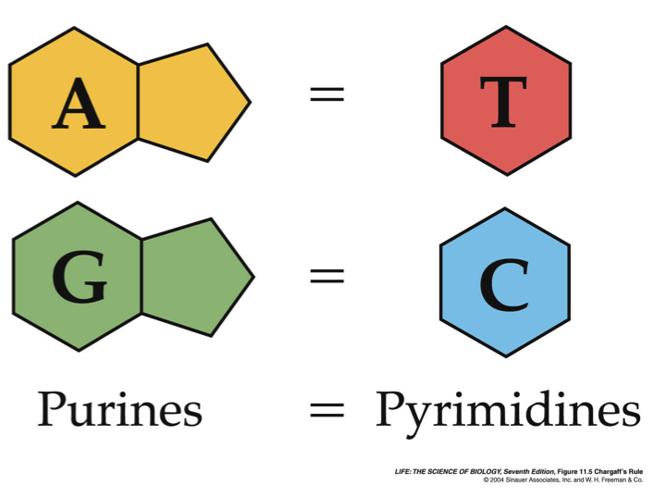
There are 2 different types of bases:
Purines
Adenine (A) & guanine (G)
2 fused rings
2. Pyrimidines
Thymine (T) & cytosine (C)
One ring
Adenine bonds with thymine
Guanine bonds with cytosine
Complementary base pairing

Slide 9
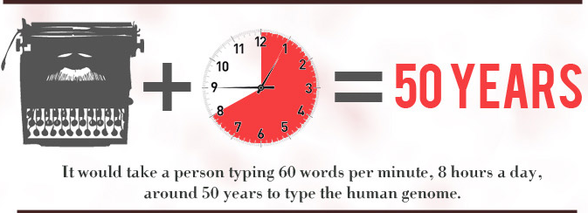
The human genome is about 3,000,000,000 DNA base pairs long!

Slide 10
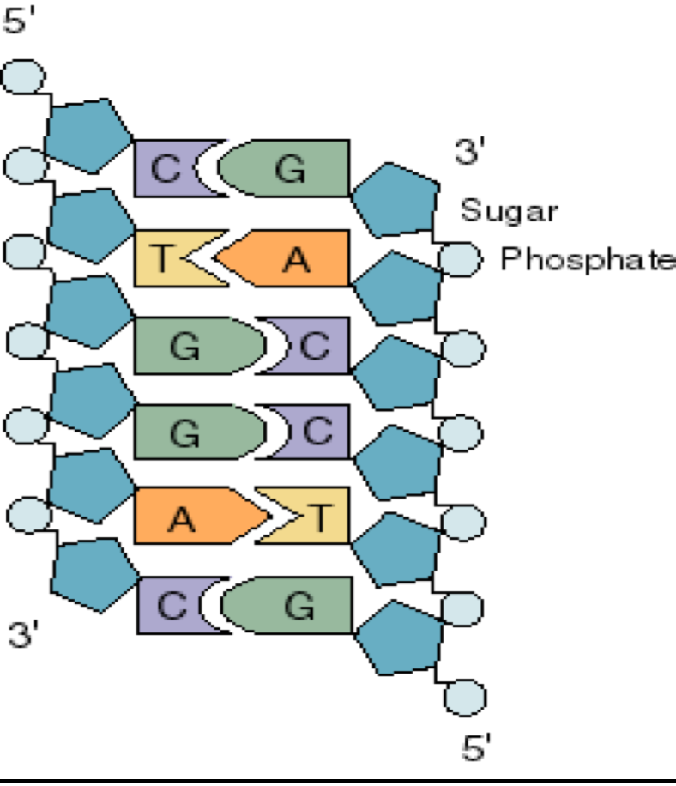
DNA looks like a “twisted ladder” = double helix
Alternating sugar & phosphates make up the backbone (“rails” of the ladder)
Bases make up the “rungs” & are held together by weak hydrogen bonds

Slide 11
DNA

Slide 12
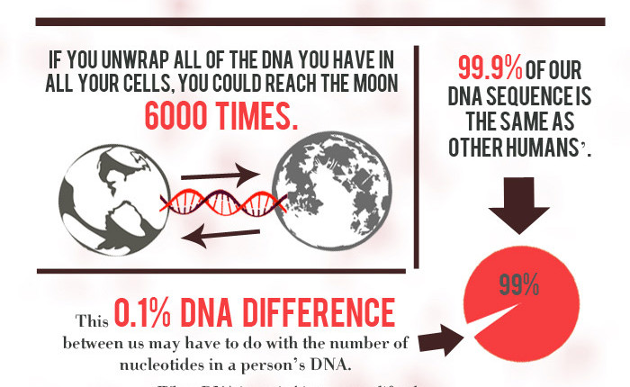

Slide 13
