Slide 1
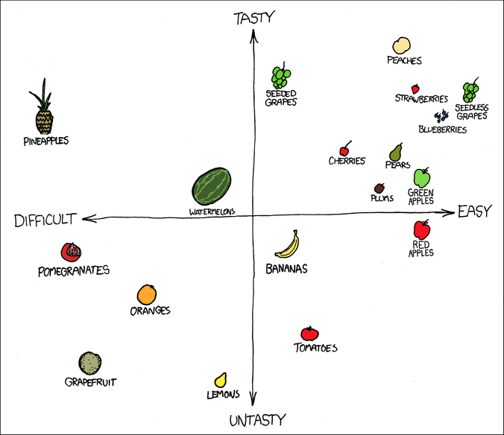
Graphing Notes

Slide 2
Variables
Independent Variable
the variable that we change in the experiment
(what you know before the experiment).
Always on the x-axis!
Dependent Variable
the thing that we measure in the experiment (what you don’t know before the experiment).
Always on the y-axis!

Slide 3
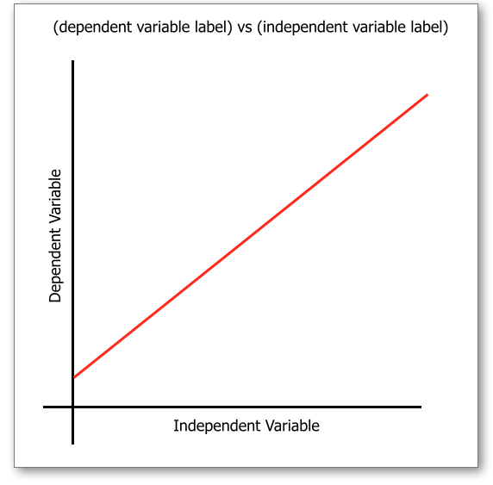

Slide 4
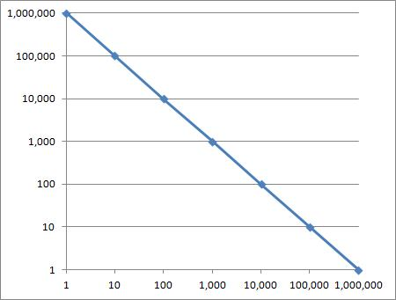
Scale
Scale is needed to make sure that the information on the graph is readable.
Your graph MUST fill nearly the whole area.
Numbers MUST be evenly spaced.
Axes are NOT equally spaced!

Slide 5
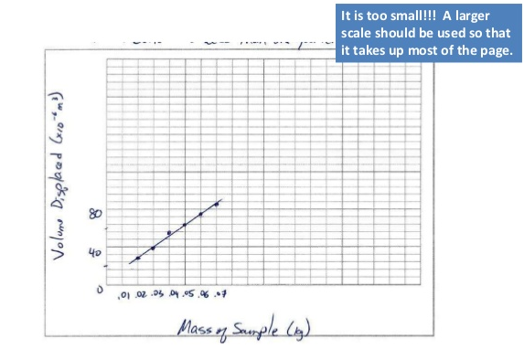

Slide 6
Title
Give the graph a title to tell the reader what the graph is showing.
The title is usually placed in the center above the graph.
The title of the graph should be in terms of what the x and y axes represent.
The proper form is “y-axis variable vs. x-axis variable.”
For ex., “Distance vs. Time”

Slide 7
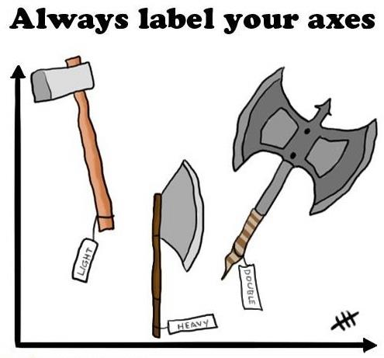
Axes
Label axes to tell what is being measured.
Include units in brackets if needed.

Slide 8
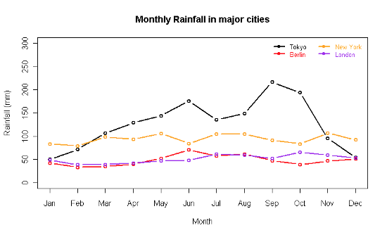
Legend
A graph with more than one set of data needs a legend (key)
It will identify what the symbol or color means

Slide 9
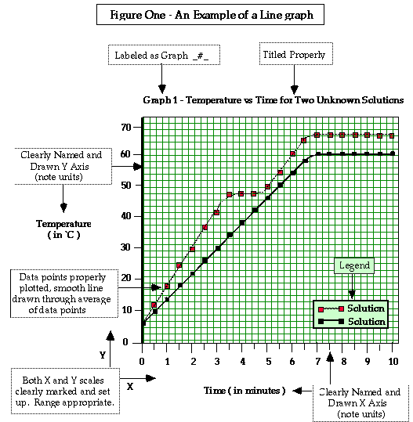
Properly Formatted Line Graph:

Slide 10
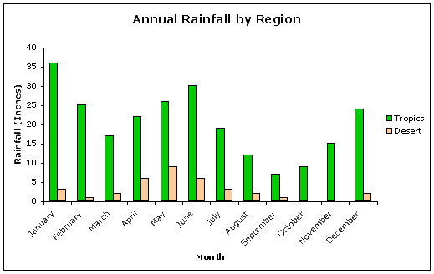
Properly Formatted Bar Graph:

Slide 11
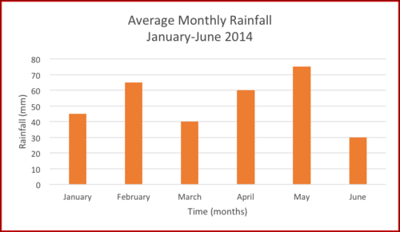

Slide 12
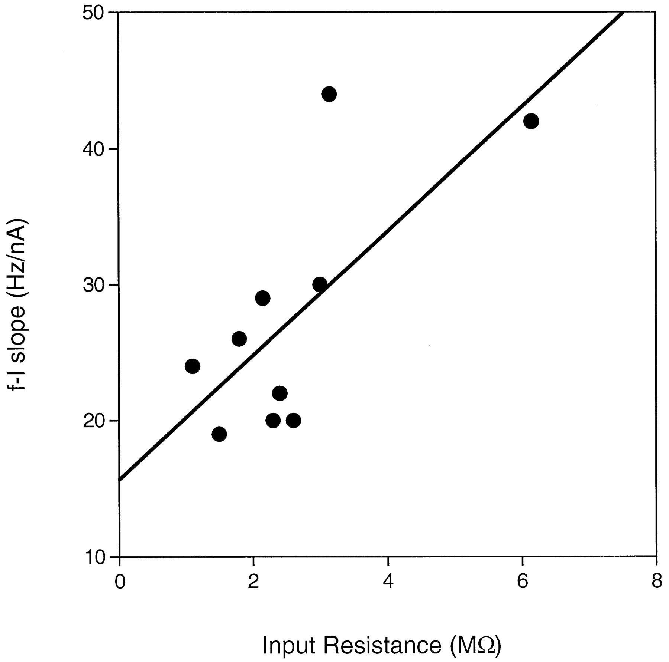
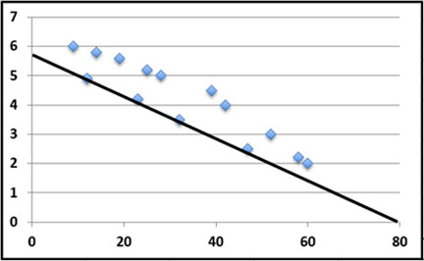
Line of Best Fit
a.k.a. trendline
an educated guess about where line might fall in a set of data plotted on a scatter plot
try to have approximately the same number of points above and below the line

