Slide 1
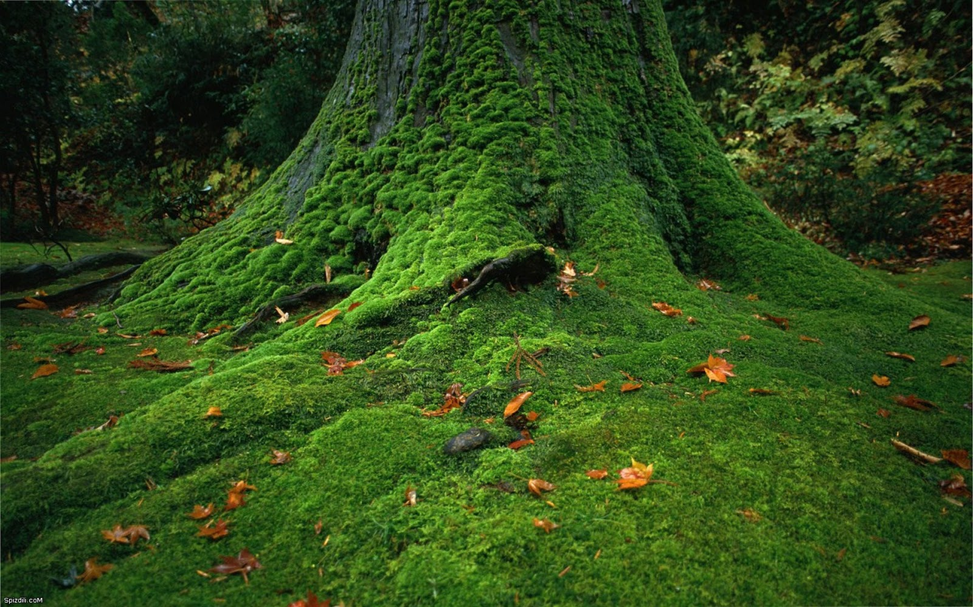
Phylum Bryophyta
pp. 451-454

Slide 2
Similarities to Algae:
Non-vascular
Display alternation of generations
Need water for reproduction

Slide 3
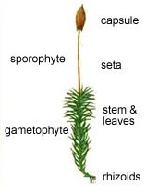
Appearance/Structure:
Less than a few centimeters tall
Rhizoids = rootlike
Leaflets = moss “leaves”, no stem, no protective layer
Seta = stalk
Sporangia = capsule containing spores

Slide 4
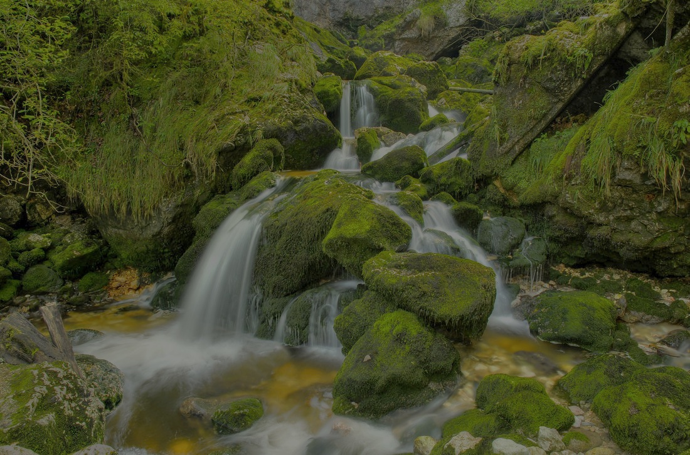
Lack Adaptations For Water-free Existence:
Lack conductive tissue
instead water passes from cell to cell by osmosis & surface tension around the stalk
Lack cuticle
Lack true roots
Have sperm which need to swim to egg

Slide 5
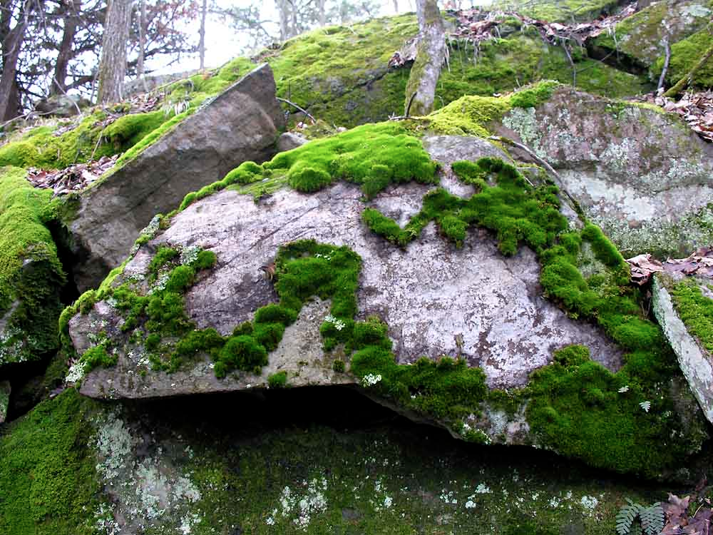
Ecological Role:
Primary producer
Pioneer species
Can grow on rock & inhabitable soil
Moss dies & creates enriched soil for other, more complex plants to colonize

Slide 6
Reproduction:
Alternation of Generations
Gametophyte
Haploid (n)
Has sexual reproduction requiring water
Dominant stage
Sporophyte
Diploid (2n)
Has asexual reproduction using spores
Dependent on the gametophyte
IMPORTANT CHARACTERISTICS OF MOSSES!

Slide 7
