Slide 1
Photosynthesis & Cellular Respiration
Chapter 6 p.113

Slide 2
 | PHOTOSYNTHESIS | CELLULAR RESPIRATION
Definition: | Process by which autotrophs capture energy & store it as carbohydrates | Process by which autotrophs & heterotrophs obtain energy through the breakdown of stored or ingested carbohydrates
Chemical equation: | 6H₂O + 6CO₂ + ENERGY → C₆H₁₂O₆ + 6O₂ | C₆H₁₂O₆ + 6O₂→ 6H₂O + 6CO₂ + ENERGY
Requires: (Reactants) | Carbon dioxide, water, & energy | Glucose & oxygen
Produces: (Products) | Glucose & oxygen | Carbon dioxide, water, & energy
Takes place in: | Plant, some protists, & some bacterial cells | All aerobic organisms
Organelle: | Chloroplast (contains chlorophyll to absorb sun’s energy) | Mitochondria

Slide 3
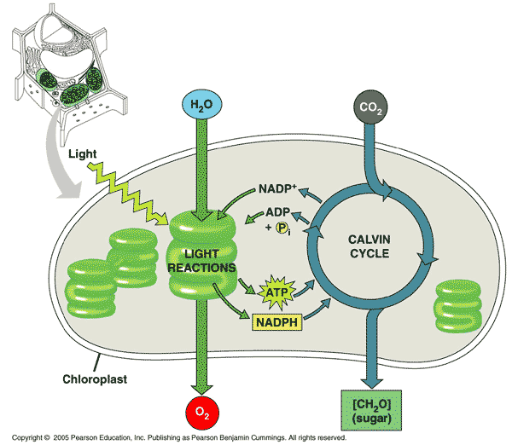
With regard to plants & animals:
Photosynthesis is used to capture & store energy; only plants, some protists, & some bacteria do this.

Slide 4
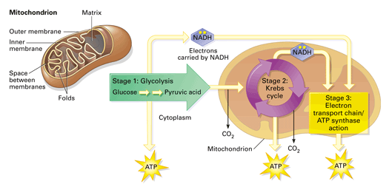
Cellular respiration is used to release energy for use; both plants & animals need to do this
Respiration in conjunction with glycolysis (breakdown of glucose) produces 36 ATP molecules (the compound that stores energy)
ONLY if oxygen is available!
If you lack oxygen (O₂), fermentation occurs instead (**only produces 2 ATP molecules)

Slide 5
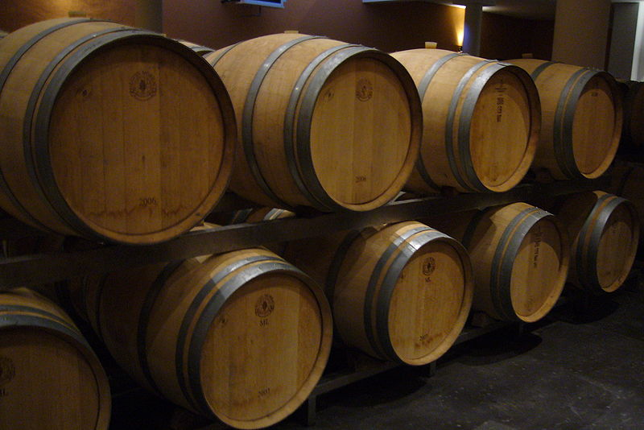
Fermentation:
Is anaerobic (does NOT require oxygen)
2 types
- One produces lactic acid
Example: in muscles; during rapid exercise
- One produces alcohol & CO₂
Example: in yeast; to rise dough

Slide 6
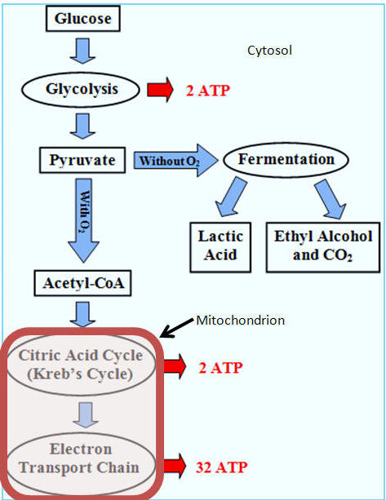

Slide 7
HW: Read Chapter 6 & begin planning project
**bring supplies (poster paper, colouring pens, ruler, etc.) for next class!

