Slide 1
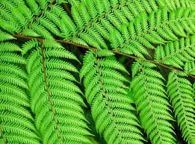
Phylum Tracheophyta (Ferns)
pp. 455-461
“True” Land Plants

Slide 2
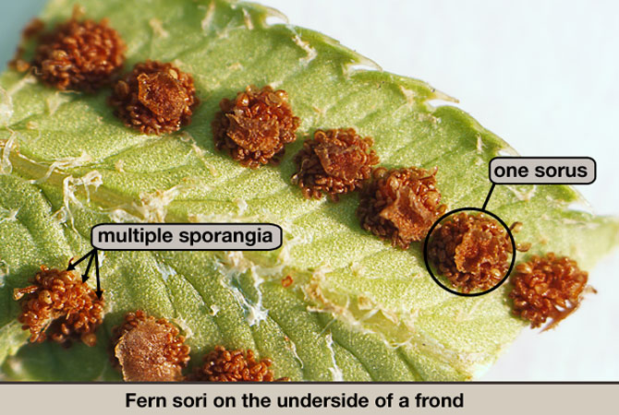
Simplest Vascular Plant
Only group of vascular plants without seeds
Have spores instead

Slide 3
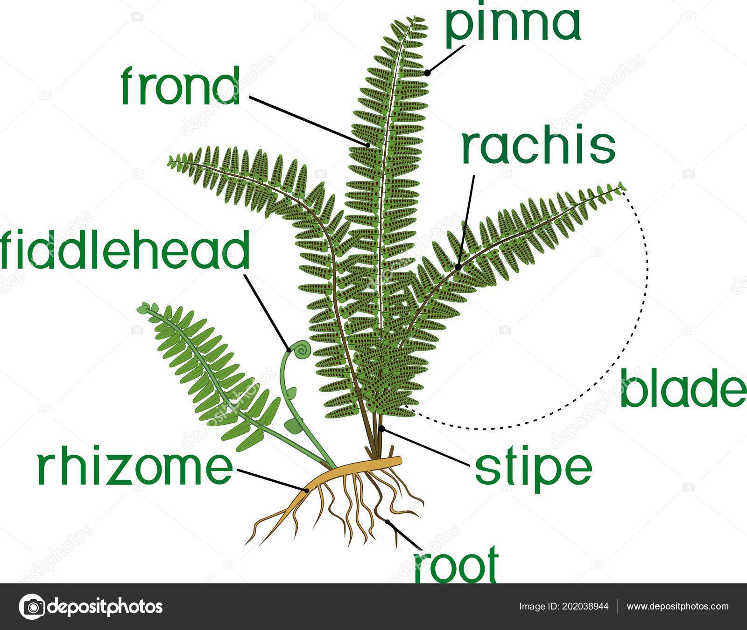
Structure:
Has true root as well as a rhizome (= underground stem)
Has frond (leafy portion) composed of leaflets (pinna)
Has sporangia (container for spores)
Grouped into sori
Sori on underside of leaflet

Slide 4
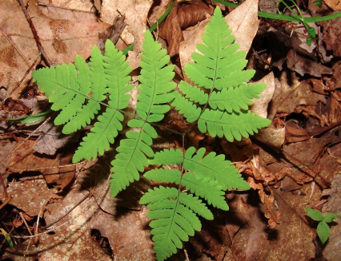
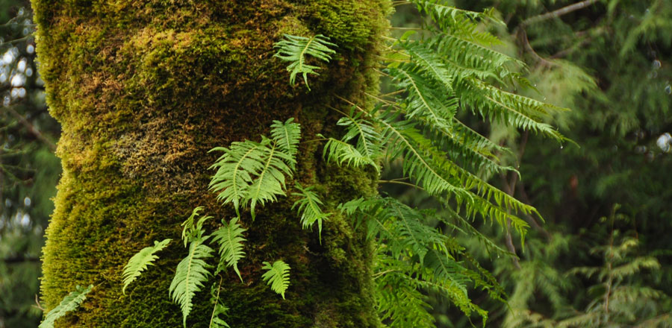
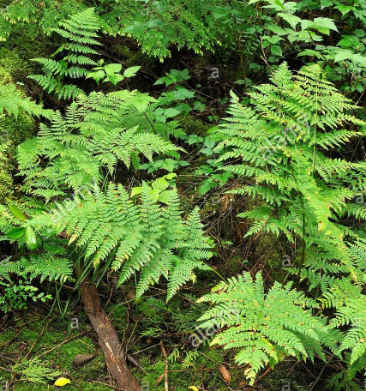
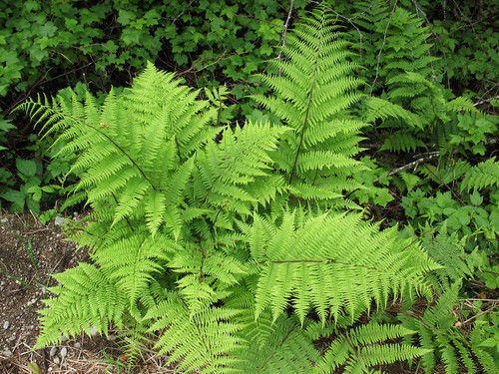
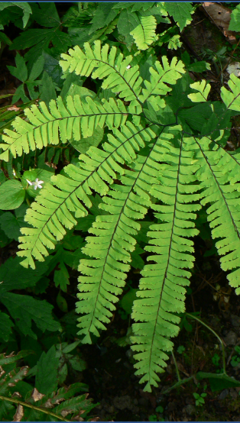
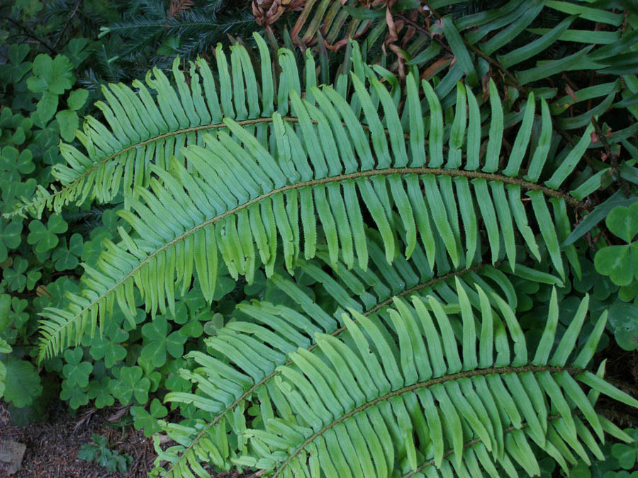
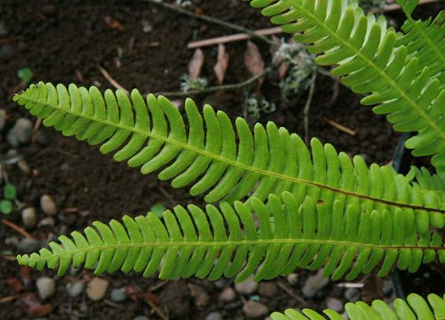
Oak Fern
Licorice Fern
Bracken Fern
Ferns of the Pacific Northwest:
Lady Fern
Deer Fern
Sword Fern
Maidenhair Fern

Slide 5
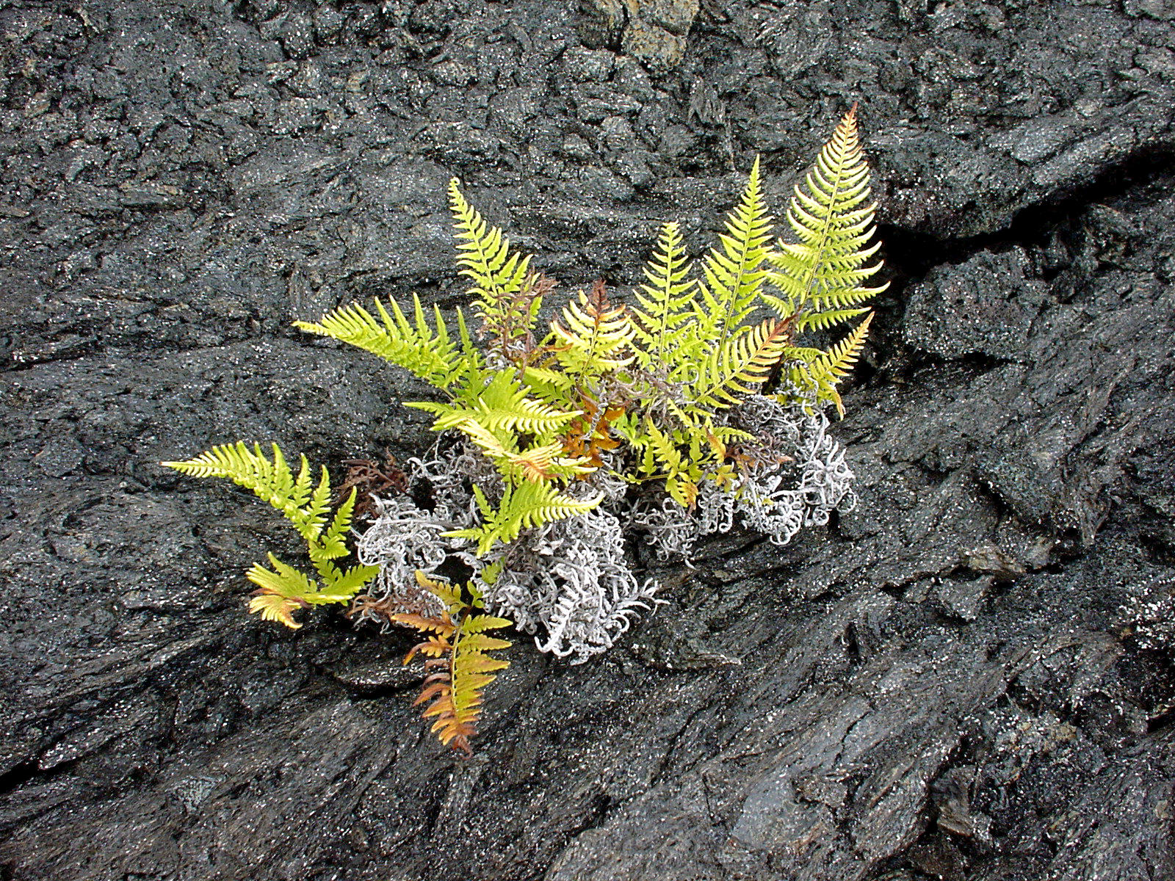
Ecological Role:
Primary producer
Pioneer plant

Slide 6
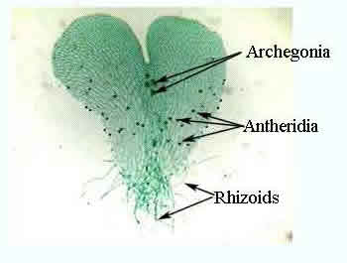
Reproduction:
Alternation of Generations
Gametophyte = Prothallus
Heart-shaped
Short-lived
Both sexes on same gametophyte
Sexual reproduction needs water

Slide 7
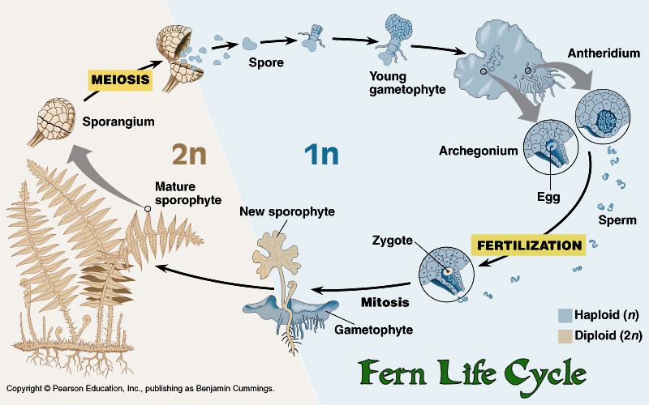
2. Sporophyte = fern
Dominant generation
**generations are independent of each other

