Slide 1
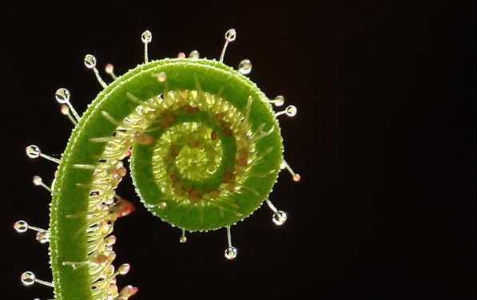
Introduction to Terrestrial Plants
pp. 449-451

Slide 2
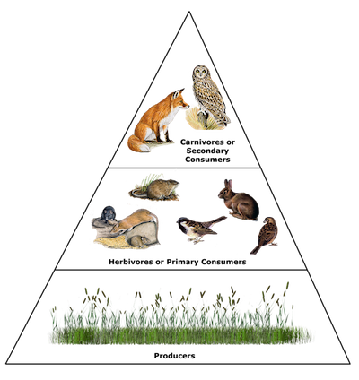
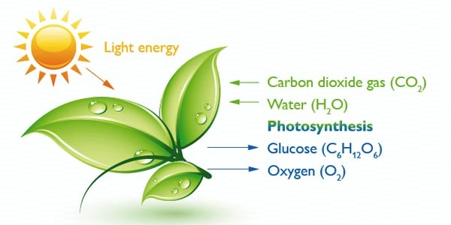
Why Terrestrial Plants are Important:
Transformed environment so terrestrial animals could evolve
Primary producers in the flow of energy through ecosystems

Slide 3
Challenges to Life on Land:
Need support so parts of plant that photosynthesize are exposed to sunlight
Need to get water & nutrients
Need to move water & nutrients throughout plant
Need to avoid water loss
Need to maintain a balance in gas exchange
Must be able to reproduce without water
Must be able to survive changing environmental conditions

Slide 4
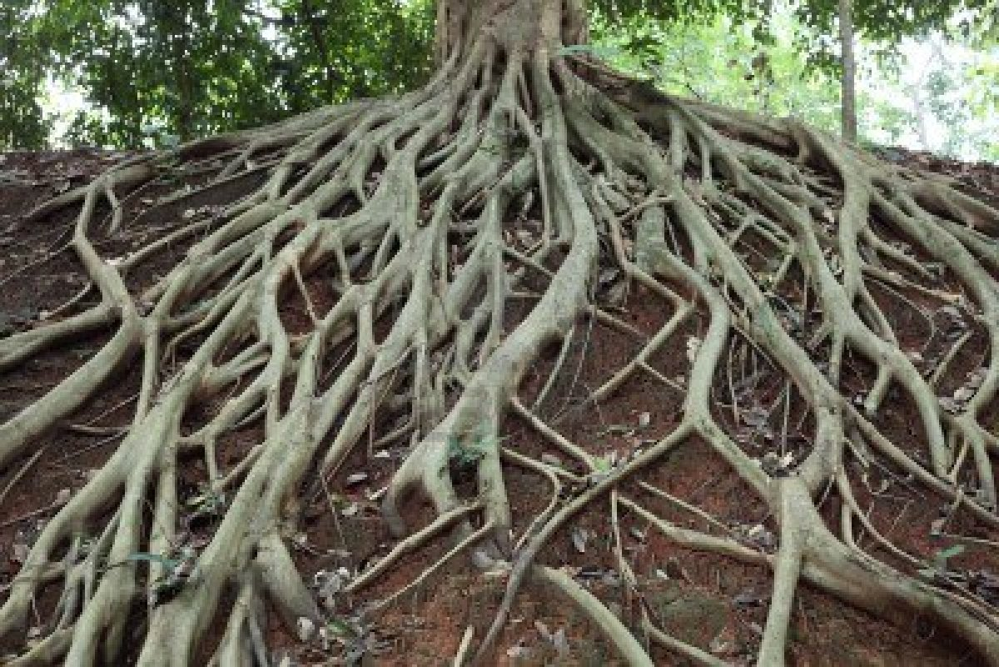
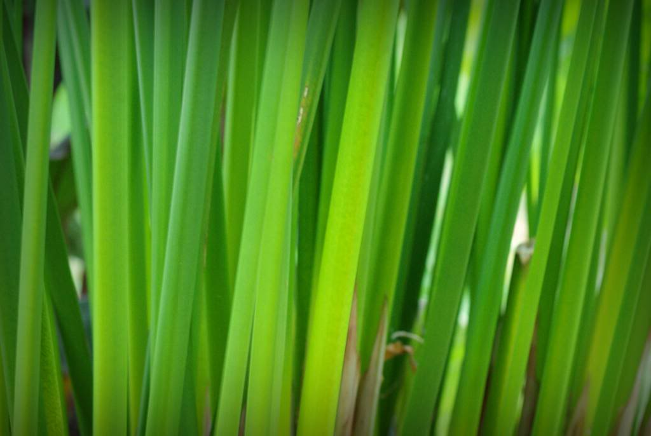
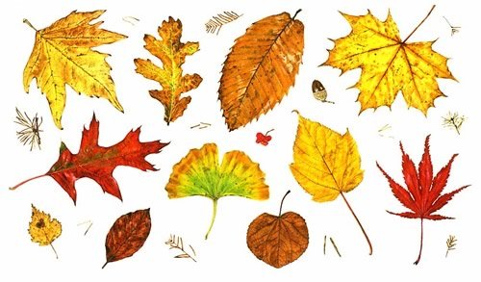
Plant Adaptations:
Development of:
Roots
To absorb water & nutrients
Anchor plant
Stems
Stronger fibers for support
Connect roots to leaves
Leaves
Primary photosynthetic organ
“catches” sunlight

Slide 5
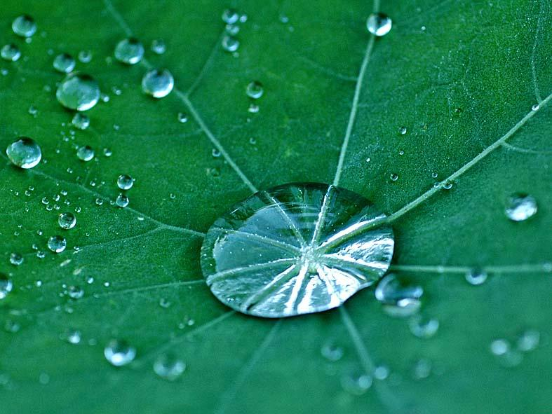
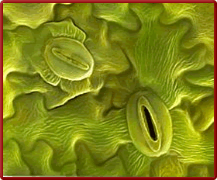
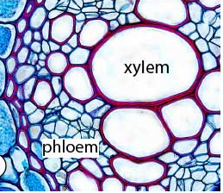
Presence of a waxy cuticle
Prevents drying out
Presence of stomata (microscopic pores)
For gas exchange
To prevent drying out
4. Presence of vascular system
Xylem tissue = transport of water & minerals up from the roots
Phloem tissue = distribution of nutrients (from photosynthesis)

Slide 6
Classification of Plants:
Non-Vascular
Terrestrial mosses, liverworts, hornworts (phylum Bryophyta)
Do NOT have true roots, stems or leaves
NO vascular tissue
Small size
Depend of water for reproduction

Slide 7
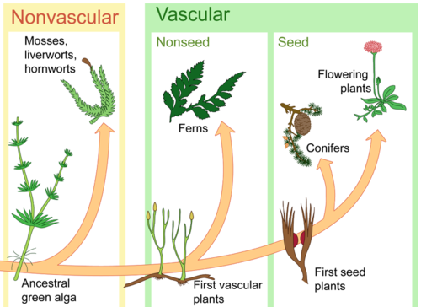
Vascular
Ferns, angiosperms (flowering plants), & gymnosperms (conifers)
Have true roots, stems, & leaves
Has vascular tissue
Larger size
Cuticle present

