Slide 1
Sec. 1.2 Scientific Method
p. 7-13

Slide 2
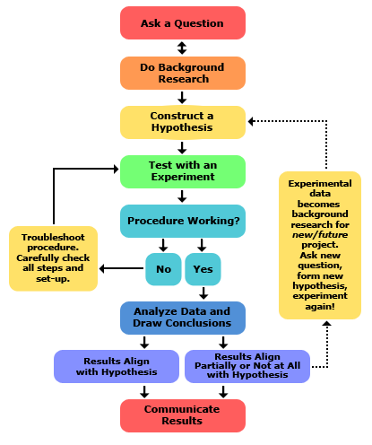
Scientific Method (Inquiry)

Slide 3
Identify a problem (ask a question).
Developed from observations
2. Gather information
Do background research

Slide 4
3. Make a hypothesis
an educated guess
MUST: explain facts
be testable
be able to predict
“if…..then…” statement
May include a “because”

Slide 5
4. Test hypothesis
- by a controlled experiment!
- MUST be: repeatable
systematic (controlled expt.)
5. Record and analyze data
- use visual aids (tables, graphs, etc.)

Slide 6
6. Make conclusions
NOTE - If conclusions refute hypothesis, either:
Revise hypothesis
or
Discard hypothesis
7. Replicate the work
* If the hypothesis survives MANY tests & explains many facts, then it becomes a theory!

Slide 7
Controlled experiment:
Experiment in which both the control group & experimental group(s) are kept under similar (controlled) variables except for the factor, the experimental variable, under study.
This allows you to determine the effect or influence of that experimental variable on the group.

Slide 8
Types of variables:
Experimental or independent variable: The variable that you are studying in an experiment. There is ONLY one.
Dependent variable: The variable which you measure to get your results. There can be more than one.
Controlled variable(s): The variable(s) that you do not change.

Slide 9
Control group: The group in an experiment in which the experimental variable is not applied.
- used for comparison with the experimental group
Experimental group: The group in an experiment to which the experimental variable is applied.

