Slide 1
Section 5.1 – Modelling Polynomials
p. 117-125

Slide 2
Review from Gr. 8:
Algebra tiles are used to model integers and variables.
Blue, green and yellow represent positive tiles.
Red represents negative tiles
x² is NEW!!!

Slide 3
Vocabulary:
Polynomial = one term or the sum of terms whose variables have whole number exponents
ex) -2x² – 3x + 5
**variables in the denominator (ex: $\frac{−5}{n}$ )OR the square root of a variable ($ex: \sqrt{3x}$) are NOT polynomials!!
Terms = numbers, variables, or the product of numbers & variables
In the example: -2x² , (-3)x, & 5 are terms

Slide 4
Using example: -2x² – 3x + 5
Coefficients = number in front of the variable
*** always written first before the variable
ex) In the example: (-2) & (-3) are the coefficients
Constant term = the number that does NOT change; it will not have a variable associated with it!
ex) In the example: 5 is the constant term

Slide 5
Using example: -2x² – 3x + 5
Degree of the term = the value of the exponent of the term
ex) -2x² has a degree of 2
– 3x has a degree of 1
Degree of the polynomial = the value of the greatest exponent of a term in a polynomial
ex) -2x² – 3x + 5 has a degree of 2

Slide 6
Classifying polynomials by # of terms:
Monomial = has 1 term
ex) 3n or -5y³ or 11
Binomial = has 2 terms
ex) -5n + 3 or 3x³ – 6x
Trinomial = has 3 terms
ex) 7p² – p + 9
NOTE: Always write your polynomials in descending order !

Slide 7
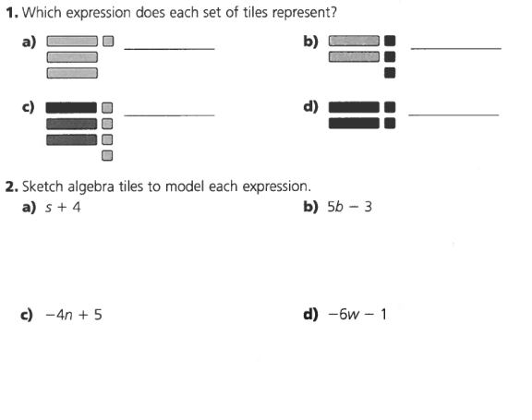
Try This:

Slide 8
3.

Slide 9
4.

Slide 10
5. Evaluate each polynomial when x = 2 and y = -5
a) 2x – y + 1
b) 3x³y

