Slide 1
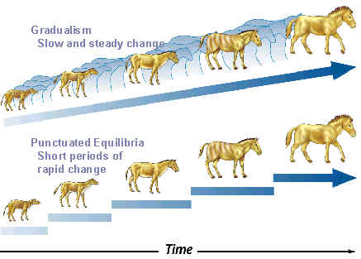
Speed of Evolution?

Slide 2
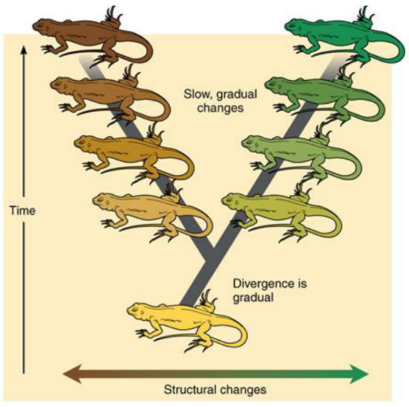
Option 1: Gradualism
A model of evolution in which one species slowly & steadily evolves into another.
Proposed by Darwin.
Explains gaps in fossil record by suggesting these are “missing links” that have yet to be found.

Slide 3
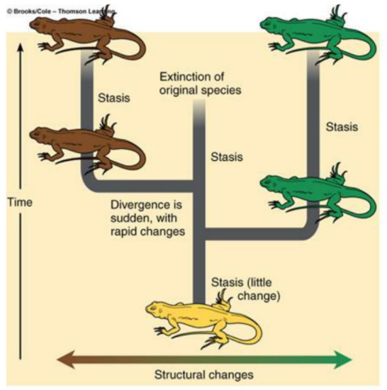
Option 2: Punctuated Equilibrium
A model of evolution in which one species suddenly changes into another after a long stable period.
Explains gaps in fossil record by suggesting there are no gaps just rapid change.
Occurs when there are:
Mass extinction
Migration into new environments
Isolation of small populations

Slide 4
