Slide 1
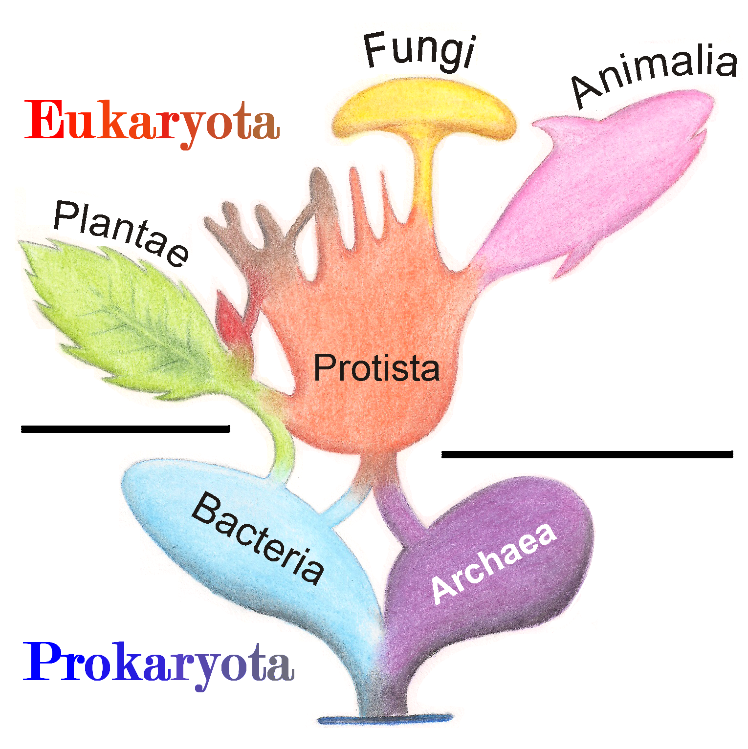
6 Kingdoms
p.325-329

Slide 2
3 Domains of Life
Bacteria
Peptidoglycan in cell walls
Archaea
No peptidoglycan in cell walls
Live in harsh conditions
Eukarya
Unicellular & multicellular
Eukaryotic
Includes Kingdom Protista, K. Fungi, K. Plantae, & K. Animalia
Unicellular & Prokaryotic

Slide 3
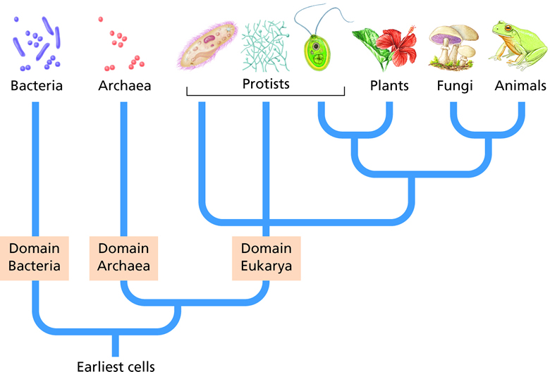

Slide 4
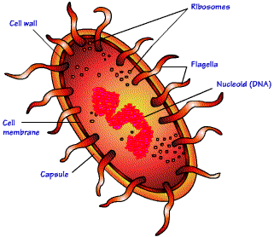
1. Kingdom Archaebacteria
“Ancient” bacteria
Prokaryotic
Unicellular
Both autotrophs & heterotrophs
Has a cell wall that lacks peptidoglycan
Reproduce asexually
Some are motile (= can move)
Live in extreme environments (Hot, Salty, Acidic)
Volcanic hot springs, Salt marshes

Slide 5
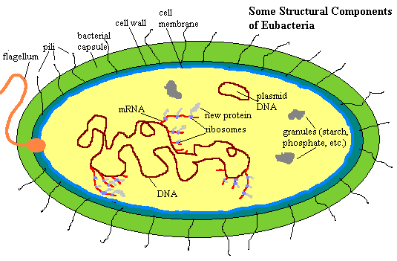
2. Kingdom Eubacteria
“Recent” bacteria
Prokaryotic
Unicellular
Both autotrophic & heterotrophic
Reproduce asexually
Some are motile
Cell wall has peptidoglycan (thick!)
Live nearly everywhere

Slide 6
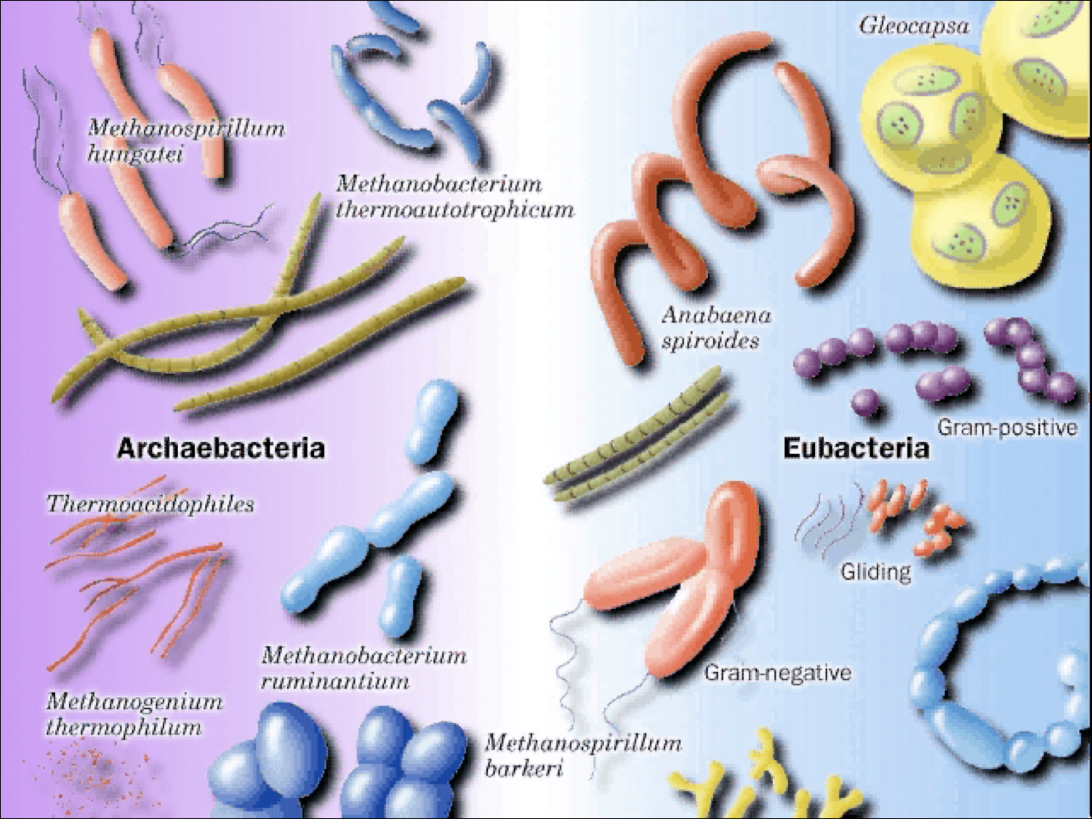

Slide 7
3. Kingdom Protista
Organisms that cannot be classified as an Animal, Plant, or Fungi.
Least satisfying of the classifications because members display the greatest variety.
3 Classifications
Animal-like Protists: Amoeba, Paramecium
Plant-like Protists: Unicellular & Multicellular; Algae
Fungi-like Protists: Slime molds & Water molds

Slide 8
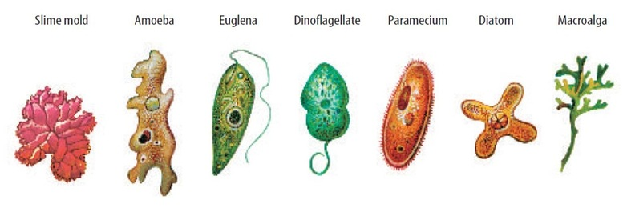
3. Kingdom Protista
Eukaryotic
Most are unicellular, some are multicellular
Autotrophs & heterotrophs
Reproduce sexually & asexually
Some are motile
Some have a cell wall (plant-like)
Live in damp or wet habitats

Slide 9
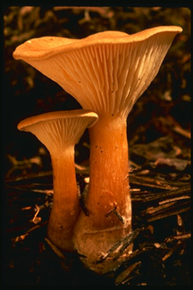
4. Kingdom Fungi
Eukaryotic
Most are multicellular (mushrooms), although some are unicellular (yeast)
Heterotrophic: Absorb their food from environment.
Feed on dead/decaying organic matter
Have a cell wall (chitin)
Reproduce sexually & asexually
Non-motile
Live as parasites or saprophytes nearly everywhere

Slide 10
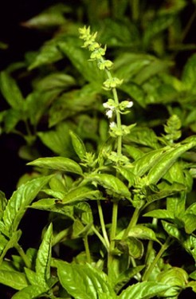
5. Kingdom Plantae
Eukaryotic
Multicellular
Photosynthetic
Autotrophs
Have a cell wall (cellulose)
Reproduce sexually & asexually
Non-motile
Includes: Cone-bearing and flowering plants, mosses, & ferns.

Slide 11
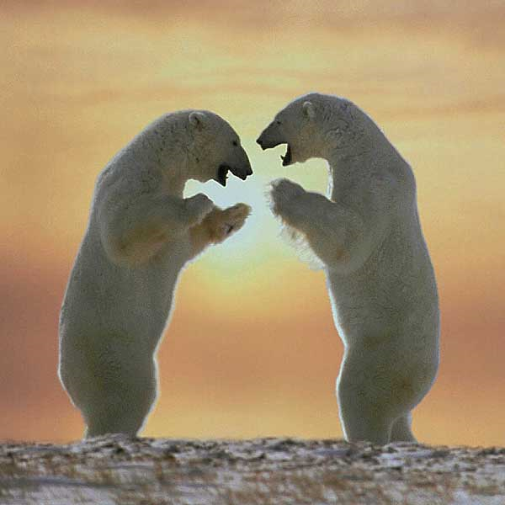
6. Kingdom Animalia
Eukaryotic
Multicellular
Heterotrophs
Most reproduce sexually
No cell walls
Motile, except sponges.
Very diverse

Slide 12
