Slide 1
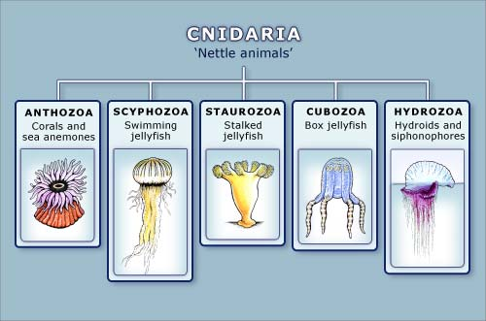

Slide 2
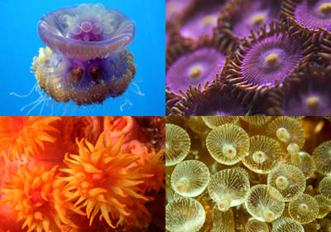
Characteristics
Soft bodied
Radial symmetry
2 germ layers
Have tissues!
Acoelomate
Mainly marine

Slide 3
Characteristics cont.
Tentacles with nematocysts (a.k.a. cnidoblasts) around mouth
Nematocysts contain stinging poisonous barbs
Predators
Examples: hydra, sea jellies (jellyfish), anemones, corals

Slide 4
Body Plan
2 germ layers
Body wall surrounds an internal space called a gastrovascular cavity
Responsible for digestion, circulation, respiration, & excretion
One opening
Body wall has 3 layers:
Epidermis/ectoderm (outer layer) – protective layer
Mesoglea (middle layer) – variety of different functions
Gastroderm/endoderm (inner layer) – secretes digestive enzymes

Slide 5
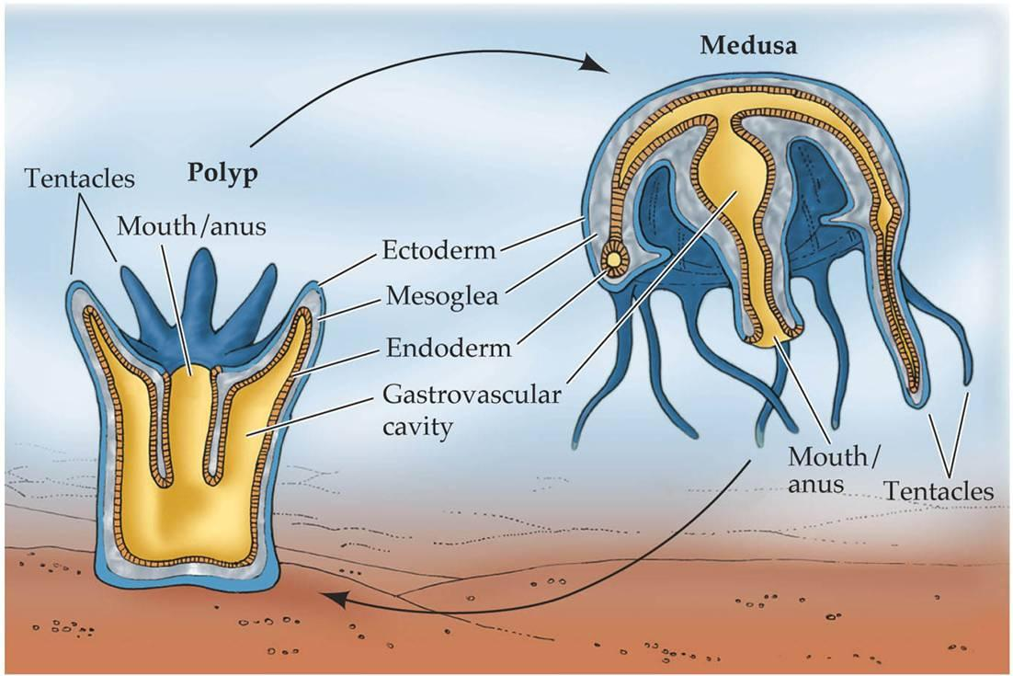

Slide 6
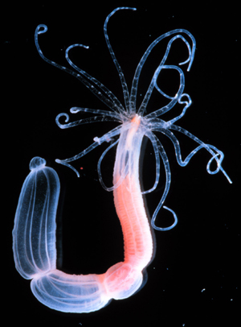
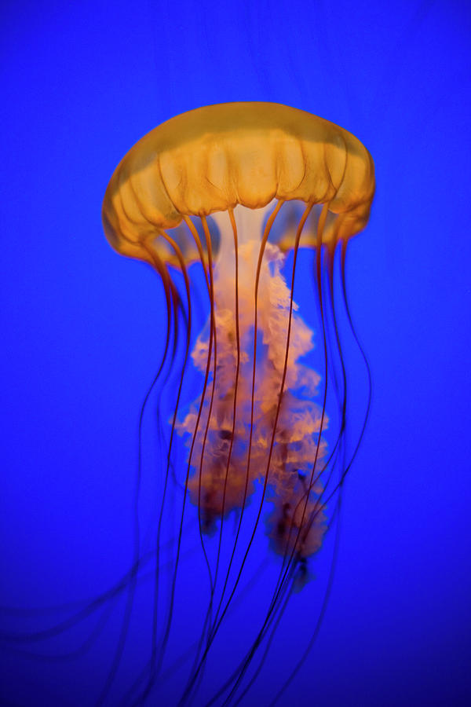
Life Cycle
Many include 2 different stages:
Polyp: non-motile (sessile)
flower-like (tentacles face up)
asexual
include hydra, anemones, coral
Medusa: motile
bell-like
sexual
include sea jellies (jellyfish)
NOTE: Some are polymorphic (go through both stages)

Slide 7
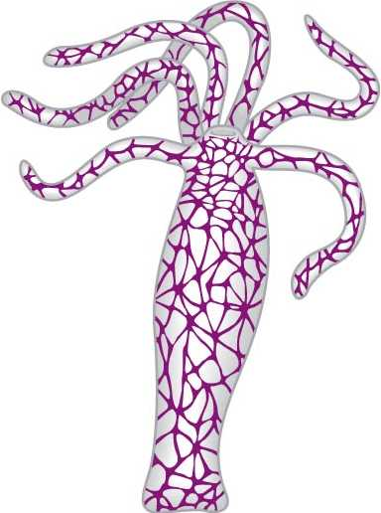
Body systems
Respiration = diffusion
Excretion = diffusion
Nervous system = nerve net
Simple, no brain or spinal cord
Reproduce sexually (often hermaphroditic but don’t self fertilize) & asexually (budding)

Slide 8
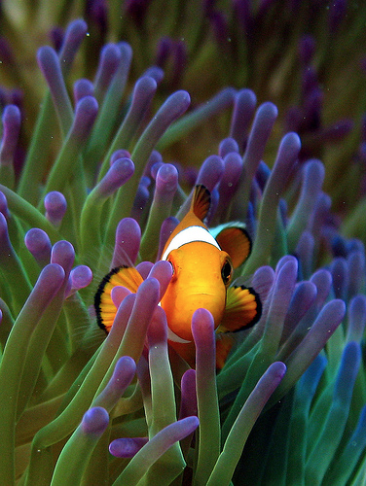
Ecological Roles
Coral reefs provide habitat & protection
Symbiotic relationships (ex. Clownfish)
Coral reefs generate billions of dollars & millions of jobs (tourism, sale of coral, jewelry, food source, etc.)
Contain chemical compounds that may treat illnesses

