Slide 1
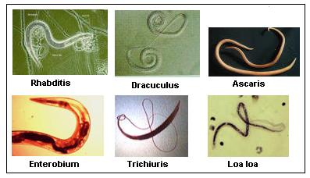
Phylum Nematoda
p. 575

Slide 2
Characteristics
Roundworms
Microscopic → 1 metre in length
Exist everywhere (aquatic, terrestrial, parasitic)
Often carnivorous
Bilateral symmetry
3 germ layers
Pseudocoelomate

Slide 3
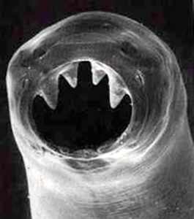
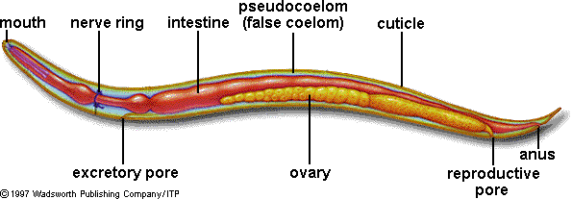
Body Systems
Digestive System:
Two openings!
Mouth → pharynx → long intestine → anus
Mobility:
Muscles run length of body

Slide 4
Excretion (metabolic wastes), respiration, & circulation (internal transport): by diffusion
Nervous System:
Ganglia (“simple brain”) at head
Ventral & dorsal nerves running down body
Nerves transmit sensory info & control movement
Sense organs detect chemicals given off by prey/hosts

Slide 5
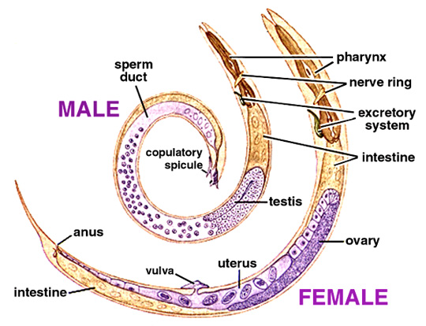
Reproduction: Sexual
Mostly separate sexes
Fertilization occurs inside female
Females release approx. 240, 000 eggs/day

Slide 6
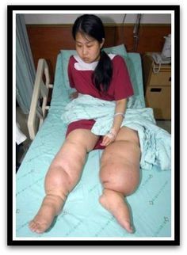
Ecological Role
Human parasites
Hookworm (live in intestines & bore through skin in feet)
Trichinosis (live in muscles, from eating undercooked pork)
Pinworm
Elephantiasis
Ascaris
Plant parasites destroy crops
Decomposers

Slide 7
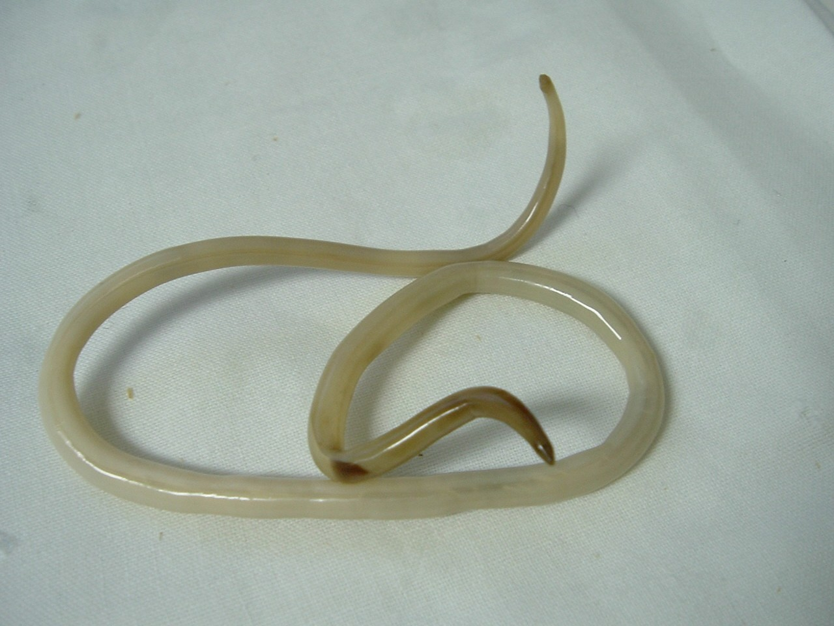
Ascaris (Fig. 26-33 p.577)
Adults live in intestines
Eggs leave in feces & eaten by another host
Eggs hatch inside intestines by new host
Larvae enter bloodstream
Enter into lungs
Coughed up into mouth
Swallowed
Once in intestines, larvae matures into adults

Slide 8
