Slide 1
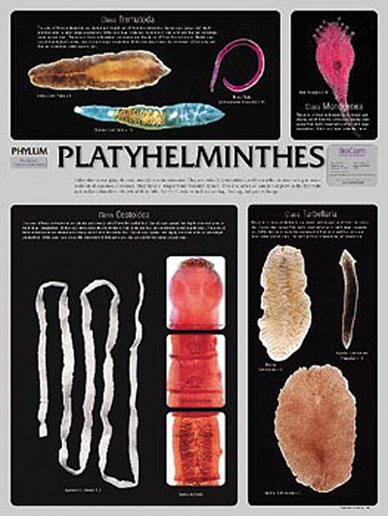
Phylum Platyhelminthes (Flatworms)
p. 570-575

Slide 2
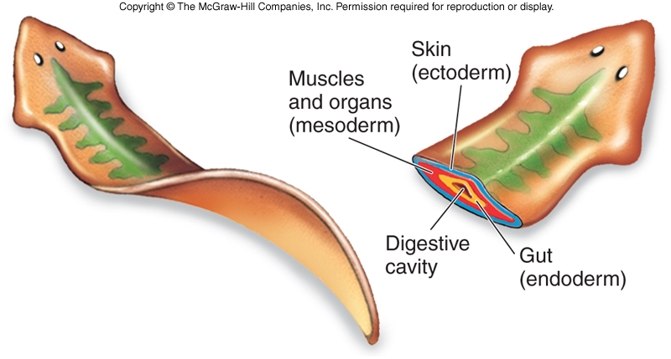
CHARACTERISTICS
Dorsoventrally flattened
Bilateral symmetry
3 germ layers: ectoderm, mesoderm, endoderm
Acoelomate
Increased cephalization (have a head)
Up to 20m long
Include: planarians, flukes, tapeworms

Slide 3
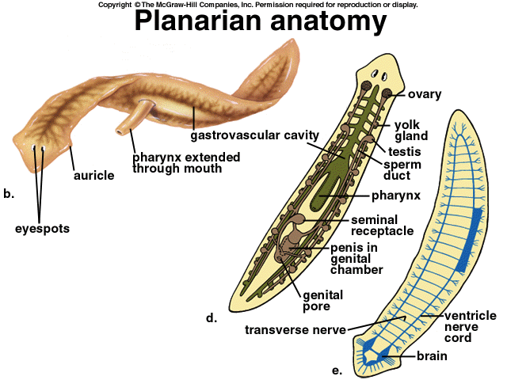
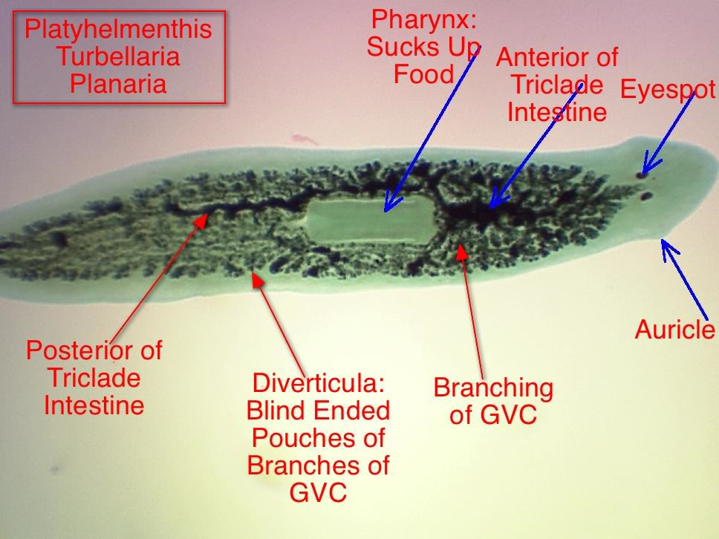
TYPES
Free-living, aquatic (ex. Planaria)
Carnivores or scavengers

Slide 4
Digestive system: one opening to pharynx to gastrovascular cavity to branching intestines (p.571 Fig. 26-25)
Mobility: move by cilia & muscle cells
Excretion: Fresh water flatworms have flame cells to deal with liquid waste
Nervous System:
simple brain with nerve cords (looks like a ladder)
Sensory cells sensitive to chemicals, light (ocelli or eyespots), & water flow direction
Circulation & Respiration: diffusion

Slide 5
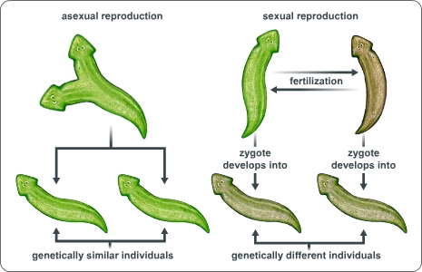
Reproduction:
Sexual (most hermaphroditic)
Asexual (fission)

Slide 6
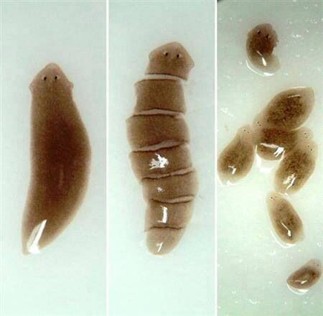
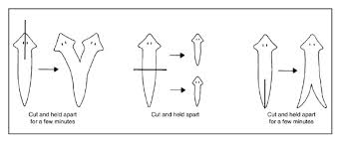
Regeneration

Slide 7
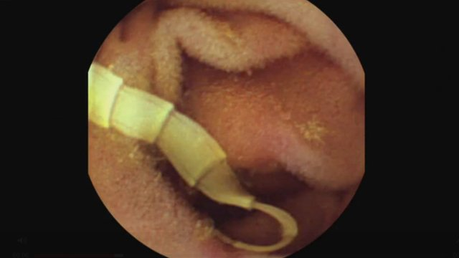
Parasitic (ex. Tapeworms)
Simplified digestive & nervous systems
For example: tapeworms have NO digestive or nervous system
Many have hooks/suckers on their head (scolex)
See Fig. 26-31 p. 575
Sexual reproduction
Most hermaphrodites
that fertilize themselves

Slide 8
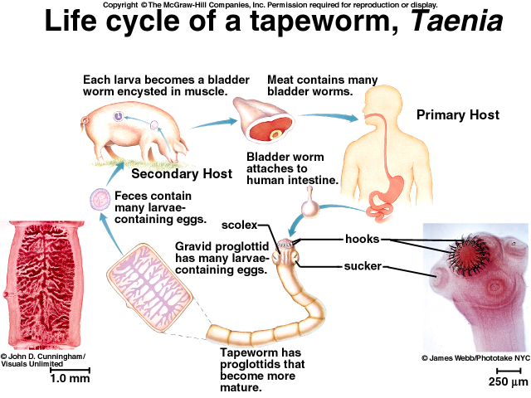

Slide 9
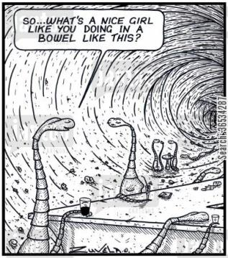
Ecological Roles
Scavengers
Some predators preying on smaller organisms
Most preyed upon by larger organisms
Some parasitic living off of a host or series of hosts, causing some degree of harm

