Slide 1
Phylum Porifera - Sponges
pp. 560-563

Slide 2
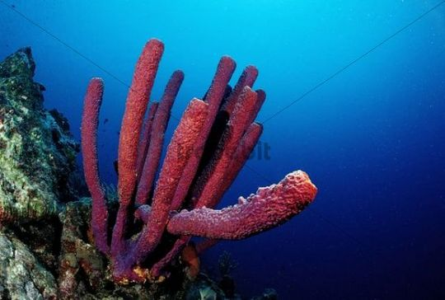
Body Plan
No tissues; specialized cells only
1000’s of small holes through which water enters = ostia
One large hole where water is expelled = osculum
2 germ layers with 3 body layers made up of:
Epithelial cells
Mesenchyme cells (= amebocytes)
Collar cells
Asymetrical
Acoelomate

Slide 3
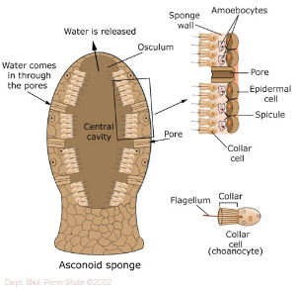
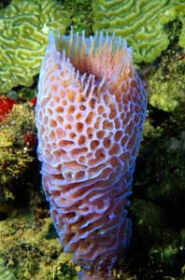
Anatomy

Slide 4
Digestion
Filter feeders
Water is beat in by collar cells’ flagella
Capture food particles from incoming water by phagocytosis
digestion occurs inside food vacuoles within the cells
50% of food is smaller than the smallest size seen by the light microscope!
Wastes are blown out through osculum

Slide 5
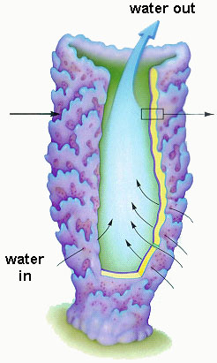
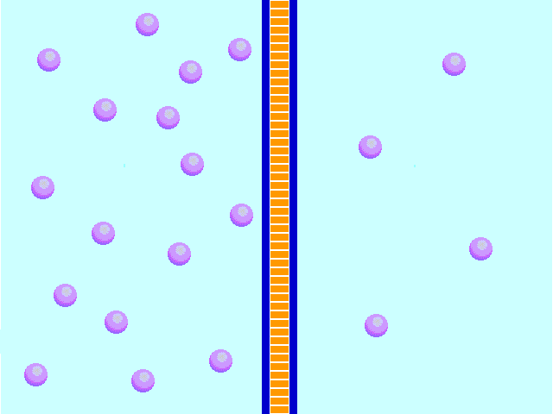
Respiration & Circulation
diffusion

Slide 6
Reproduction
Sexual
Mesenchyme cells produce eggs or sperm
Sperm is released into the water current
Asexual reproduction
By gemmules which can become dormant survive adverse conditions
By budding

Slide 7
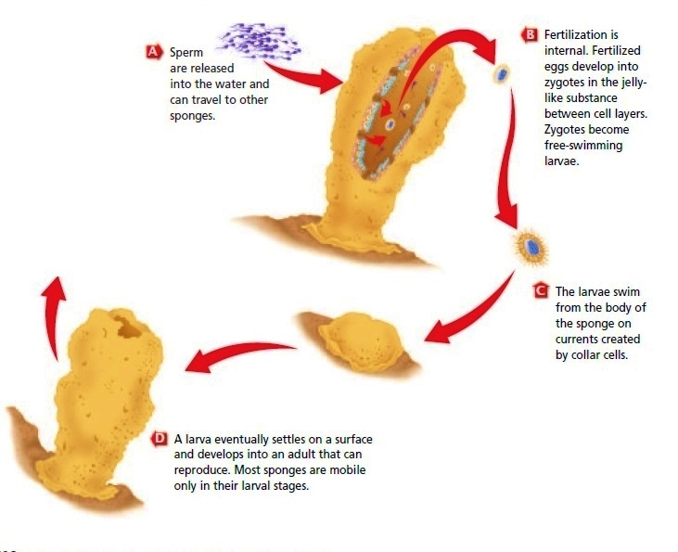

Slide 8
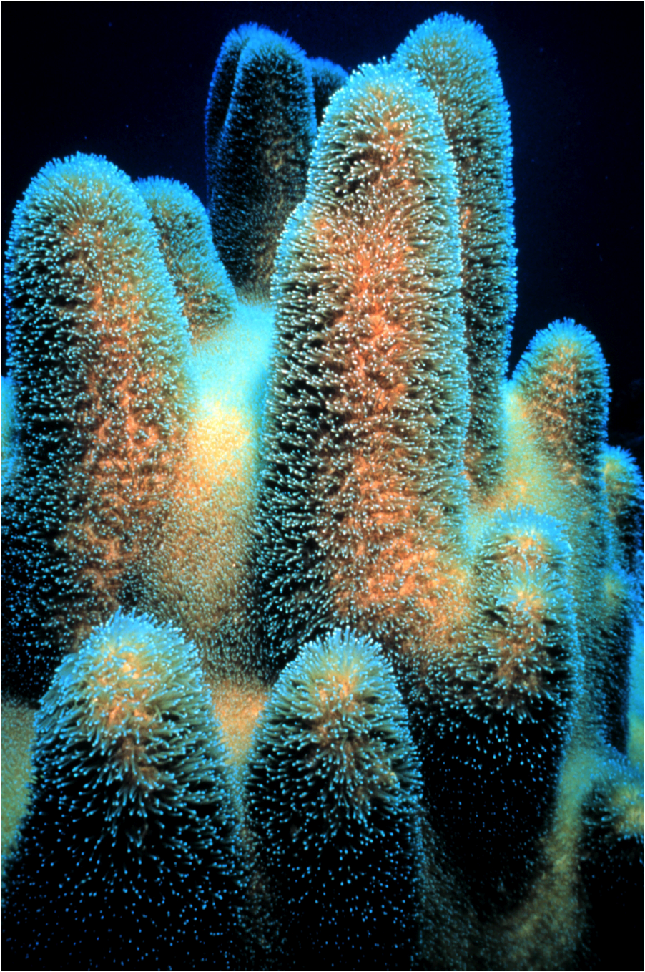
Mobility
Behaviour
No nervous system
No sensory or nerve cells
Adult is sessile (no movement)
Larva is free-swimming

Slide 9
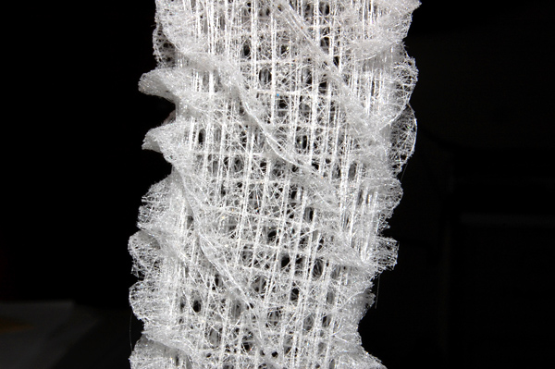
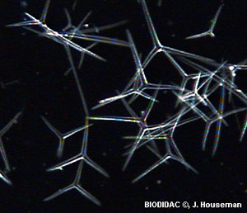
Support
Mesenchyme cells can produce spicules which provide support & protection

Slide 10
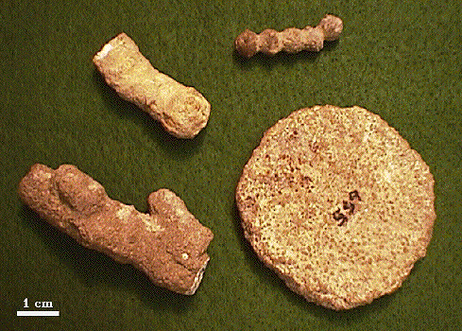
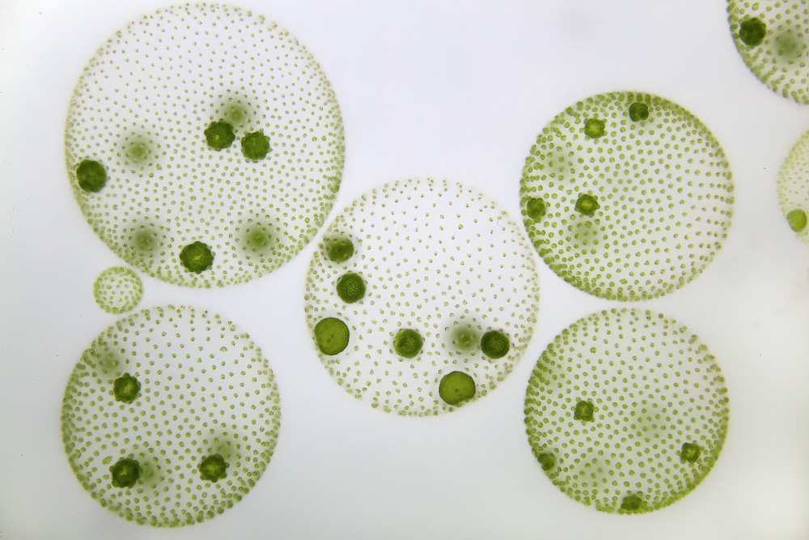
Evolution
Fossils date back 600 million years
Thought to have evolved from colonial, flagellated protists such as Volvox
They are a “dead end” as no higher order animal has evolved from them

Slide 11
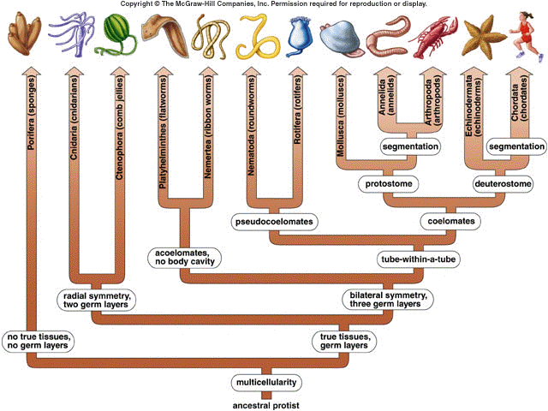

Slide 12
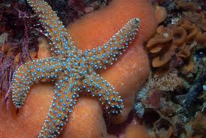
Ecological Role
Shelter/home for smaller animals
Symbiotic relationships with bacteria
Produce cytotoxins that have potentially anti-cancer, anti-bacterial, & anti-fungal properties
Food for snails, sea stars, fish

