Slide 1
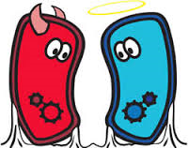
The Good & the Bad

Slide 2
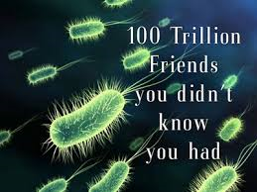
Importance of Bacteria
Ecological Role:
Some are producers which make oxygen
Some are decomposers that break down the nutrients in dead matter.
Some can converting nitrogen from the air into a form plants can use (nitrogen fixation)
2. Human uses:
foods and beverages
Sewage treatment
Cleaning up oil spills
synthesis of drugs and chemicals via genetic engineering
production of vitamins in human intestines

Slide 3
3. Pathogenic bacteria (parasites)
- either directly cause damage to cells/tissues (bacterial pneumonia) or produce toxins (tetanus)

Slide 4
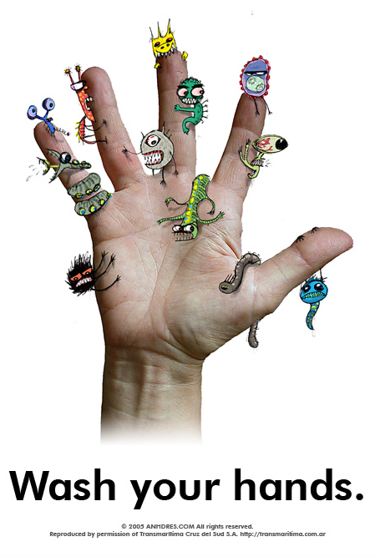
Defending Against Bacterial Infections
Prevention
Wash hands
Active immunity (vaccination)
Passive immunity
Food preservation
Use heat or chemicals (salt, sugar, acids, etc.) to slow down/stop bacterial growth
Includes: sterilization, refrigeration, cooking through, canning, freezing, drying

Slide 5
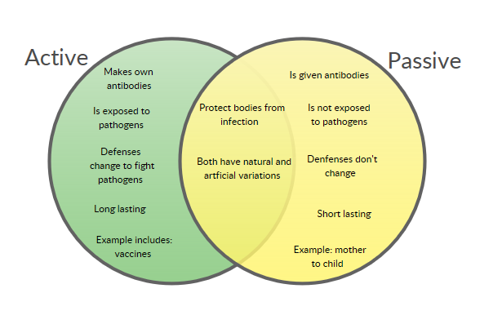
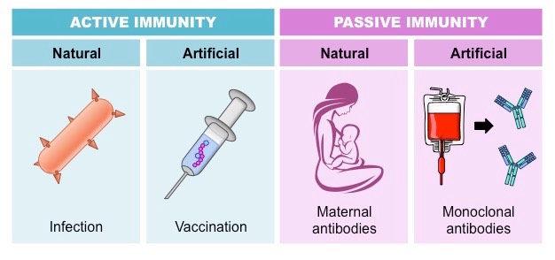

Slide 6
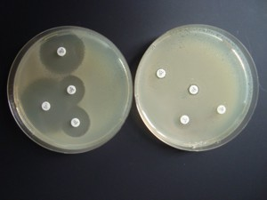
3. Antibiotics
Organic compounds made by living organisms that can kill or inhibit the growth of bacteria

