Slide 1
2.1 Characteristics of Living Things
p. 27 - 31

Slide 2
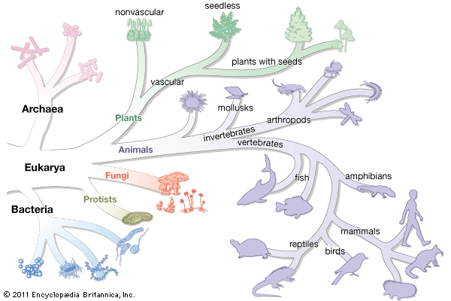
Organism: a living thing
All living things….

Slide 3
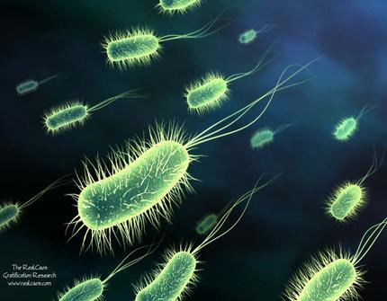
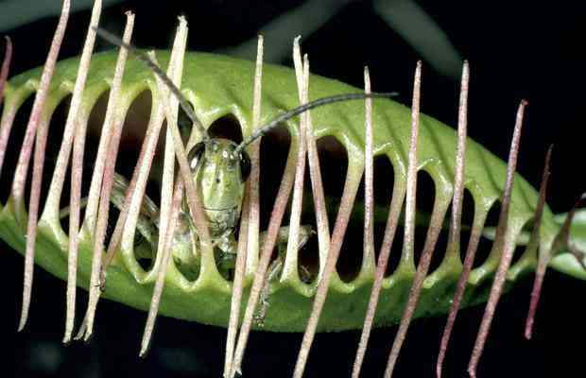
1. are made of one or more cells
Unicellular – made up of a single cell
Multicellular – made up of more than one cell
Note: The cell is the basic unit of life.

Slide 4
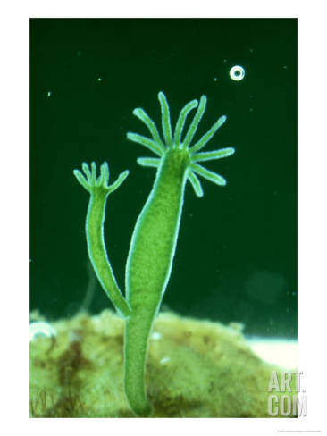
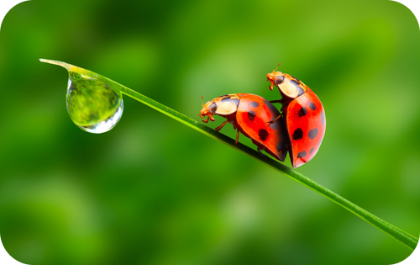
2. reproduce
Sexually – req. 2 different gametes
Asexually – req. only 1 individual

Slide 5
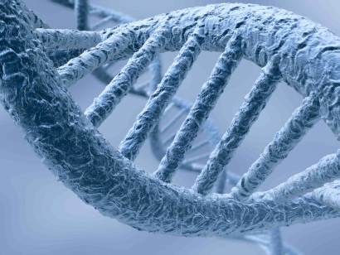
3. are based on a universal genetic code
DNA (deoxyribonucleic acid) that they inherit from their parent(s)

Slide 6
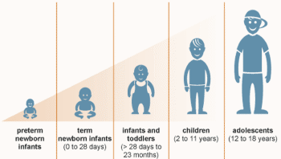
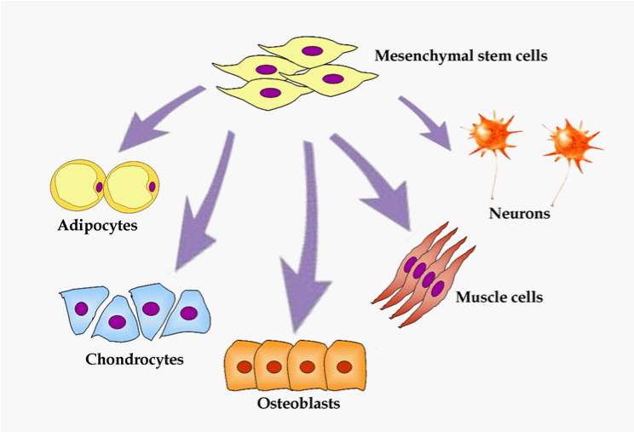
4. grow and develop
Growth results in an increase in size (mass).
Development results in different abilities.

Slide 7
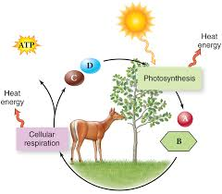
5. Obtain & use energy
Metabolism = the combination of chemical reactions by which an organism builds up or breaks down materials

Slide 8
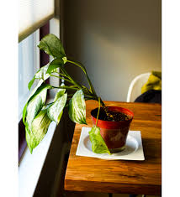
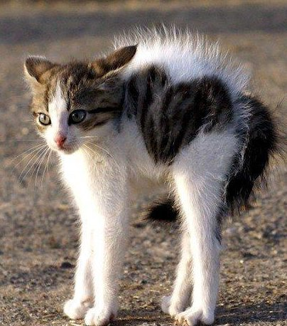
6. respond to their environment
Stimulus = signal to which an organism responds

Slide 9
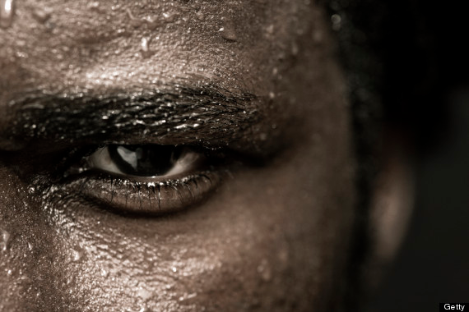
7. maintain a stable environment
Homeostasis = process by which organisms maintain a relatively stable internal environment (ex. temp., pH, etc.)

Slide 10
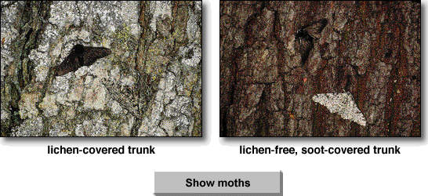
8. evolve as a group
organisms change over time to help the species survive in an every changing world

