Slide 1
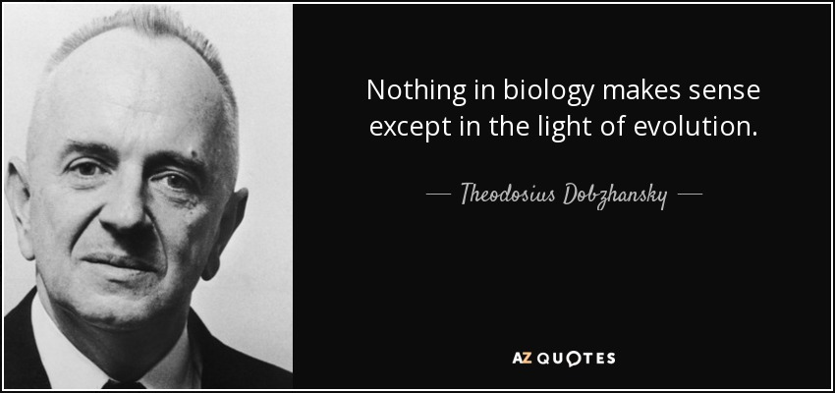
Ch. 14: Evolution: How Change Occurs
p. 290-317

Slide 2
Evolutionary Theory = a collection of carefully reasoned & tested hypotheses about how evolutionary change occurs
“A living group is but a link between a dead ancestor & an unborn progeny”

Slide 3
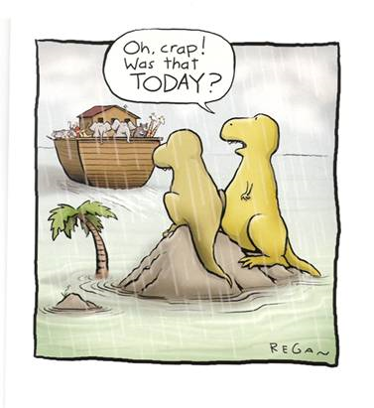
Early Views of the Origin of Species
Hypothesis I:
“fixity of species” - all plants and animals had been placed on the Earth at its beginning & none have ever changed
Aristotle believed species were fixed creations arranged by their complexity
Idea lasted 2000 years

Slide 4
2. Hypothesis II:
Life has changed over time
HOW?
Lamarck’s Theory
1809
B. Darwin’s Theory
1859

Slide 5
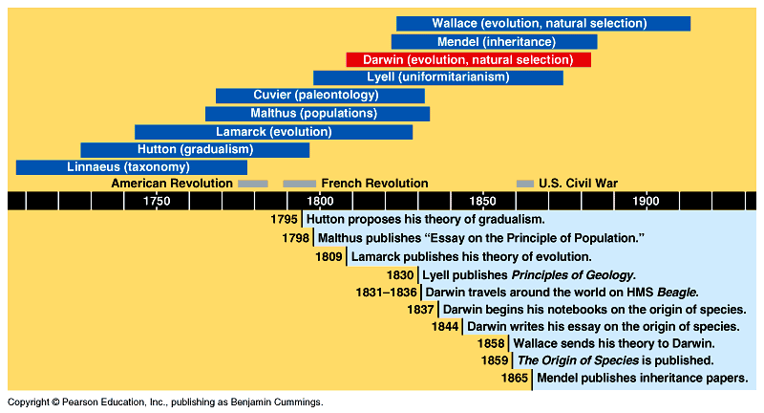
Evolutionary Timeline

Slide 6
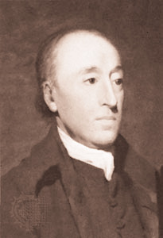
1. Hutton’s Theory of Geological Change
Darwin’s Influences:
Changes in Earth’s crust due to slow continuous processes (erosion, earthquakes, volcanoes…)
A.K.A. Gradualism

Slide 7
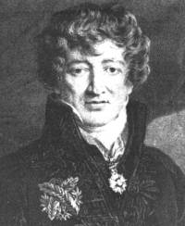
2. Cuvier - Catastrophism
Found some species completely disappeared in more recent geological layers
Stated that species disappear due to a catastrophic event (volcano, earthquake…)

Slide 8
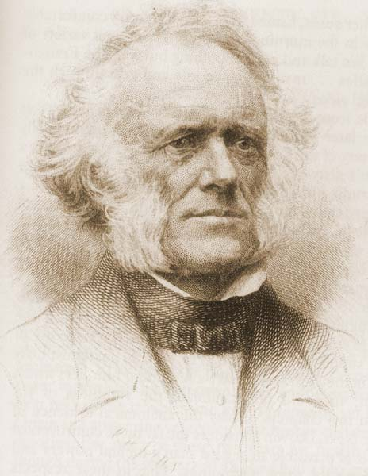
3. Charles Lyell
Proposed theory of Uniformitarianism
Geological processes at uniform rates building & wearing down Earth’s crust
Proposed that the Earth was millions of years instead of a few thousand years old

Slide 9
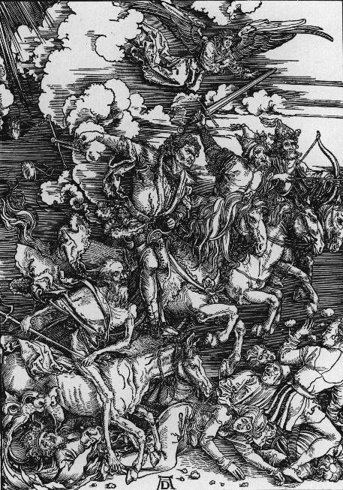
4. Thomas Malthus - Population Growth
Noted # of babies born > # of people dying
high birth rates & limited resources would force life & death competition
each species struggles for existence
Death rate will increase to balance population size & food supply

Slide 10
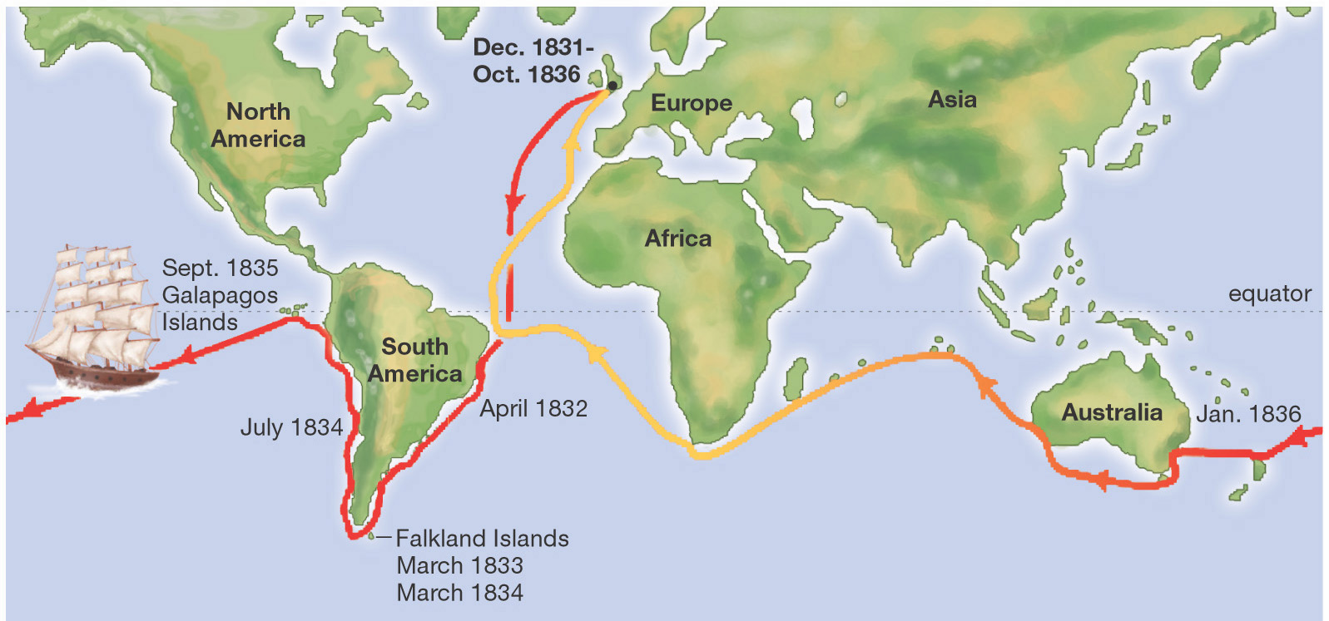
Darwin Left England in 1831
Voyage of the Beagle
Darwin returned 5 years later in 1836

Slide 11
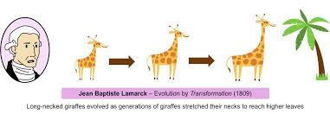
5. Lamarck’s Theory (1809) – 2 points
“Law of Use & Disuse” – The parts of the organism that are used develop more than those that are not used
“Inheritance of Acquired Characteristics” – developed traits are passed onto their children

Slide 12
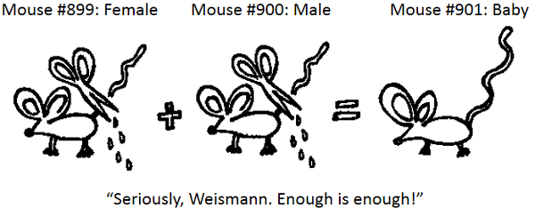
Example: Stretching a piece of anatomy during the parent’s life results in stretched parts in the children.
Disproving Lamarckism :
- In 1891, August Weismann cut the tail off ~ 20 generations of parent mice resulting in NO change in their children.

Slide 13
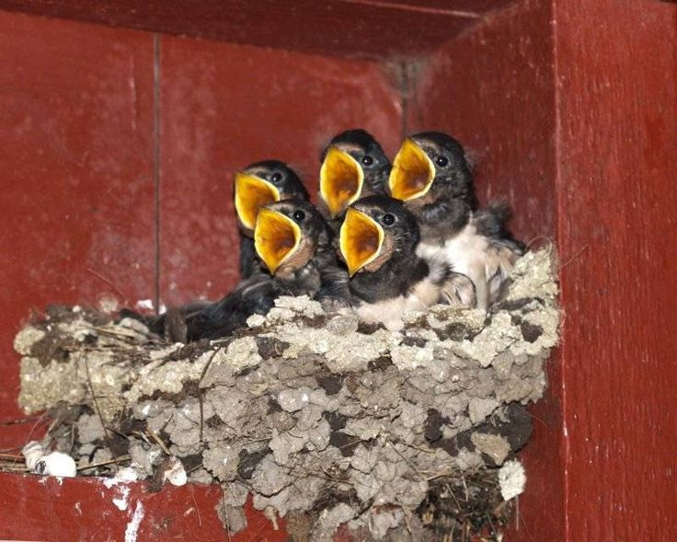
Darwin’s Theory (1859) – 5 points
“Struggle for Existence” = competition between living things to survive
- idea developed after studying Malthus’Principle of Population
- always more young are produced than the environment can support

Slide 14
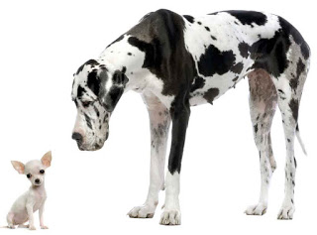
ii) Variation within a population (Artificial selection & farmers in England) – all organisms of the same species differ slightly
Canis domesticus

Slide 15
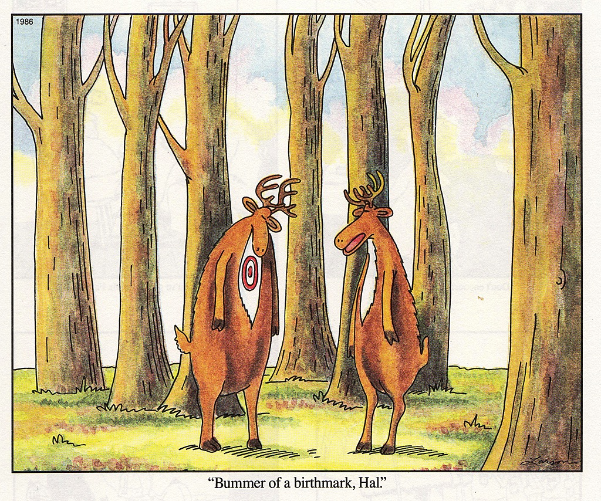
iii) Survival of the fittest – the most “fit” survive the competition
*organisms with less favourable traits do not reproduce as quickly, and in time, they become extinct

Slide 16
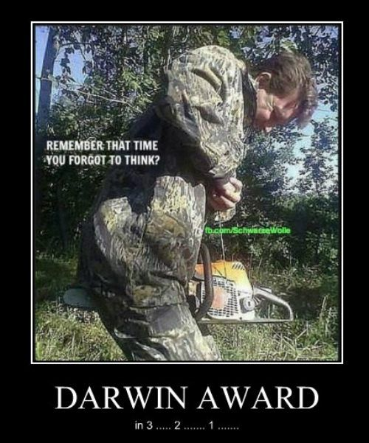
iv) Inheritance = fittest reproduce & pass their special characteristics on to their children

Slide 17
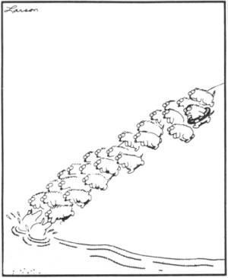
v) Consequently, over enormous spans of time, small changes accumulate & populations change = evolution
Evolution = change in the relative frequency of alleles in a population’s gene pool

Slide 18
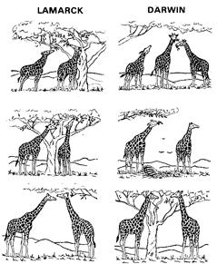

Slide 19
Publication of “On The Origin of Species”
Darwin refused to publish his findings until he received an essay from Alfred Wallace
fellow naturalist
independently developed the same theory
after 25 years, someone else had come to the same conclusions from their observations of nature

Slide 20
WHY?
Darwin knew that his theory would be extremely controversial and would be attacked
his theory challenged established religious & scientific beliefs, particularly about the creation of man

