Slide 1
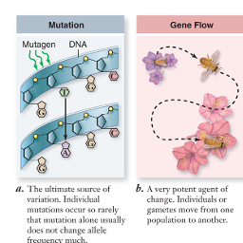
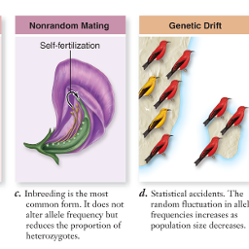
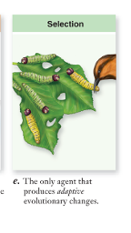
5 Agents of Evolutionary Change

Slide 2
1. Mutation p.212-214
= sudden, inheritable change to DNA
Caused by:
Radiation – alpha, beta, gamma, x-ray, UV
Chemicals – food additives, pesticides, herbicides, nicotine
Spontaneously through DNA replication
Can be positive, negative, or neutral
Creates genetic variation

Slide 3
Location of mutation:
Germline (aka. Germinal) mutations
Occur in sperm and/or egg
Passed onto offspring
Examples: Cystic fibrosis, Tay-Sachs, hemophilia, certain breast cancers, retinoblastomas?, neuroblastomas?
2. Somatic mutations
Occur in cells other than gametes
Change is passed onto cells of that type
Example: cancers like melanoma, liver cancer, lung cancer

Slide 4
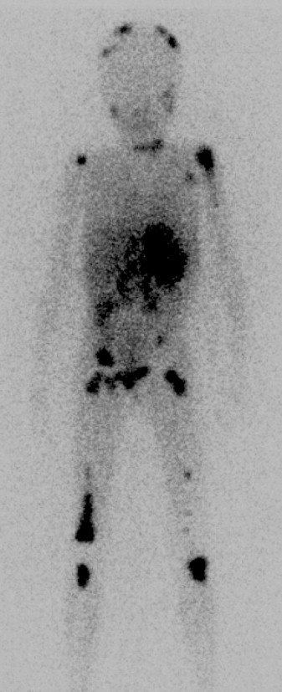
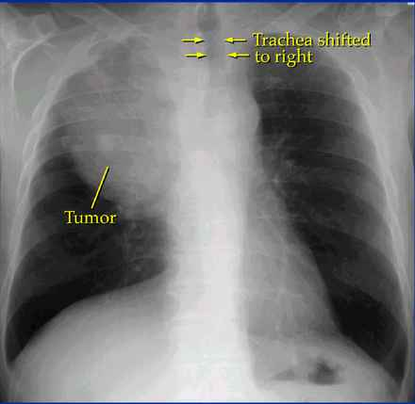

Slide 5
Mechanics:
A) Gene mutation
A change in the nucleotide sequence
3 types:
1) Substitution
ATTGCG → ATGGCG
2) Insertion
ATTGCG → ATGTGCG
3) Deletion
ATTGCG → ATGCG
Example: Sickle cell anemia
p. 213 Fig. 10-13

Slide 6
B) Chromosomal mutation
Change in the number or structure of the chromosomes
b/c chromosomes tangle, break & reconnect in diff. orders & lengths
4 types:
Deletion p. 212
Duplication p. 212
Inversion p. 212
Translocation p. 213
Ex) Down’s Syndrome (Trisomy 21)

Slide 7
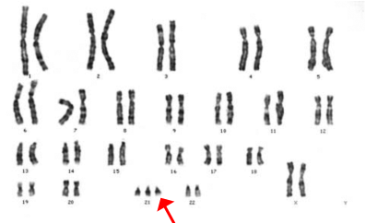
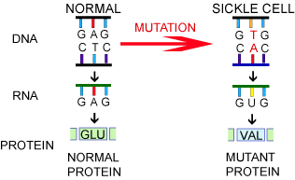
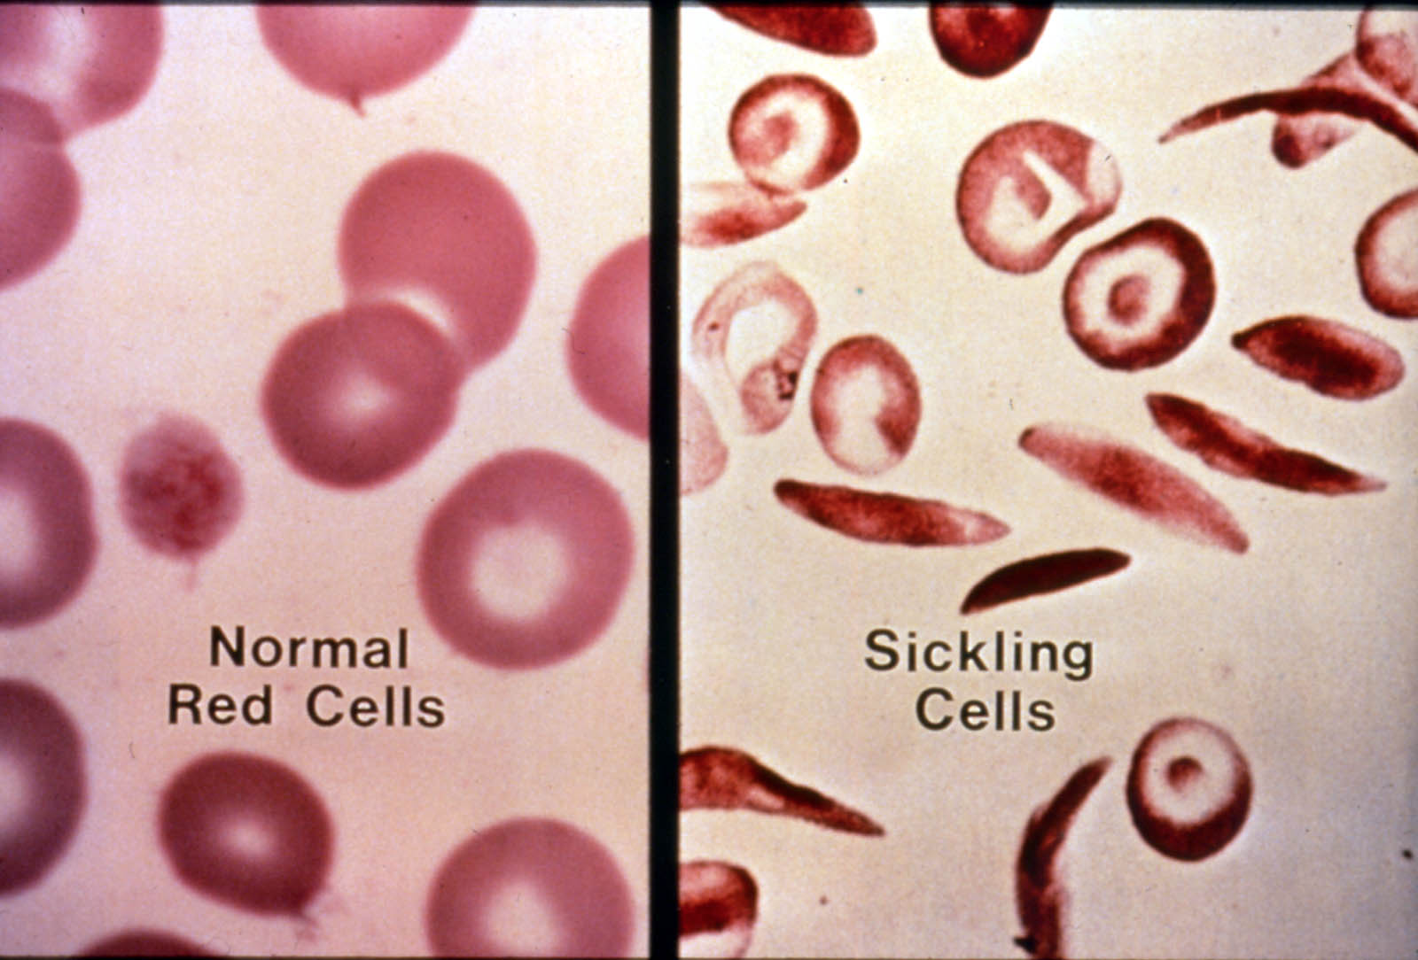

Slide 8
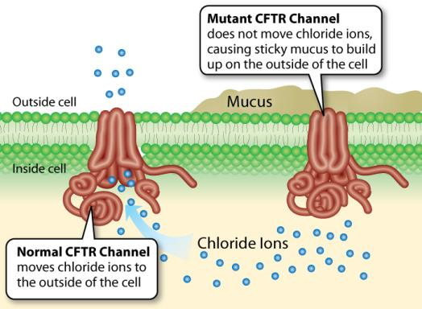
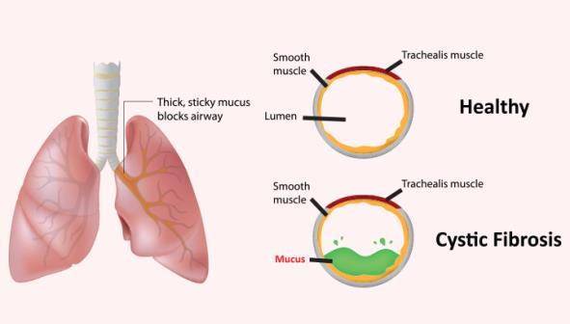
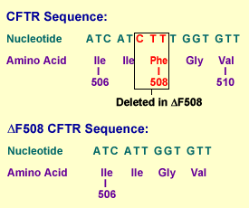
Cystic fibrosis
-mutation of the gene for the chloride channel in the lungs

Slide 9
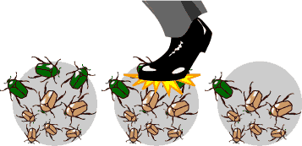
2. Genetic Drift p. 310-311
= random circumstance causes a certain genetic trait to become more common or rarer over time
Can produce evolutionary change
not caused by environmental or other kinds of stresses on individuals
Easier seen in small populations

Slide 10
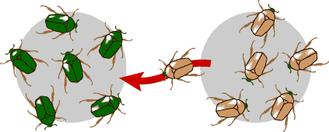
3. Gene Flow (aka: migration)
= any movement of genes from one population to another
If new genes are brought in, it can create new genetic variation
Can make populations more similar to each other
Example: If all red haired people left Scotland, the next generation would likely have very few people with this trait. The Scottish population would have evolved as would the populations into which the red haired people migrated.

Slide 11
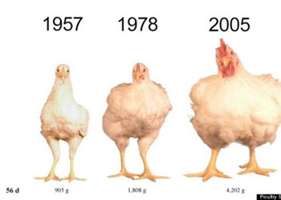
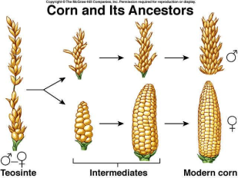
4. Non-random Mating (w.r.t. alleles!)
= some individuals have more opportunity to mate than others
For example:
Assortative mating: mating between individuals with similar phenotypes (“like” mates with “like”)
Artificial selection: humans breed animals and plants for particular traits

Slide 12
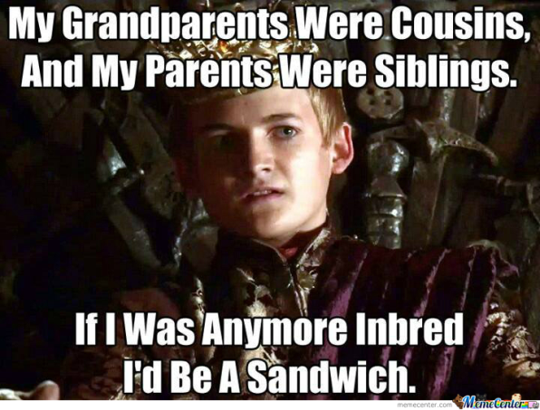
Inbreeding: reproduction of closely related animals over multiple generations

Slide 14
5. Natural Selection
Affects variation in a population as the better adapted (more fit) individuals survive and reproduce, passing on their genes to the successive generations.
Acts only upon an organisms phenotype.
Preserves favourable traits & eliminates unfavourable ones

Slide 15
