Slide 1
Life Science 11
Selecting and Citing Sources
Mrs. Sharp

Slide 2
How to locate and access information
Consider the following when starting to research a topic?
Consider what you already have – class notes, textbooks, etc.
Search the library catalogue for available print resources
Search the internet for available web-based resources
With every resource - always ask: “How current is this?” and “How reliable is the author?”
Use the CRAAP Model to help you to determine this.

Slide 3
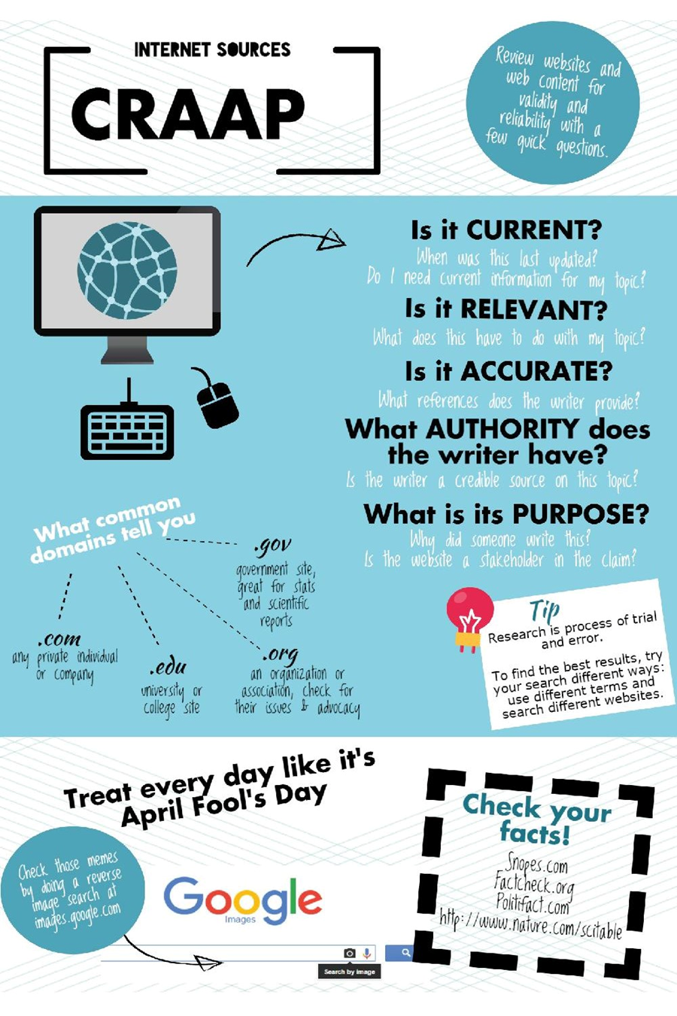
Apply the CRAAP test for each of your sources to ensure you are using quality sources.

Slide 4
Evaluating Sources
Other factors to consider:
Errors in spelling and/or grammar
Use of acronyms that are not explained (i.e. IUNC)
Use of quotes from another source – are they taken out of context?

Slide 5
Evaluating Sources
Other factors to consider:
Use of ‘loaded words/phrases’ (i.e. supposedly, hypocrisy, … all people know…, …
Use of absolutes (i.e. always, never, all, none, etc.)
Are the statements fact OR opinion? How can you tell?

Slide 6
Evaluating Sources
Other Factors to Consider:
Is the source peer-reviewed?
Reference list is missing
Works are referenced in discussion, but not included in their reference list
What sources are on their reference list? Varied OR limited? Many OR few? Own work?

Slide 7
WHAT IS A SCHOLARLY/PEER REVIEWED ARTICLE?
Peer review is a well-accepted indicator of quality scholarship.
It is the process by which an author's peers read a paper submitted for publication. Several recognized researchers in the field will evaluate an article and recommend its publication, revision, or rejection.
Scholarly articles are peer reviewed by experts in each field for validity, originality, clarity, completeness, and bibliographic honesty.
The articles are signed, bibliographies are extensive, and articles appear in journals that are published by academic and scientific societies.

Slide 8
Use a variety of search engines: Google, FireFox, Duck Duck Go
Use unique terms that are specific to the subject you are researching.
Use the ‘Advanced’ search settings.
Use multiple tabs for your search process so you can easily flip back and forth between them.
Have your chosen citation generator open in a separate tab, so each time you find a website that is useful you can add it to your list of citations.
Helpful hints when searching online

Slide 9
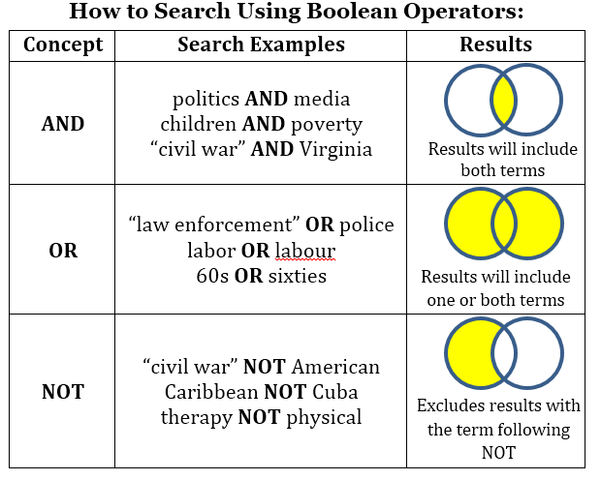
Search Strategies
Another Strategy … the use of “around”
Using around in your search will ensure that the terms you are searching for show up within the designated number of words.
Eg. “Kennedy” around 10 “moon”
All search results will have the terms Kennedy and moon within 10 words of each other.

Slide 10
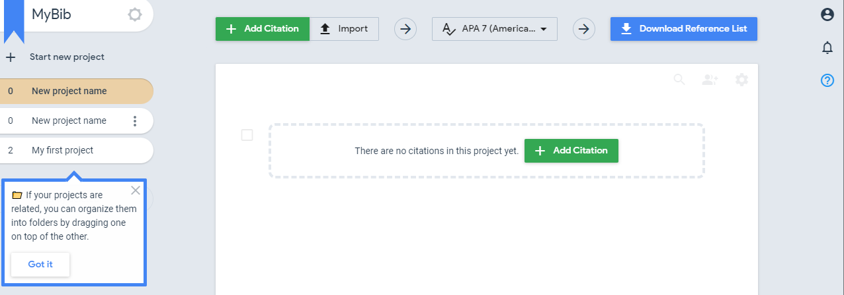
Citation Generator – wwwmybib.com
STEP ONE:
Create a free account – you can then save all the different reference lists for your different classes.
Click on the three dots by ‘My first project’ and rename it to reflect the assignment.

Slide 11
STEP TWO: * Select which style of citation: APA 7 for sciences * Select the type of source: Website, Book, Journal, etc. * Copy and paste OR enter the requested information for your selected source – i.e. web address, title, title of article, etc. Then enter SEARCH.

Slide 12
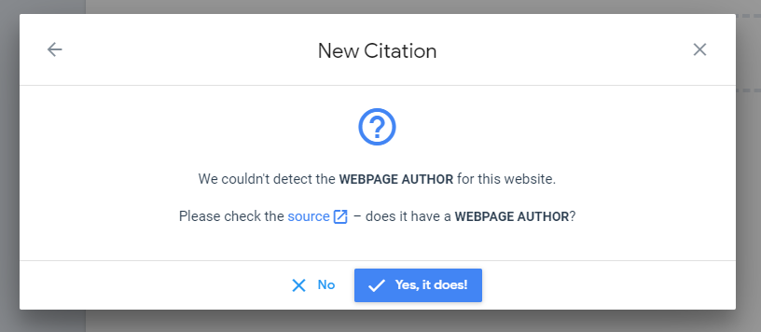
STEP THREE:
Select your source from
the list provided.
Depending on your source, you may be asked for more information. Refer to the source and add in any additional information that you can.
Once you have added in any additional, click SAVE and the citation will be added to your Reference List.

Slide 13
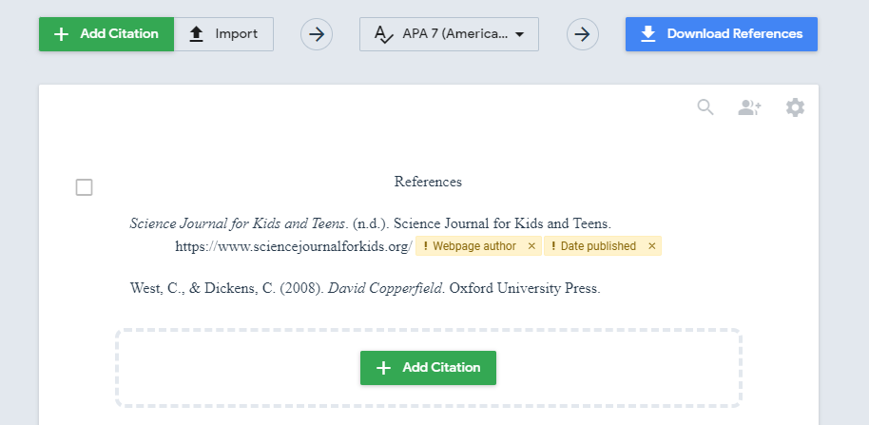
STEP FOUR:
To add another citation, select
+ Add Citation.
Select your source (click MORE to find other types of sources) and enter the requested information.
Repeat the same process as above and SAVE your new
citation.
Your reference list will be updated.
Continue to add citations until you are done.

Slide 14
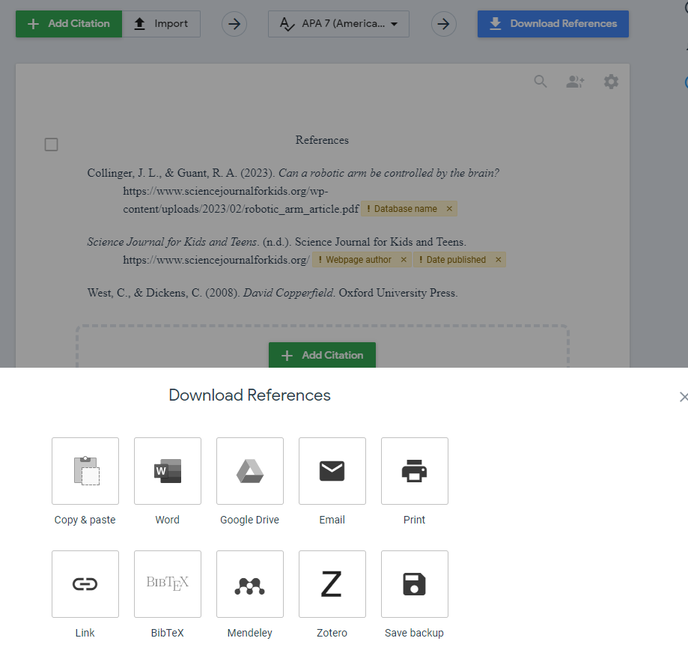
STEP FIVE:
With Reference list completed, select Download Reference List and select where to send your completed reference list.
Attach your reference list to your project and share/email/print your completed project.

