Slide 1
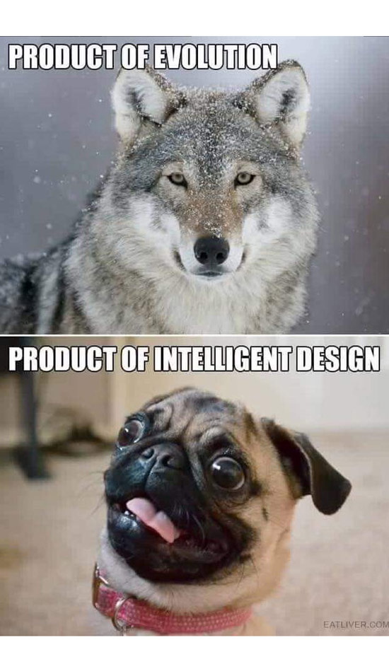
Human Interference in Selection

Slide 2
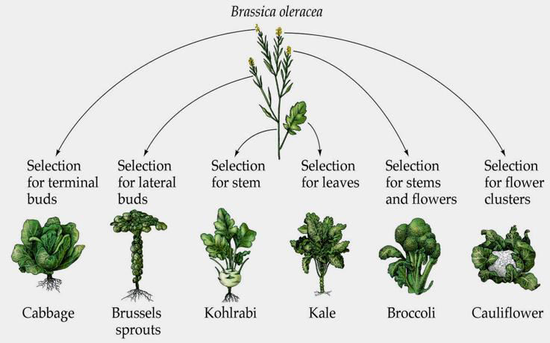
Artificial Selection
a.k.a. Selective breeding
is when humans, rather than the environment, decide which traits are useful

Slide 3
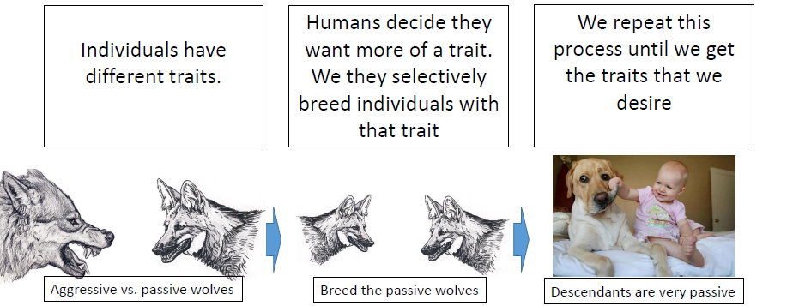
Artificial and natural selection work on exactly the same principles
We then selectively

Slide 5
Inbreeding & Genetic Diversity
Genetic diversity is important
Too much similarity and they become vulnerable to diseases and other health issues
Inbreeding is useful for getting the traits that we want, but also increases the chances that they will suffer debilitating problems

Slide 6
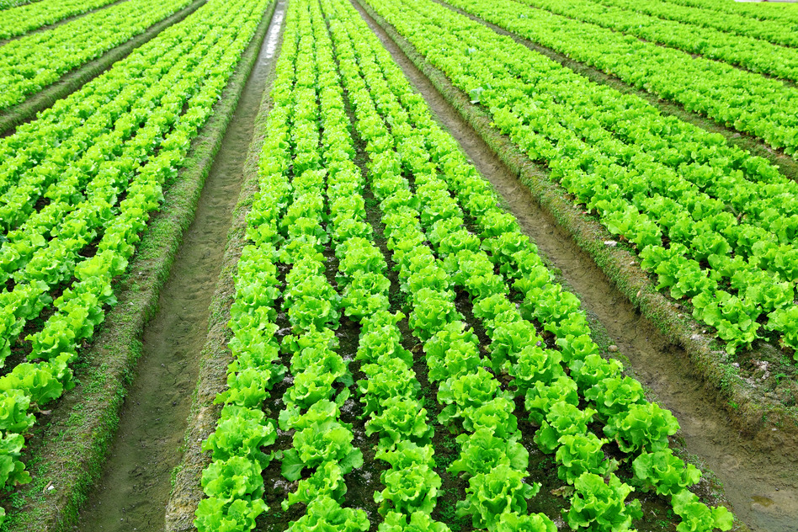
Creates monoculture
vast tracts of farmland that are occupied by identical individuals
These crops are very susceptible to pests and diseases, because without diversity what works on one plant will work on all of them

Slide 7
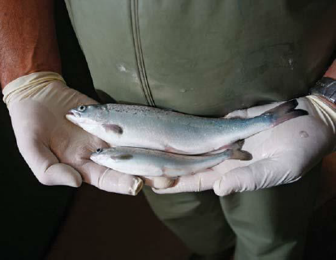
Modern Techniques
Can alter the DNA of living organisms
These are known as “genetically modified organisms” or “GMO”s.
There is currently a lot of debate over GMOs.

Slide 8
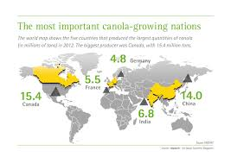
Example:
Bayer CropScience produces genetically modified canola for the Canadian market. It is produced to resist the herbicide “Liberty” and can yield up to 20% higher than conventional canola.

Slide 9
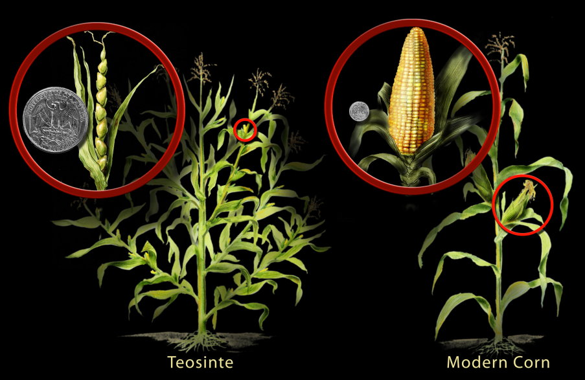
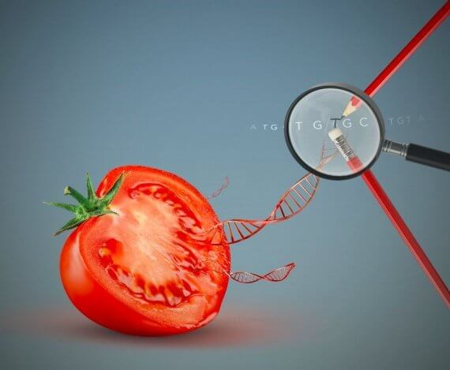
Artificial Selection vs. GMOs
Artificial Selection:
-slow
-imprecise
-modification of genes that naturally occur in the organism
GMOs:
-very fast
-precise
-can introduce genes into an organism that would not occur naturally!

Slide 10
