Slide 1
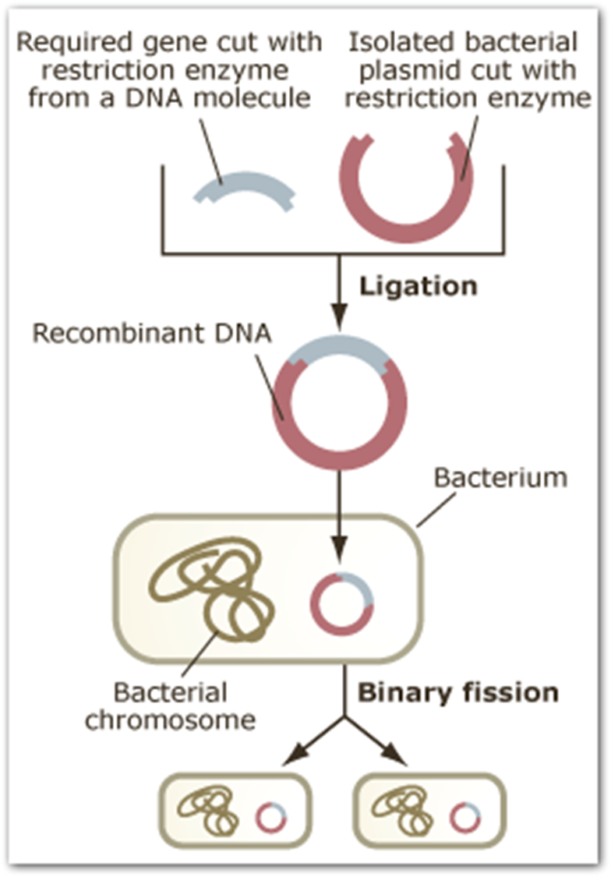
Recombinant DNA Technology

Slide 2
Recombinant DNA Technology
Some bacterial chromosomes are rings (plasmid)
restriction enzymes break this ring
add in another organism’s chromosomes
DNA fragments are joined together (ligation)
Placed into a bacterium
the chromosome is replicated perfectly & passed on to new generations
So you can acquire many copies of the desired genes

Slide 3
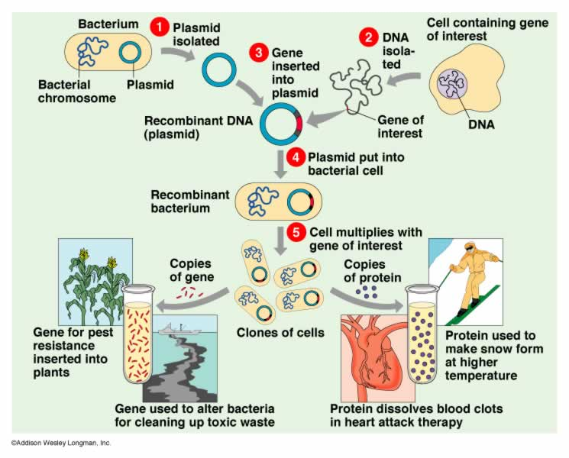

Slide 4
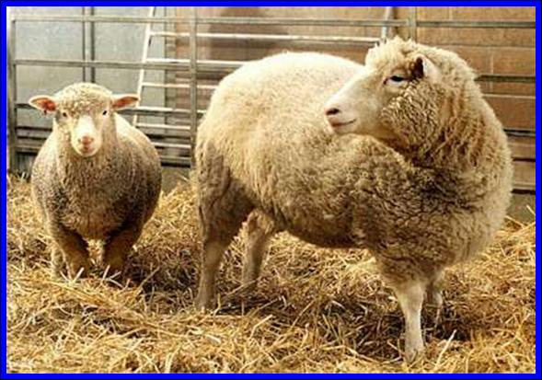
Applications include:
Synthesizing human insulin, HGH (human growth hormone), blood clotting factor VIII
Developing hepatitis B vaccine
Production of antigens to aid in diagnosis of viral diseases
Herbicide-resistant crops
Insect-resistant crops
NOTE: This is not the type of cloning that resulted in Dolly (reproductive cloning) or clones human embryos (therapeutic cloning) which is a controversial area of stem cell research.

Slide 5
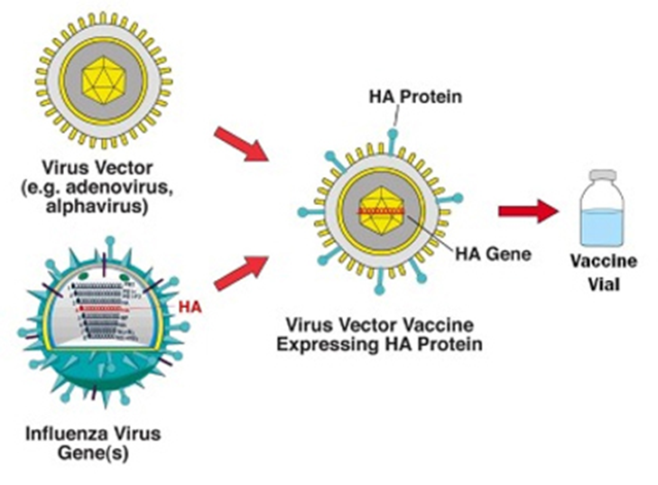

Slide 6
