Slide 1
The Microscope Appendix C pp.4-5
In the 17th Century, Anton Von Leeuwenhoek designed the first simple microscope.
There are different types of microscopes:
Simple microscopes
use beams of light
have one lens
magnify 10X or more; but limited
Can view living cells

Slide 2
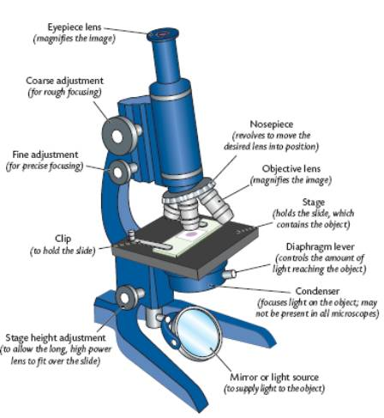
Compound microscopes
use beams of light
have two or more lens
magnifies up to 2000X
Can view living cells

Slide 3
Electron microscopes - use beams of electrons - cannot view living cells
TEM (transmission electron microscope) | SEM (scanning electron microscope)
magnifies 2 000 000X | does NOT magnify as much as TEM
examines INSIDE a specimen | examines OUTSIDE a specimen
must use VERY thin sections | thickness does NOT matter
images in 2D | images in 3D

Slide 4
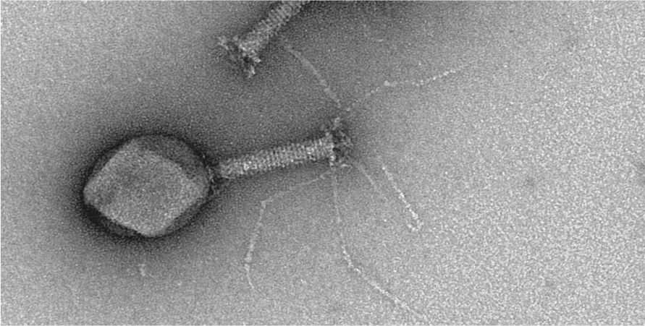
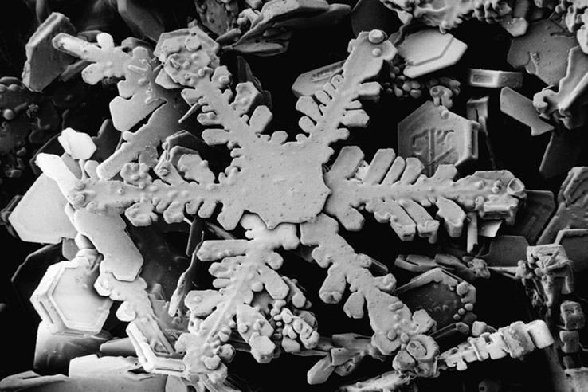
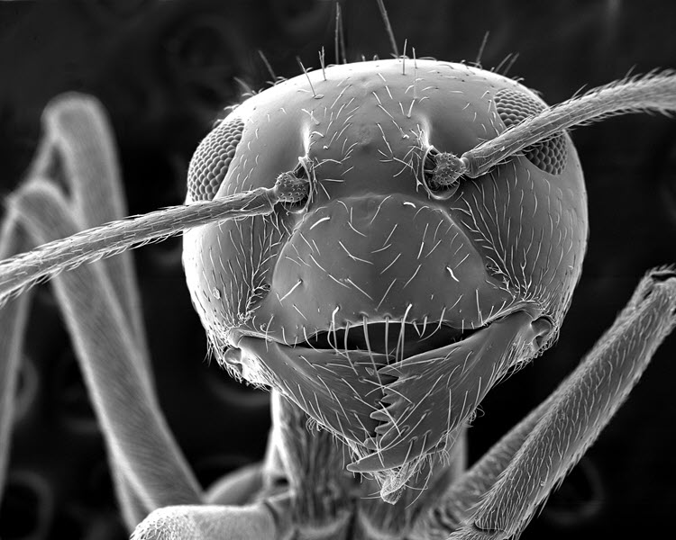
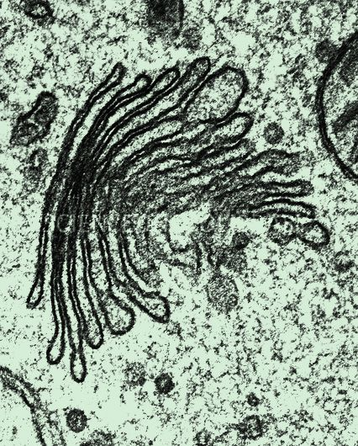
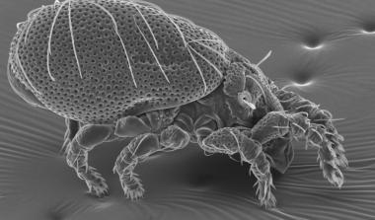
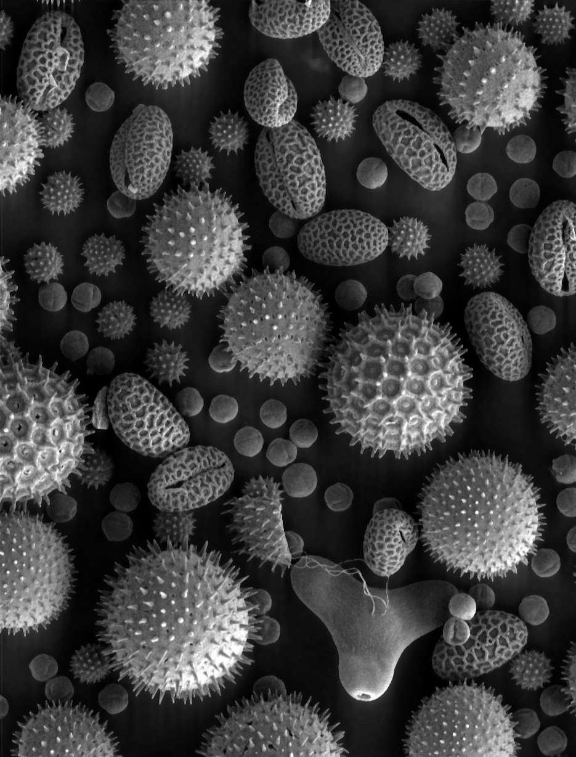
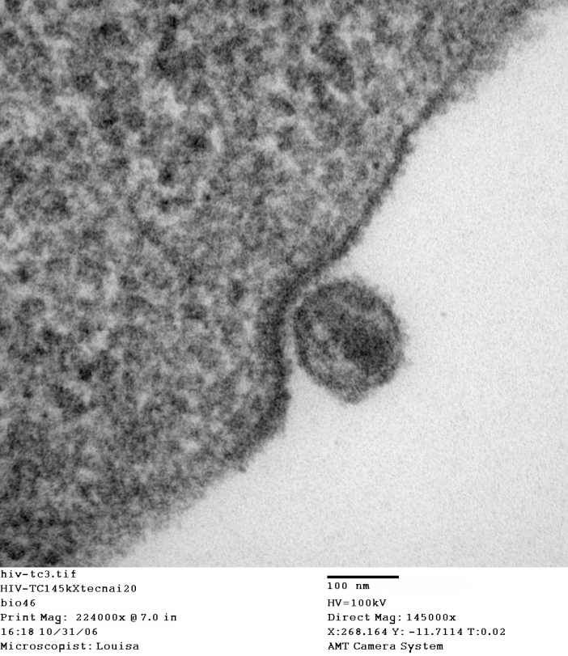
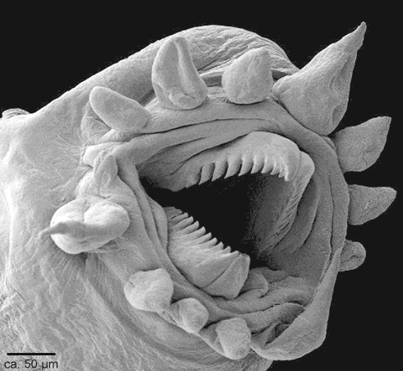

Slide 5
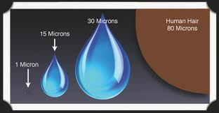
How Big is a Micron?

