Slide 1
Phylogenetic Trees & Cladograms
Many biologists use these terms interchangeably
Both are based on ancestral relationships
Both show how alike or similar organisms might be.

Slide 2
Phylogeny - the evolutionary history for a group of species.
Uses evidence from living species - morphology (ex. homologous structures), fossil record, and biochemistry (ex. DNA)
shown with branching tree diagrams = phylogenetic trees or evolutionary trees

Slide 3
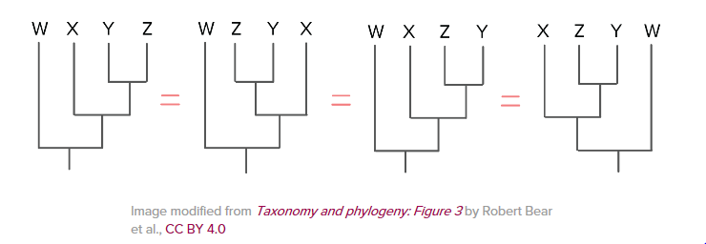
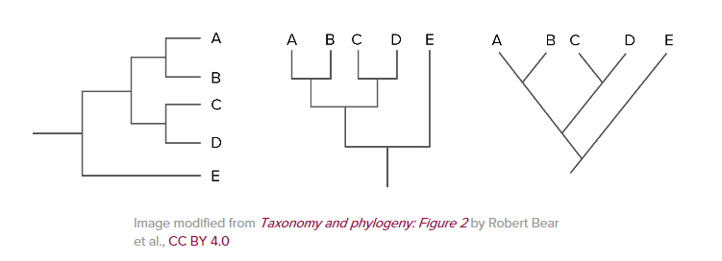
Phylogenetic trees drawn in many different formats:
NOTE: It is not the order that matters rather the branching patterns!
Phylogenetic can be rotated:

Slide 4
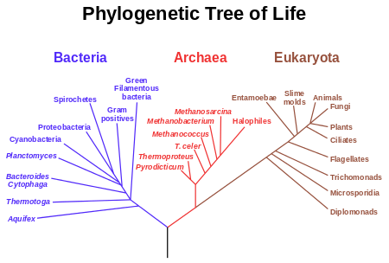
Complete “Missions 1 and 2” of the virtual evolution lab

Slide 5
Cladistics – A method of classifying organisms into groups of species called clades
Clade – is a group of species that shares a common ancestor.
Members of a clade will possess common characteristics as a result of their shared evolutionary lineage

Slide 6
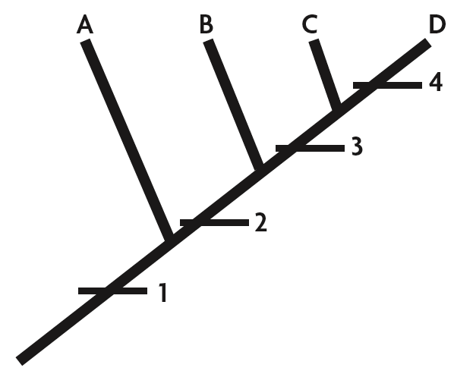
Cladograms are a common method of making evolutionary trees.
based on derived traits
species placed in order that they descended from common ancestor
made up of dichotomous branches

Slide 7
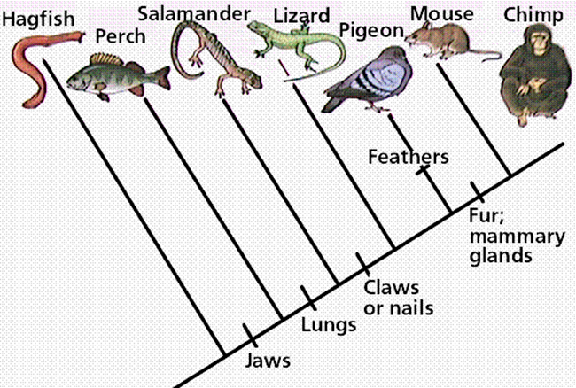
Ancestral or Primitive Trait: A characteristic that evolved in a common ancestor.
For ex.) Jaws is an ancestral character of the perch and the chimp.

Slide 8
Derived Trait: A characteristic that evolved within one group but not another.
derived traits are represented on cladogram as hash marks or dots
For ex.) Fur and mammary glands evolved in an ancestor of mice that was not also ancestral to pigeons

Slide 9
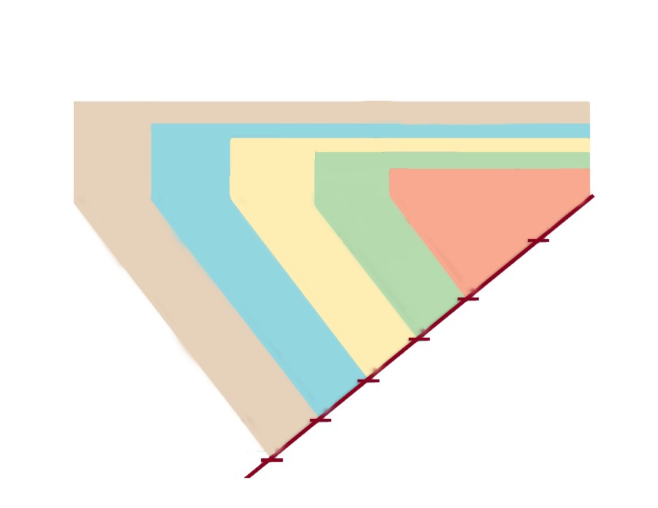
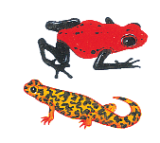
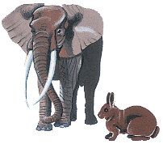
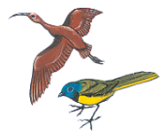
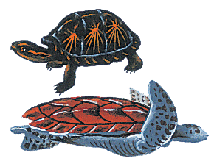
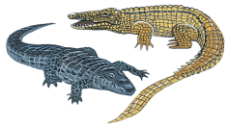
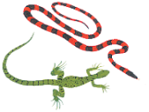
more closely related species share more derived traits
1
Tetrapoda clade
2
Amniota clade
3
Reptilia clade
4
Diapsida clade
5
Archosauria clade
FEATHERS & TOOTHLESS BEAKS.
SKULL OPENINGS IN FRONT OF THE EYE & IN THE JAW
OPENING IN THE SIDE OF THE SKULL
SKULL OPENINGS BEHIND THE EYE
EMBRYO PROTECTED BY AMNIOTIC FLUID
FOUR LIMBS WITH DIGITS
DERIVED CHARACTER

Slide 10
Structure of a Cladogram:
Node – a branching point that represents divergence from a hypothetical common ancestor; a speciation event
Root - an initial ancestor common to all organisms within the cladogram (incoming line shows it originated from a larger clade)
Outgroup – The most distantly related species in the cladogram. Functions as a point of comparison.

Slide 11
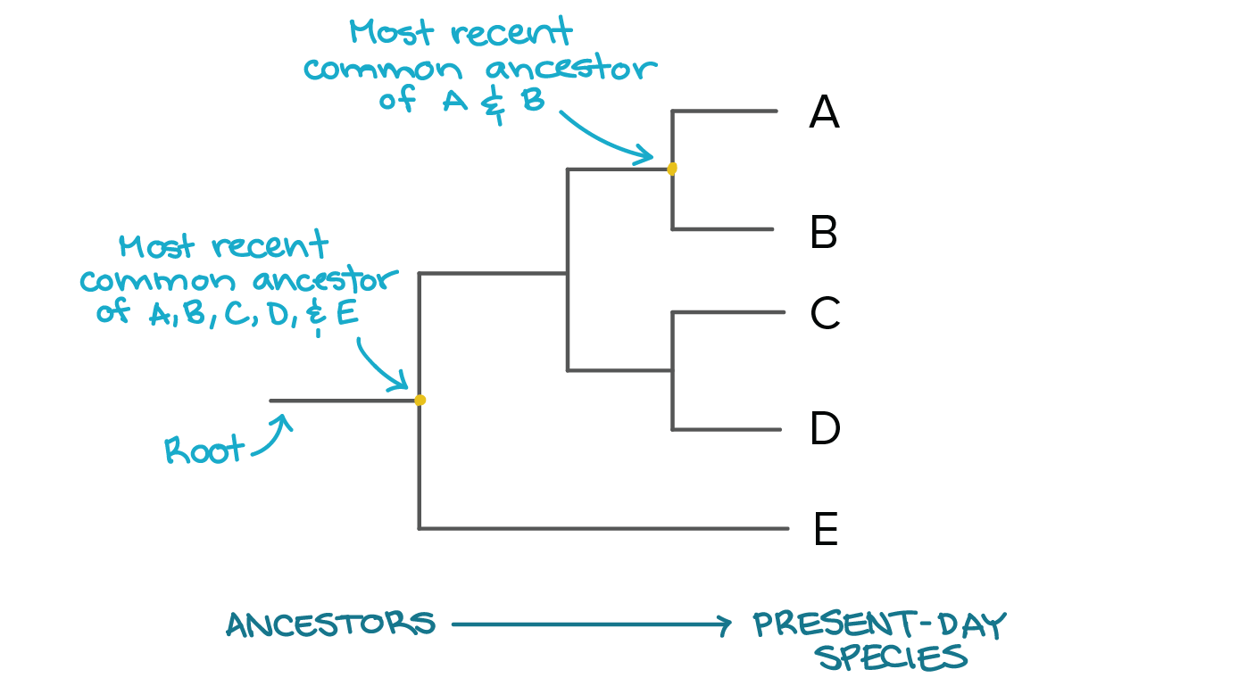
At each node lies the most recent common ancestor of all the groups descended from that branch point.
For example:

Slide 12
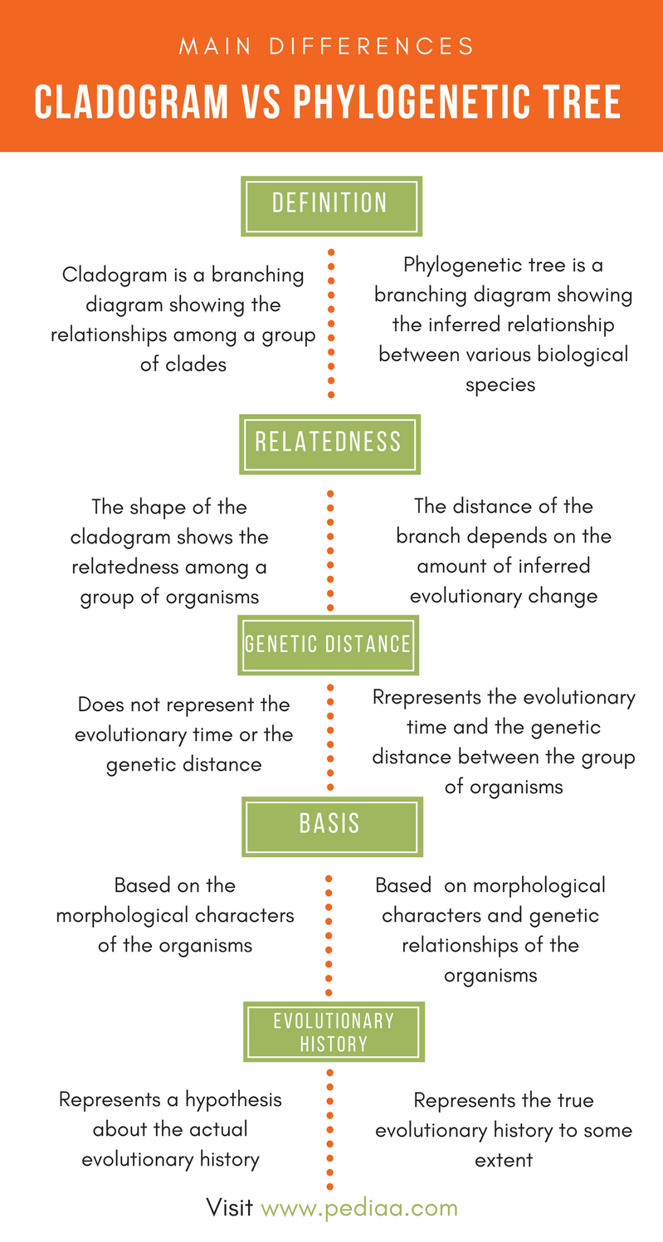
Differences between phylogenetic trees & cladograms:
Generally, not much.
Both are based on hypotheses, not definitive facts. So, can change with new data.
A phylogenetic tree can show a much broader comparison, for example consisting of all life on Earth with a common ancestor.
A cladogram typically focusing on a single ancestor and the divergences from that ancestor

Slide 13
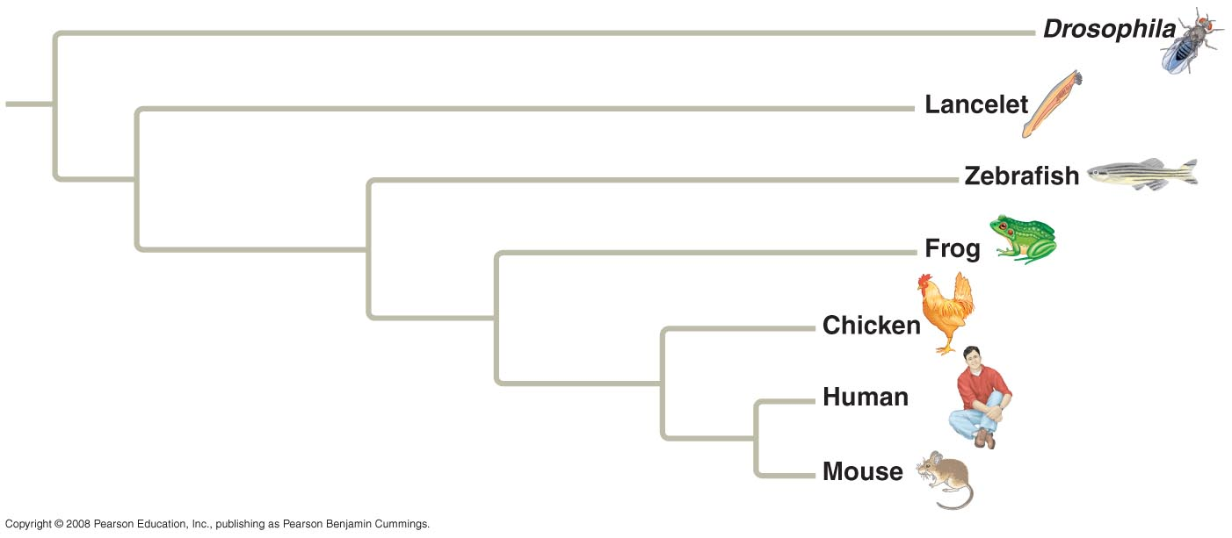
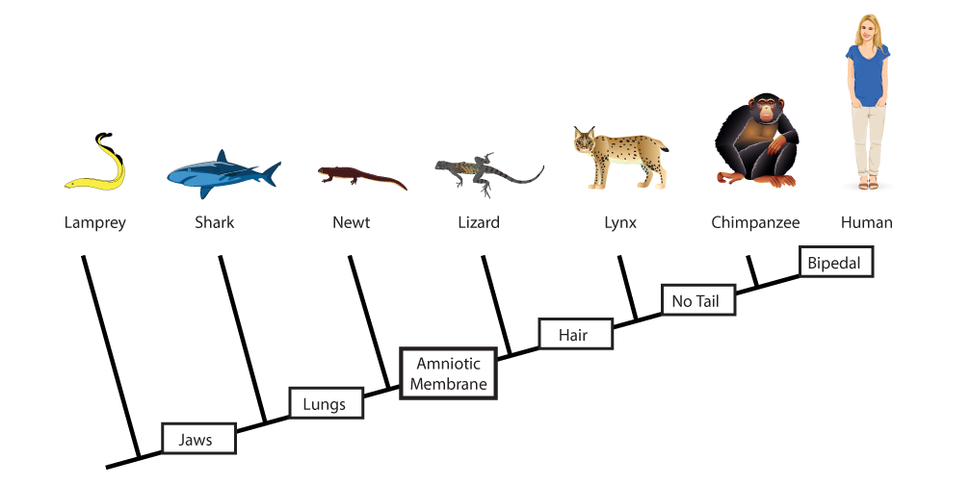
In phylogenetic trees, branch lengths can represent the amount of genetic change and are proportional to evolutionary time
In cladograms the branch lengths are usually arbitrary and do NOT indicate degree of change or time.

Slide 14
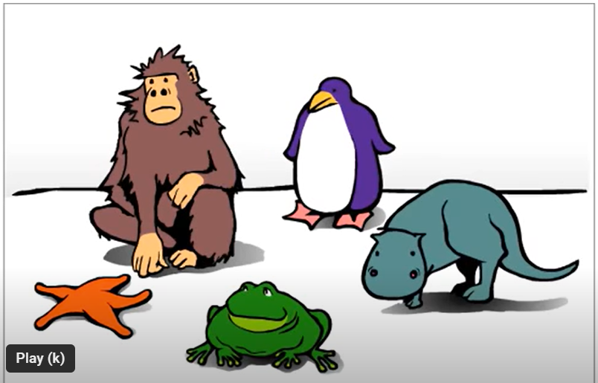
How to Build a Cladogram:

Slide 15
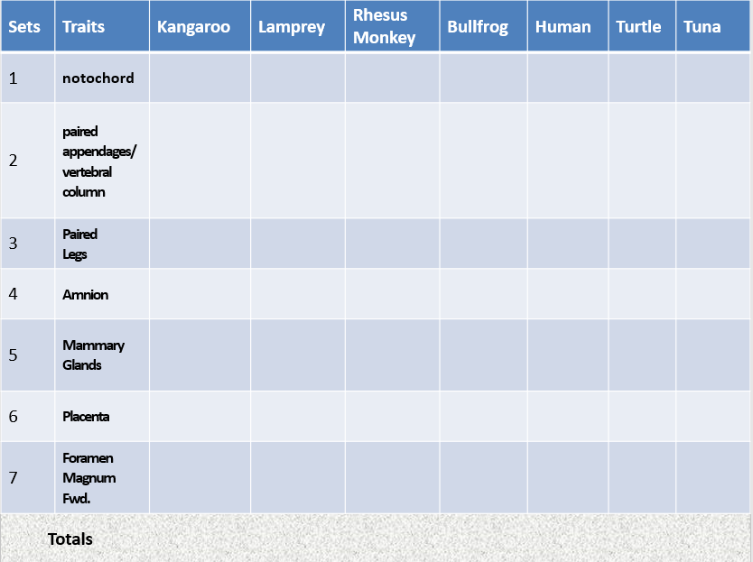
Making a Cladogram - PPT

Slide 16
Citations:
Classroom, The Biology. Unit 1-2: Cladistics – the Biology Classroom. blogs.ubc.ca/mrpletsch/2019/09/17/unit-1-2-cladistics/.

