Slide 1
Angiosperms – Flowering plants
Phylum Tracheophyta
Class Angiospermae
pp. 466-485

Slide 2
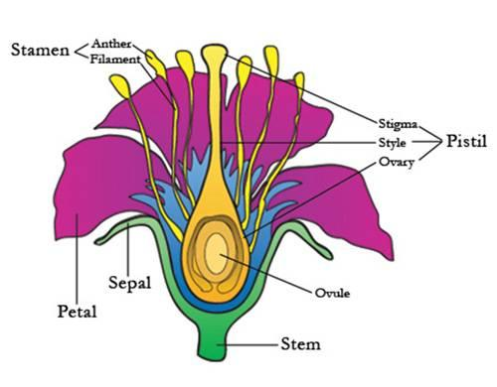
1. All angiosperms reproduce sexually through flowers

Slide 3
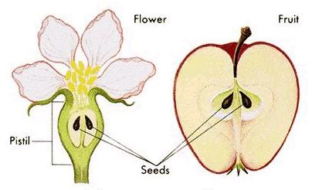
2. All angiosperms have seeds
Unlike gymnosperms, seeds are contained within a protective wall
The protective wall becomes a fruit
Seeds provide nourishment & protection to the embryo
Have 1 or 2 seed leaves (= cotyledons)
Cotyledons store food

Slide 4
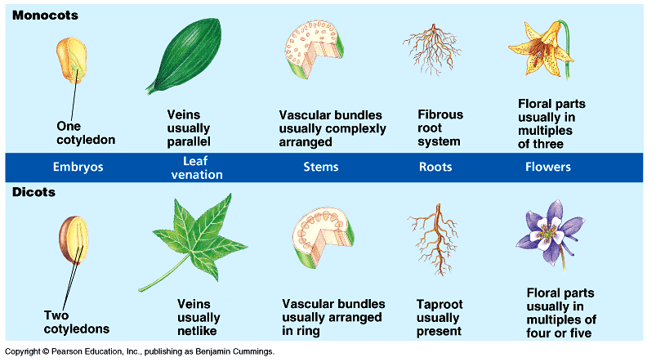
3. All angiosperms can be divided into 2 subclasses:
a) monocotyledonae (monocots for short)
b) dicotyledonae (dicots for short)

Slide 5
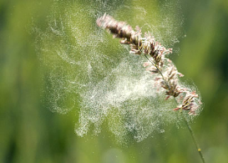
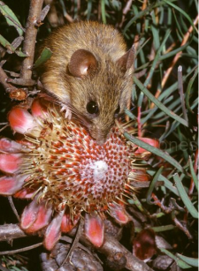
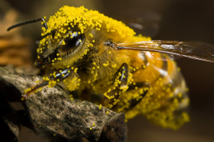
Flower Pollination:
By wind (ex. Grasses)
Pollen grains fall off easily
Often have small, simple flowers with little or no fragrance
By animals (= vector pollination)
Plants provide food (pollen and/or nectar)
Very efficient & common
Co-evolutionary relationship between vector & plant

Slide 6
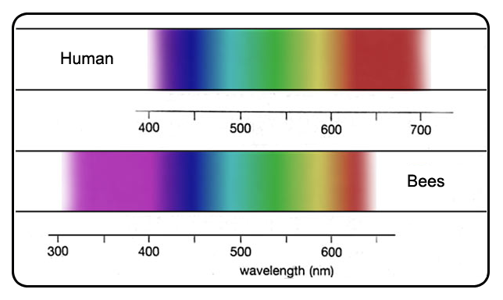
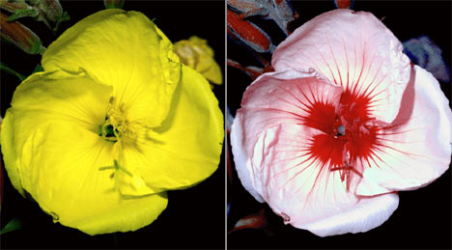
Examples of Co-evolutionary Relationships
1. Bees have excellent eyesight so flowers are brightly coloured & having “landing strip” patterns

Slide 7
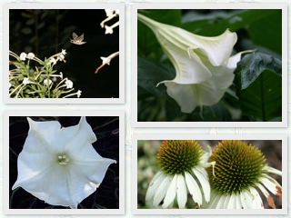
2. Moths are nocturnal, have poor eye-sight & excellent sense of smell so flowers are
plain white
Have an intense odour at night
No landing strip because moths hover

Slide 8
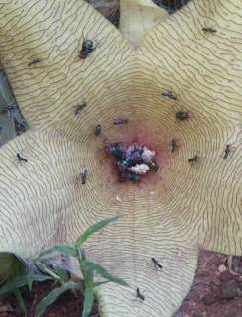
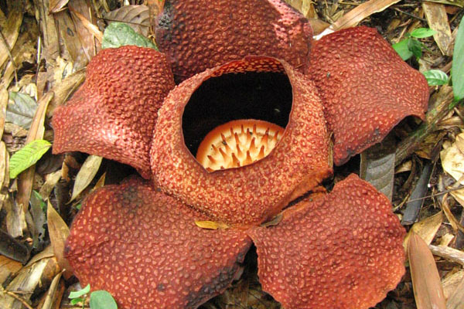
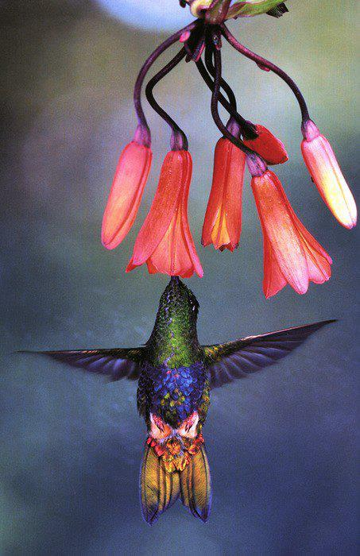
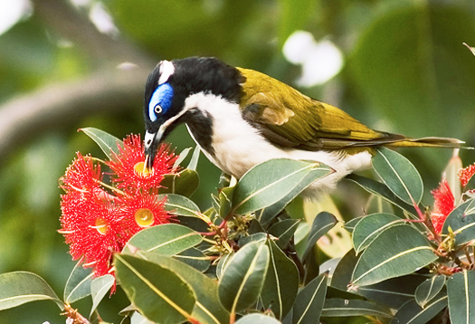
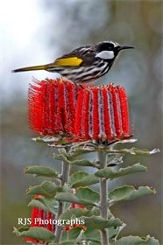
3. Flies lay their eggs on dead animals so flowers smell like rotting meat.
4. Birds have poor sense of smell but see red & orange especially well so flowers are bright orange & red with no fragrance.
Starfish flower
Corpse flower

Slide 9
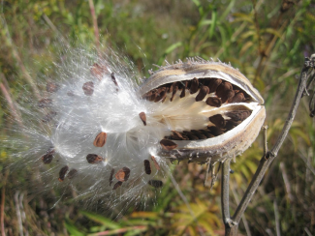
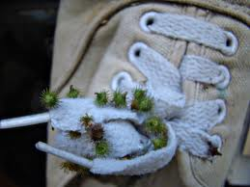
Seed Dispersal:
= the process of distributing seeds away from parent plants
Advantages
a) distance apart means less competition for resources
b) allows for colonization of new environments

Slide 10
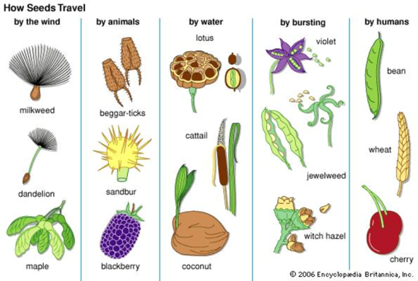
Methods
a) wind
b) mechanical “explosion”
c) animals via barbs
d) animals via fruit consumption
e) water

