Slide 1
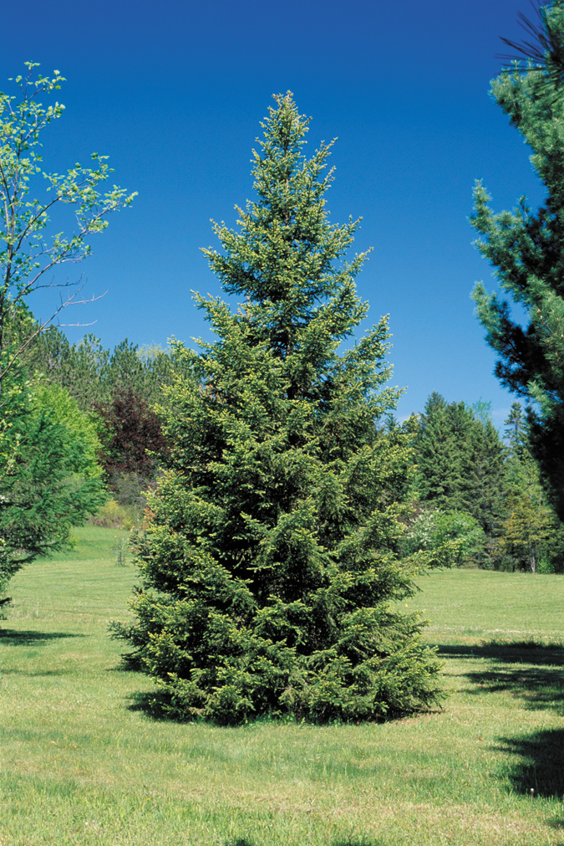
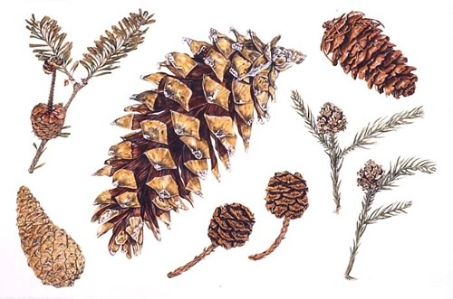
The Gymnosperms
pp. 467-475

Slide 2
Phylum Tracheophyta
Vascular plants
Three major classes:
Class Filicineae - the ferns
Class Gymnospermae - plants which bear seeds not enclosed in an ovary
Class Angiospermae - plants which bear seeds enclosed in an ovary (flowering plants)

Slide 3
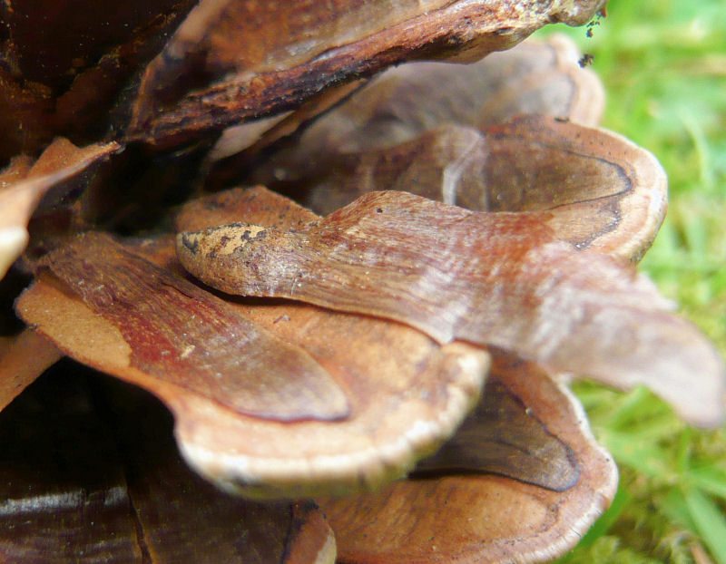
The Gymnosperms
“gymno” = naked
“sperm” = seed
Seeds are exposed on scales of a cone

Slide 4
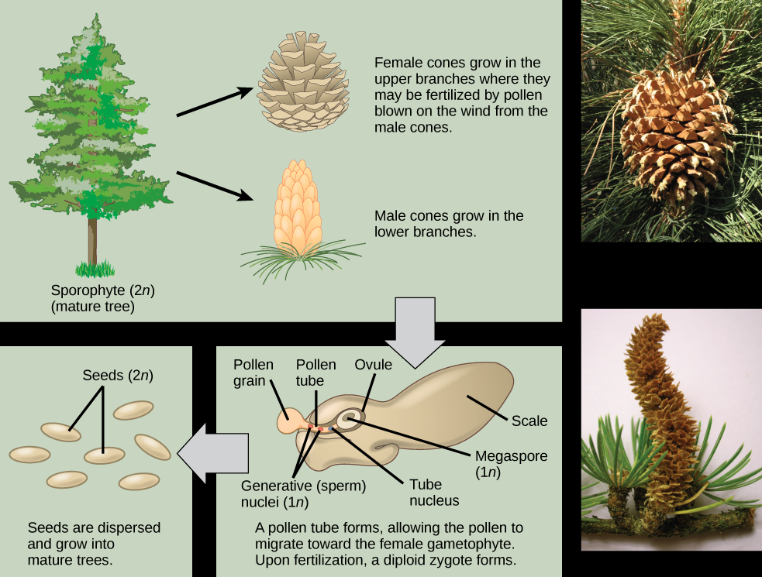

Slide 5
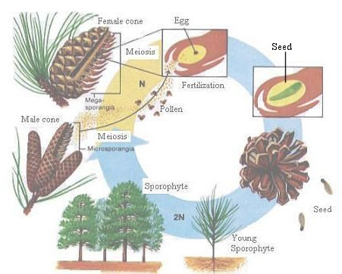
Adaptations to very cold & very dry climates:
Alternation of generations
Haploid gametophyte dependent on diploid sporophyte
So, gametophytes do NOT require moist environments to survive or reproduce!!

Slide 6
Needles
Modified leaves
Have less surface area
Have waxy cuticle
So, are more resistant to water loss!

Slide 7
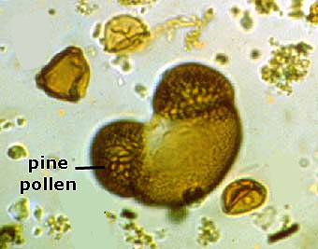
Pollen (male gametophyte)
Do NOT require water to travel
Are carried by wind to female gametophyte
So, is adapted to dry conditions!

Slide 8
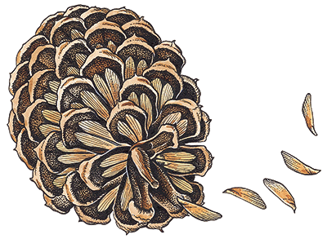
Seeds
Can become dormant if conditions are not favourable
Provides food supply for developing embryo
Has protective seed coat (protects embryo)

Slide 9
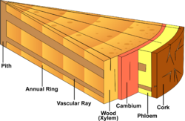
Vascular tissue (xylem & phloem)
Conducts water & nutrients to different parts of the plant
Helps strengthen the stem

