Slide 1
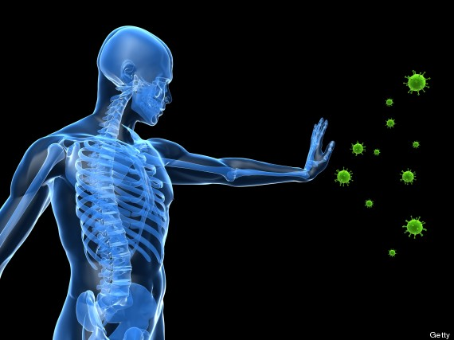
Protecting the Body
pp. 968-976

Slide 2
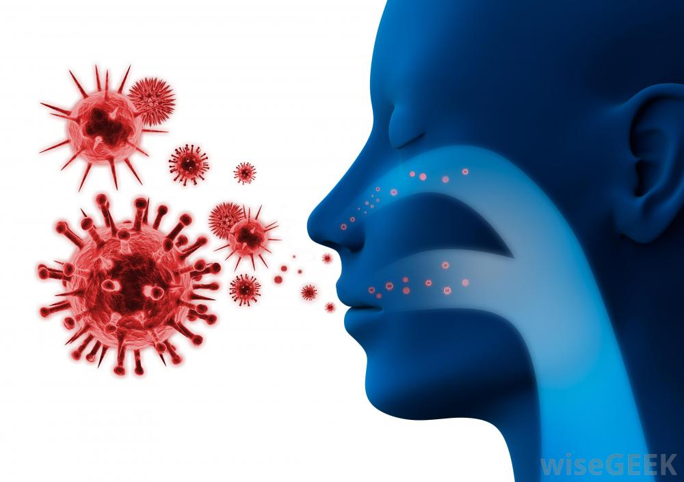
Pathogens (disease-causing microorganisms or virus) can:
1. interfere with cell function
OR
2. produce toxins
Pathogens can enter through:
openings in the body
food/water
bites

Slide 3
Your Immune System:
Two main components:
1. Nonspecific defenses
Body’s first & second lines of defense
Not directed at any particular pathogen
2. Specific defenses
Body’s third line of defense
If pathogen gets past the nonspecific defenses, its antigens (“markers”) will trigger an immune response

Slide 4
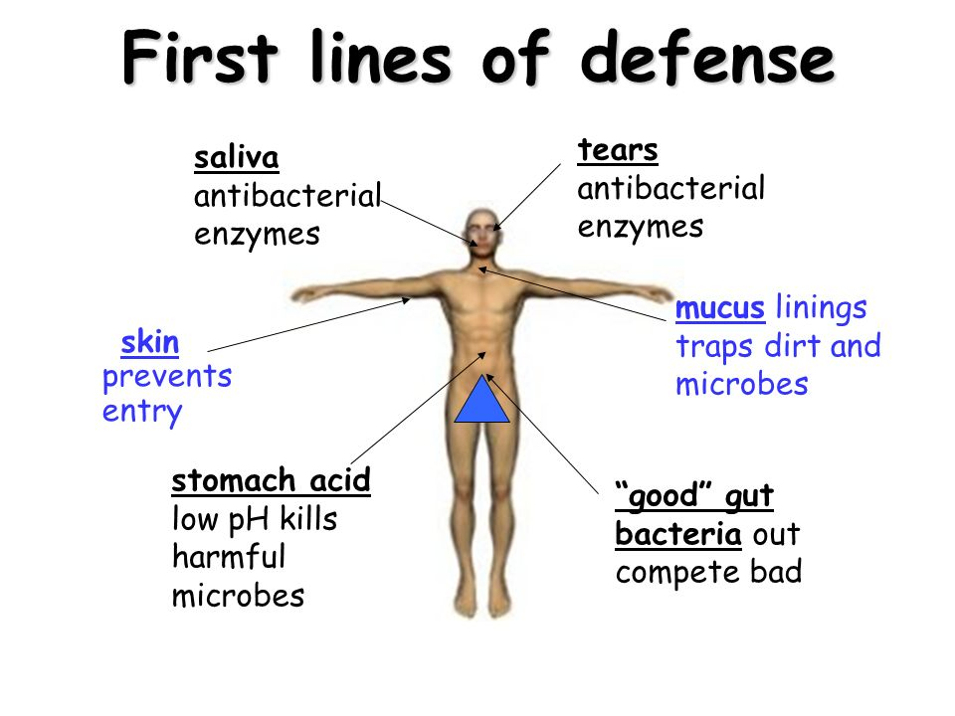
Nonspecific defenses:
Physical barriers
First line of defense
Include the skin, mucus, hairs (in nose), wax (in ears), tears (from eyes), cilia (line respiratory tract), sweat& oils (on skin)

Slide 5
Inflammatory response
Second line of defense
white blood cells called phagocytes then engulf & digest pathogen
Fever is produced which will stimulate phagocytes’ actions
Virus-infected cells produce a protein called interferon
helps other cells resist viral infection
Interferes with the growth of viruses

Slide 6
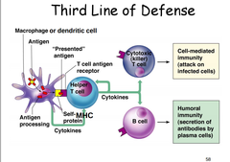
Specific defenses:
- Third line of defense
Cell-Mediated Immunity:
Killer T-cells
Transfer special proteins into pathogen’s cell membrane
Makes membrane leak fluids
Pathogens lyses & dies
Can cause rejection of tissue & organ transplants

Slide 7
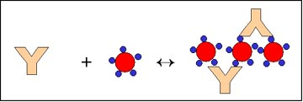
Immune response:
Body recognizes chemical marker on/produced by pathogen (= antigen)
White blood cells produces antibodies
Antibodies are special proteins that can “lock” onto antigens so pathogen cannot function
Each antibody is specific to an antigen (“lock-and-key”)

Slide 8
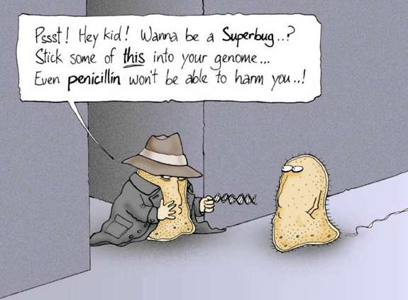

Slide 9
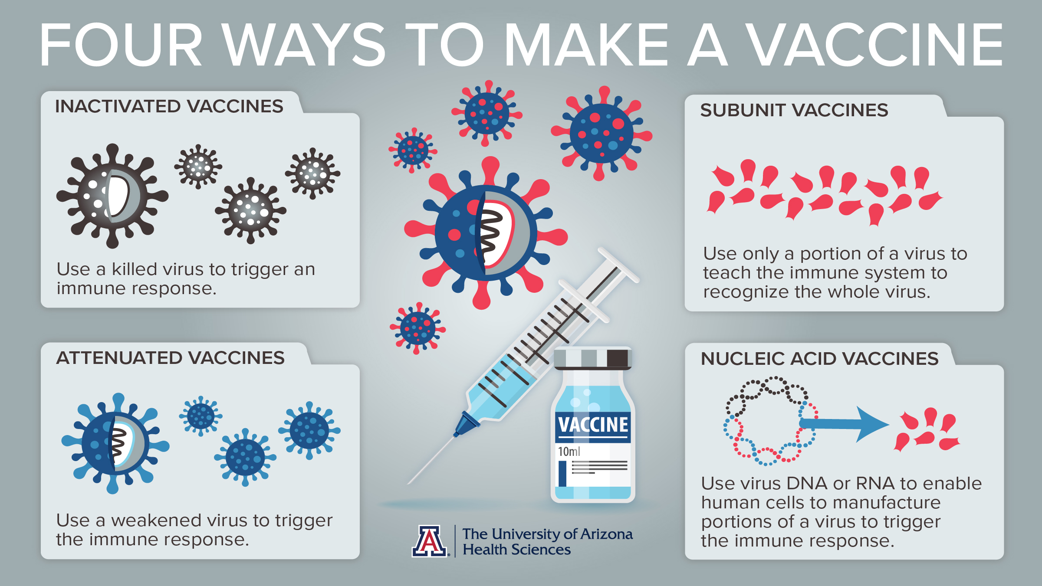
Vaccines
a substance which is used to stimulate the production of antibodies, in turn provide immunity against a disease

Slide 12
Cereal Box Project
 | 1 | 2 | 3 | 4 | 5
Side A of Box - Research (x2) | More than 6 research questions have been missed or answered incorrectly. | 5-6 research questions have been missed or answered incorrectly. | 3-4 research questions have been missed or answered incorrectly. | Only 1-2 research questions have been missed or answered incorrectly. | All research questions have been answered and are correct.
Depth of Research | All questions are answered very simply. There is little detail, information is not specific, and effort is lacking. | Few research questions have been thoughtfully answered. Most questions lack detail and specificity. | Some research questions have been thoughtfully answered with detail and specificity. | Most research questions have been thoughtfully answered with detail and specificity. | All research questions have been thoughtfully answered. They are detailed and specific.
Front of Box – Basic Identification | More than one error has been made in presenting the common name or picture or type of organism | An error has been made in presenting the common name or picture or type of organism. | Common name, picture, and type of organism is correct.
Side B of Box – Additional research | Only 1-2 correctly identified fun facts are given. | 3 correctly identified fun facts are given. | 4 correctly identified fun facts are given. | 5 correctly identified fun facts are given.
Back of Box - | Simply puzzle lacking any applicability is included. | Puzzle is lacking either creativity/ Thoughtfulness or applicability. | Puzzle is creative/ thoughtful and is applicable to the disease.
Communication: Organization Appearance Spelling/Grammar | The project is poorly organized, difficult to follow, and appears to have little/no effort towards a professional appearance. Significant grammatical or spelling errors. | The project is well organized, easy to follow, and neatly presented. There are a few grammatical or spelling errors | The project is exceptionally well organized, easy to follow, and very professionally presented. There are minimal grammatical or spelling errors.
Sources | 3 or more sources are listed but not correctly cited. Or only 2 properly cited sources. | 3 or more sources are listed and correctly cited.
Gallery Walk | Many questions are incompletely answered. Questions that are answered lack depth of thought and/or supportive details. | Few questions are incompletely answered. Questions that are answered lack depth of thought and/or supportive details. | Questions are all answered correctly but lack depth of thought and/or supportive details. | Questions are all answered correctly, thoughtfully, and completely. Supportive details are provided.

