Slide 1
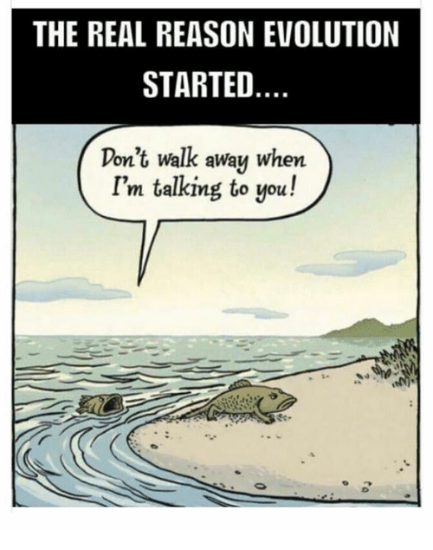
Speciation & Evidence of Evolution
pp. 304-309

Slide 2
Speciation
Sometimes evolutionary changes within a population are so great that reproductive isolation (when organisms can no longer interbreed with the original species) occurs
When this happens, it is called SPECIATION
Remember: A species is a group of organisms which can breed with each other & producing fertile offspring.

Slide 3
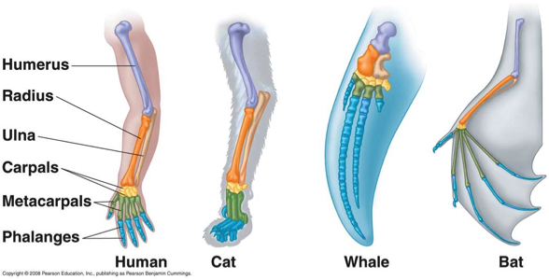
Evidence of Evolution
Homologous Structure
Parts of the body that are similar in skeletal structure but have different functions

Slide 4
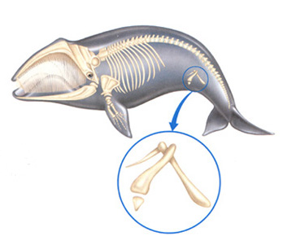
2. Vestigial structures
Organs or parts that seem to have no useful function

Slide 5
3. Biochemical Evidence (Think: chemical compounds!)
similar RNA & DNA; same amino acids, etc.
More similarities are found in species that are more closely related
Ex) Human & gorilla hemoglobin differ by one amino acid but human & frog hemoglobin differ by 67 amino acids. So, humans are more closely related to gorillas than frogs.

Slide 6
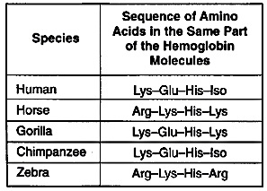

Slide 7
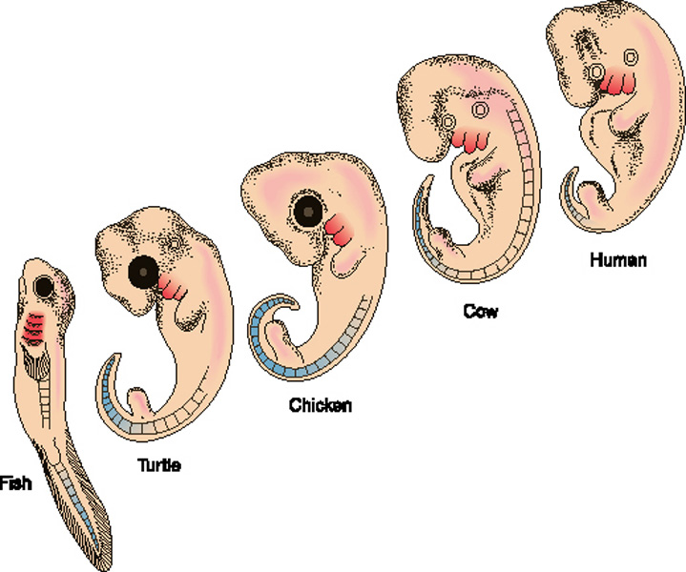
4. Embryological Development
Embryos of different species develop in almost identical ways.
Indicates common ancestry

Slide 8
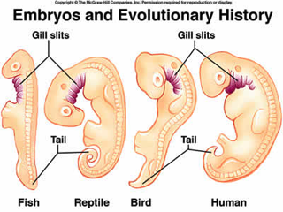

Slide 9
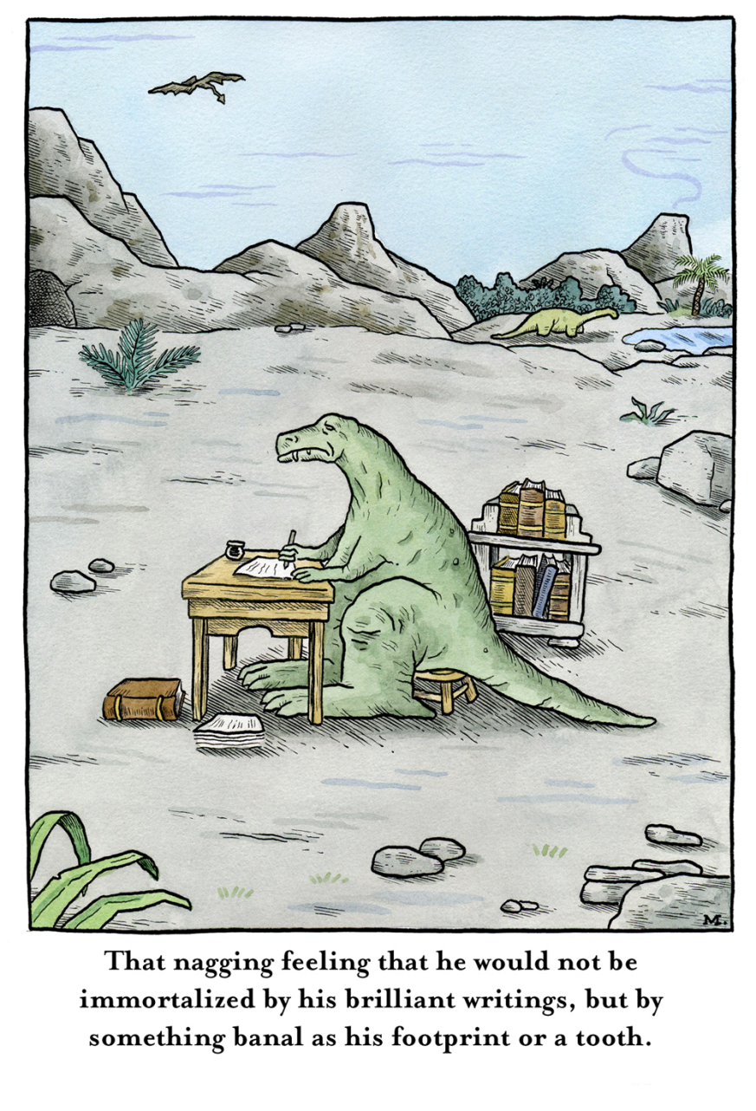
5. Fossil record
Gives us a time scale
Shows similarities between extinct animals and animals alive today
Debate about the speed of evolution because of gaps in the fossil record

Slide 10
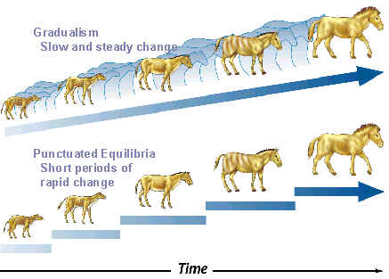
Speed of Evolution?

Slide 11
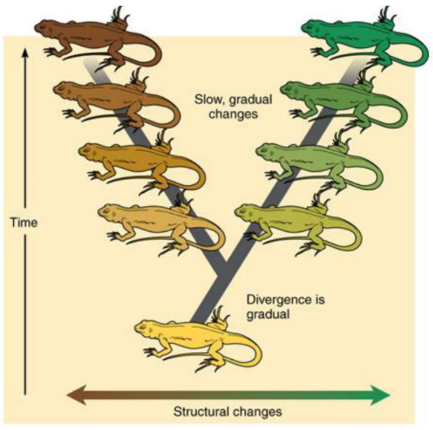
Option 1: Gradualism
A model of evolution in which one species slowly & steadily evolves into another.
Proposed by Darwin.
Explains gaps in fossil record by suggesting these are “missing links” that have yet to be found.

Slide 12
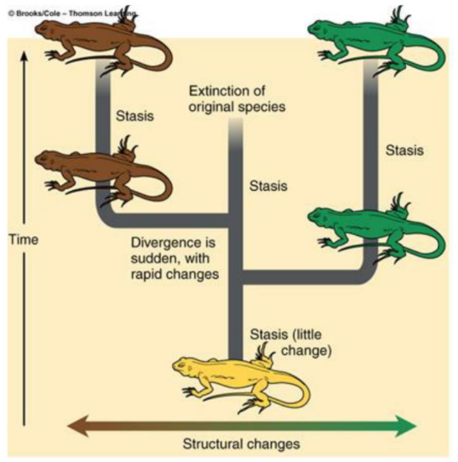
Option 2: Punctuated Equilibrium
A model of evolution in which one species suddenly changes into another after a long stable period.
Explains gaps in fossil record by suggesting there are no gaps just rapid change.
Occurs when there are:
Mass extinction
Migration into new environments
Isolation of small populations

Slide 13
