Slide 1
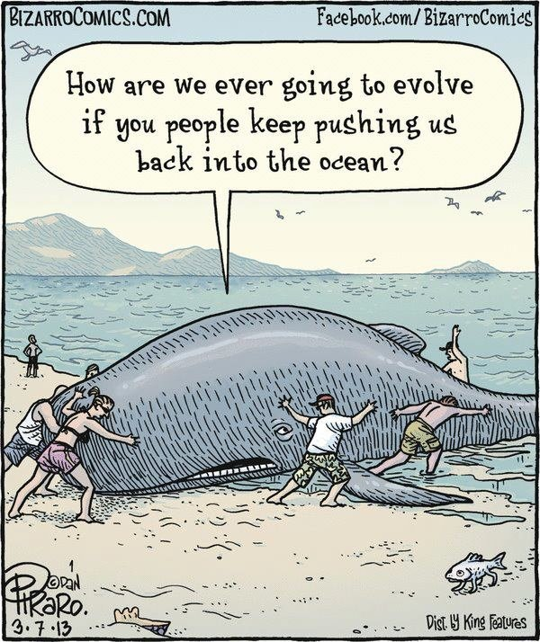
Types of Natural Selection (Macroevolution)

Slide 2
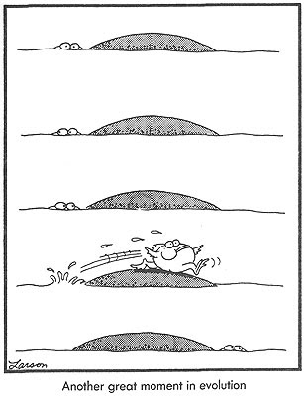
There are 3 types of selection:
Directional
Disruptive
Stabilizing

Slide 3
Normal Distribution
For example: Height
In a normal distribution curve, most individuals are in the middle of the curve
– medium height
There are few at the extremes
very short or very tall

Slide 4
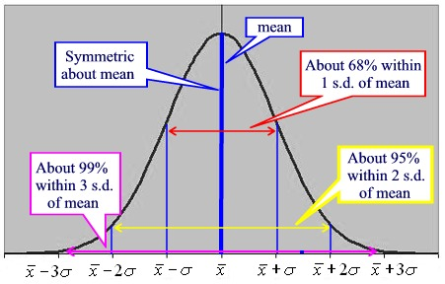

Slide 5
1. Directional Selection
Environmental conditions favour individuals of one extreme
The curve shifts to the right or to the left
Occurs when the environment is changing
Can cause evolution to occur
Does not increase biodiversity
Ex) Either very tall or very short is better suited to the environment

Slide 6
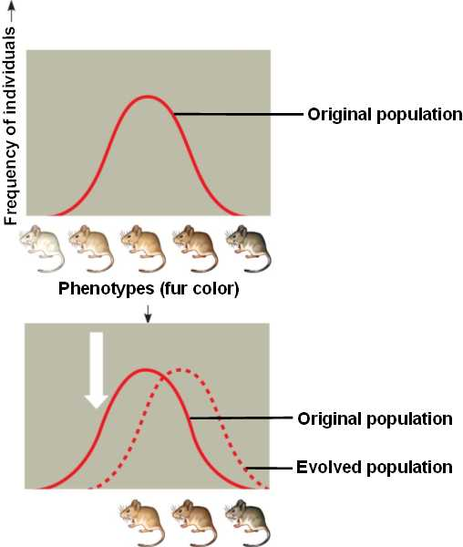

Slide 7
2. Disruptive Selection
Selection against the middle of the curve
Both extremes are favoured
Can lead to divergent evolution (a.k.a. adaptive radiation)
Can increase biodiversity
Ex) medium height is no longer best suited to the environment rather being either very short or very tall is

Slide 8
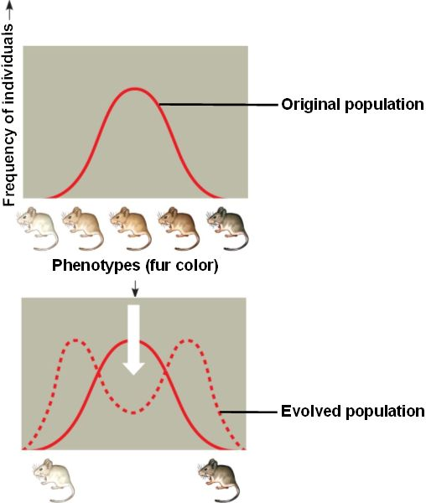

Slide 9
3. Stabilizing Selection
Selection is against the extremes
The middle traits are most suited to the environment
Environmental conditions remain stable for long periods of time
No divergence occurs
Does not increase biodiversity
Ex) medium height is best suited

Slide 10
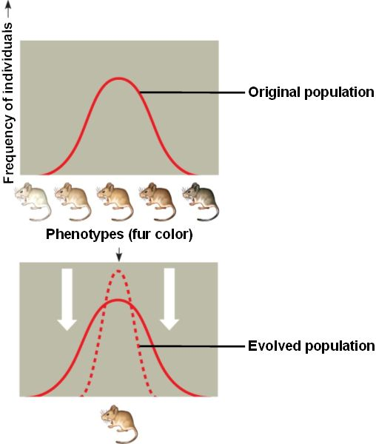

Slide 11
